Slide 1
Transfer Learning for small datasets in Weed Identification
SmartDroplets
Borja Espejo-García, PhD

Slide 2
Agenda
- 13.00-13.20: CNNs & Transformers Recap.
- 13.20-13:35: Transfer Learning.
- 13.35-13:55: Practice I: Transfer Learning with PyTorch.
- 14.05-14:20: Practice I (cont.): Transfer Learning with PyTorch.
- 14.20-14:50: Practice II: Transfer Learning with PyTorch.
- 14.50-15:00: Questions.

Slide 3
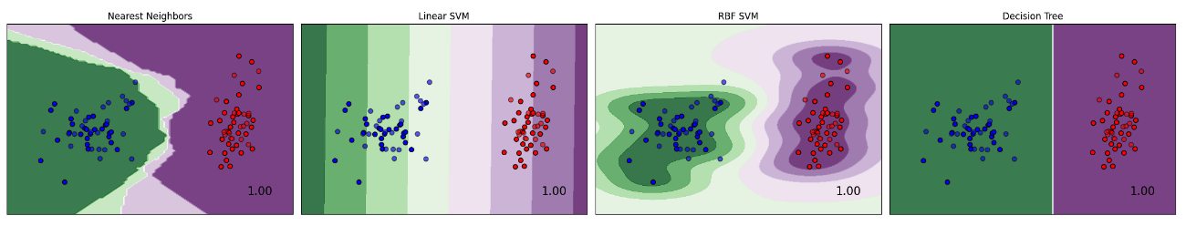
1. Representation
A classifier needs to be described in a language that is computationally interpretable. Selecting a representation for a learner essentially means determining the range of classifiers it can learn: learner's hypothesis space (e.g.: Decision trees, rules, hyper-planes, distances to instances etc.).

Slide 4
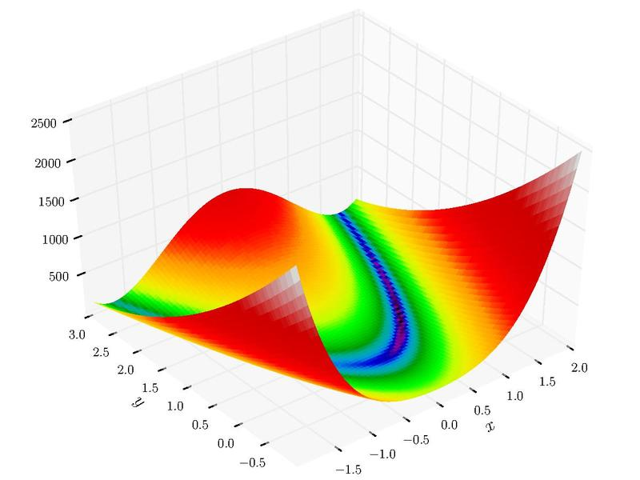
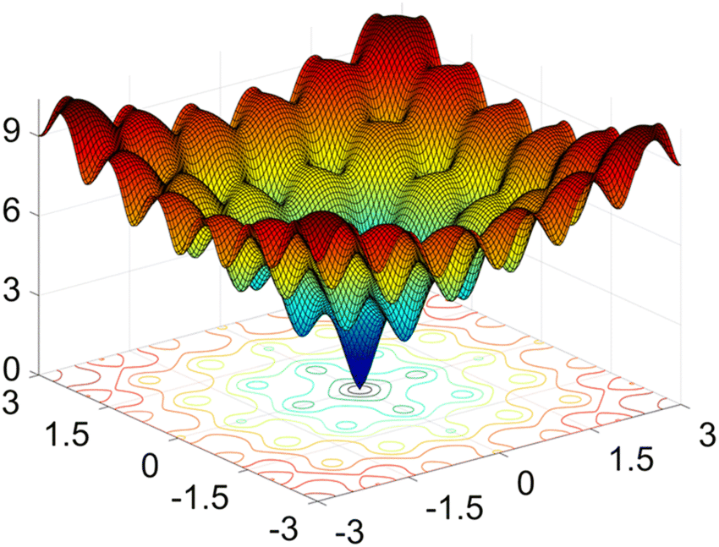
2. Evaluation/Loss function
A loss function is essential to differentiate between effective and ineffective models. To simplify the optimization process, the loss employed within the algorithm might vary from the external one we actually desire the model to optimize.
Examples:
  Accuracy
  Mean Squared Error
  Mean Average Precision
  Cross Entropy
  Cosine Distance

Slide 5
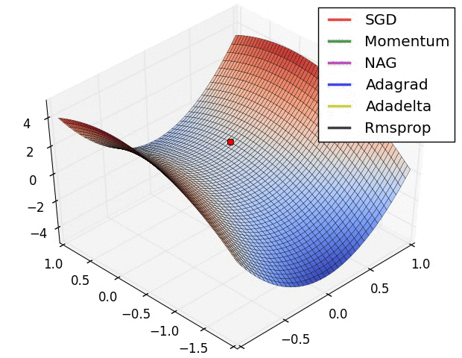
3. Optimization
We need a strategy to find the classifiers in the given representation language to find the one with the highest evaluation score.
Types:
  Hill Climbing
  Simulated Annealing
  Stochastic Gradient Descent
  Adam
  Genetic Programming

Slide 6
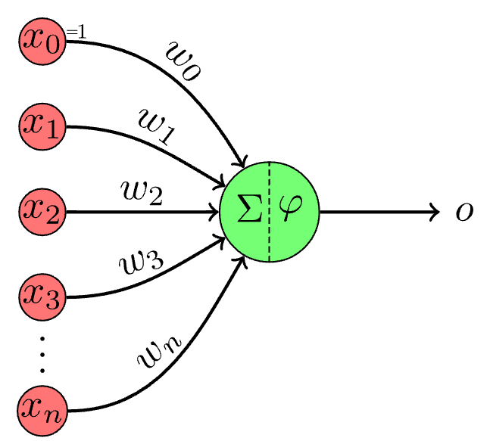
Perceptron: The most basic Neural Network
Neural Network (NN) is a computational model inspired by the way biological neural networks in the human brain work.The process of learning in neural networks typically involves the following:
1. Feedforward: The input is passed through the network, layer by layer, from the input layer to the output layer. Each neuron applies a weighted sum of its input (plus a bias), and an activation function, to produce its output.
2. Loss Calculation: A loss function evaluates the difference between the network’s prediction and the actual target values. It provides a measure of how well the network is performing.
3. Backpropagation: Backpropagation is an algorithm used to minimize the error by adjusting all weights in the network. By computing the gradient of the loss function with respect to each weight by the chain rule, the weights of the network are adjusted to minimize the loss.
4. Iterative Optimization: The process of forward pass, loss calculation, backpropagation, and weight adjustment is iteratively performed, often over multiple epochs (where an epoch is one pass through the full training dataset), to refine the weights and reduce the training error.

Slide 7
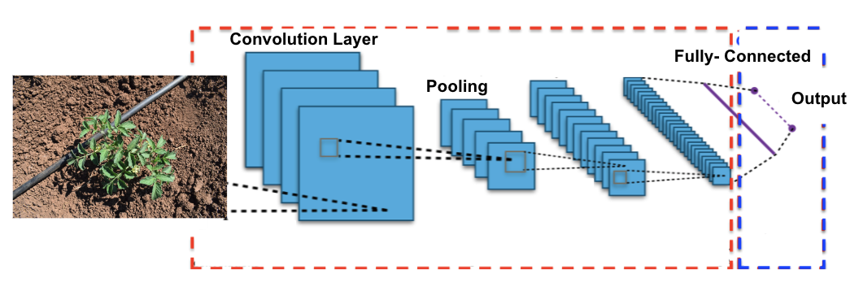
Convolutional Neural Networks (i)
A Convolutional Neural Network (CNN) is a category of neural networks that has proven highly effective for processing grid-like data, such as images. CNNs are specifically designed to automatically and adaptively learn spatial hierarchies of features from input images, which is a crucial advantage in computer vision tasks.
CNNs are designed to process data in a grid-like topology (e.g., image data).
They use convolutional layers to apply convolutional filters (kernels) that detect patterns such as edges, textures, and other features in images.

Slide 8
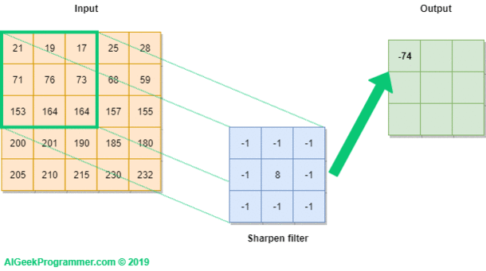
Convolutional Neural Networks (iv)

Slide 9
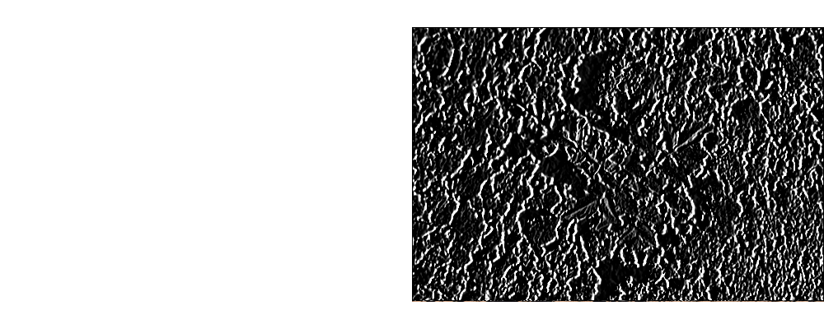
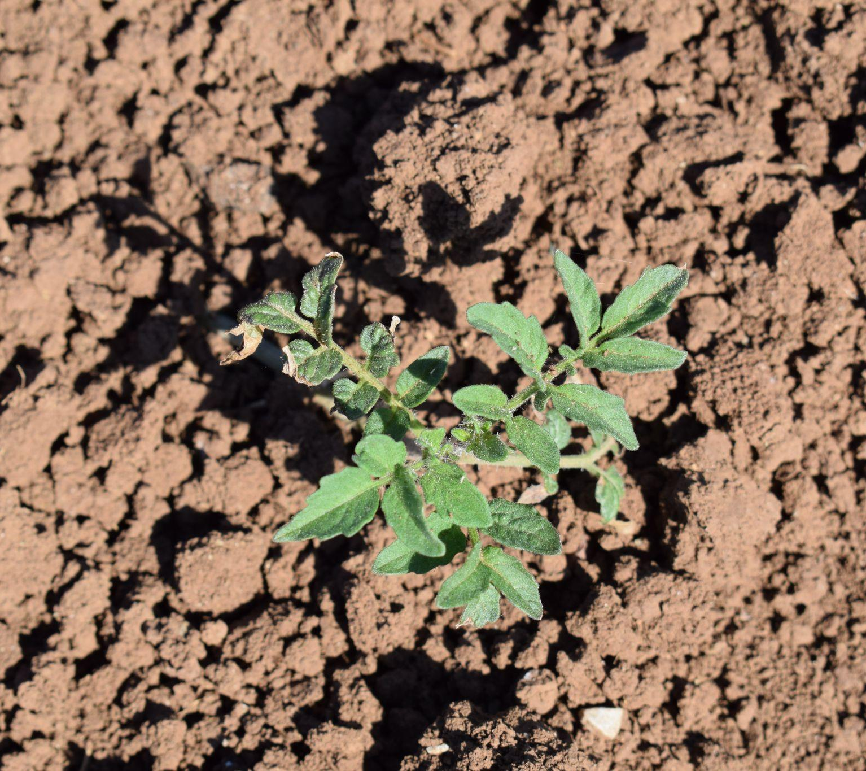
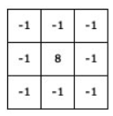
Convolutional Neural Networks (v)
+
=
https://setosa.io/ev/image-kernels/

Slide 10
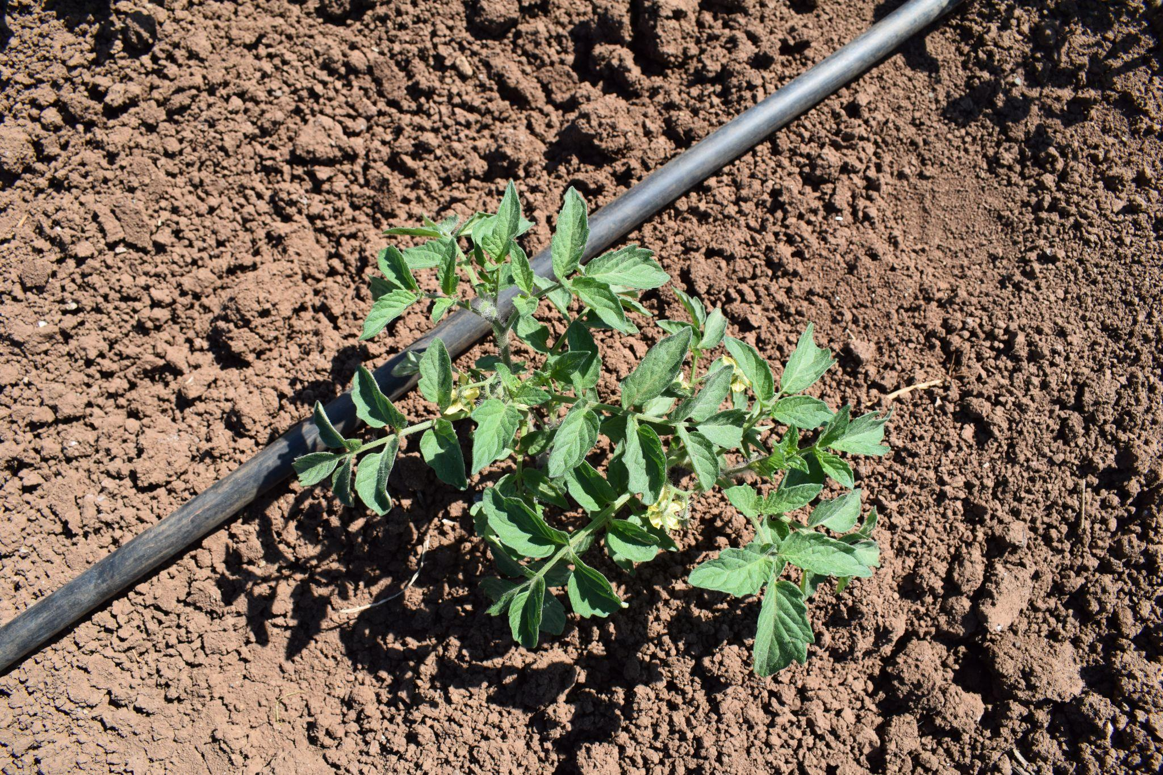
Convolutional Neural Networks (vi)
-1
-1
-1
-1
-1
1
-1
8
-1
-1
3
-1
-1
-1
-1
-1
1
1
-1
-1
-1
1
-1
-1
Tomato
-1
4
-1
-1
2
-1
-1
-1
-1
-1
-1
1
0
-1
0
0
-1
1
-1
2
2
-1
5
-1
-1
-1
3
-1
-1
0
Layer 1
Layer 2

Slide 11
CNNs: Advantages
Local Feature Extraction: Excellent at capturing local dependencies and spatial hierarchies in image data.
Parameter Efficiency: Shared weights in convolutional layers make CNNs more parameter-efficient than fully connected networks.
Translation Invariance: Through pooling layers, they achieve some degree of translation invariance, making them robust to the location of features in the input.
Well-suited for Image Data: Particularly effective for tasks like image classification, object detection, and more.

Slide 12
CNNs: Disadvantages
Limited Contextual Understanding: Struggle with capturing global context or long-range dependencies without very deep architectures.
Fixed-size Input: Typically require a fixed-size input (e.g., images need to be resized).
Invariance Limitation: While translation invariance is a strength, it can be a limitation for tasks where the position of objects is crucial.

Slide 13
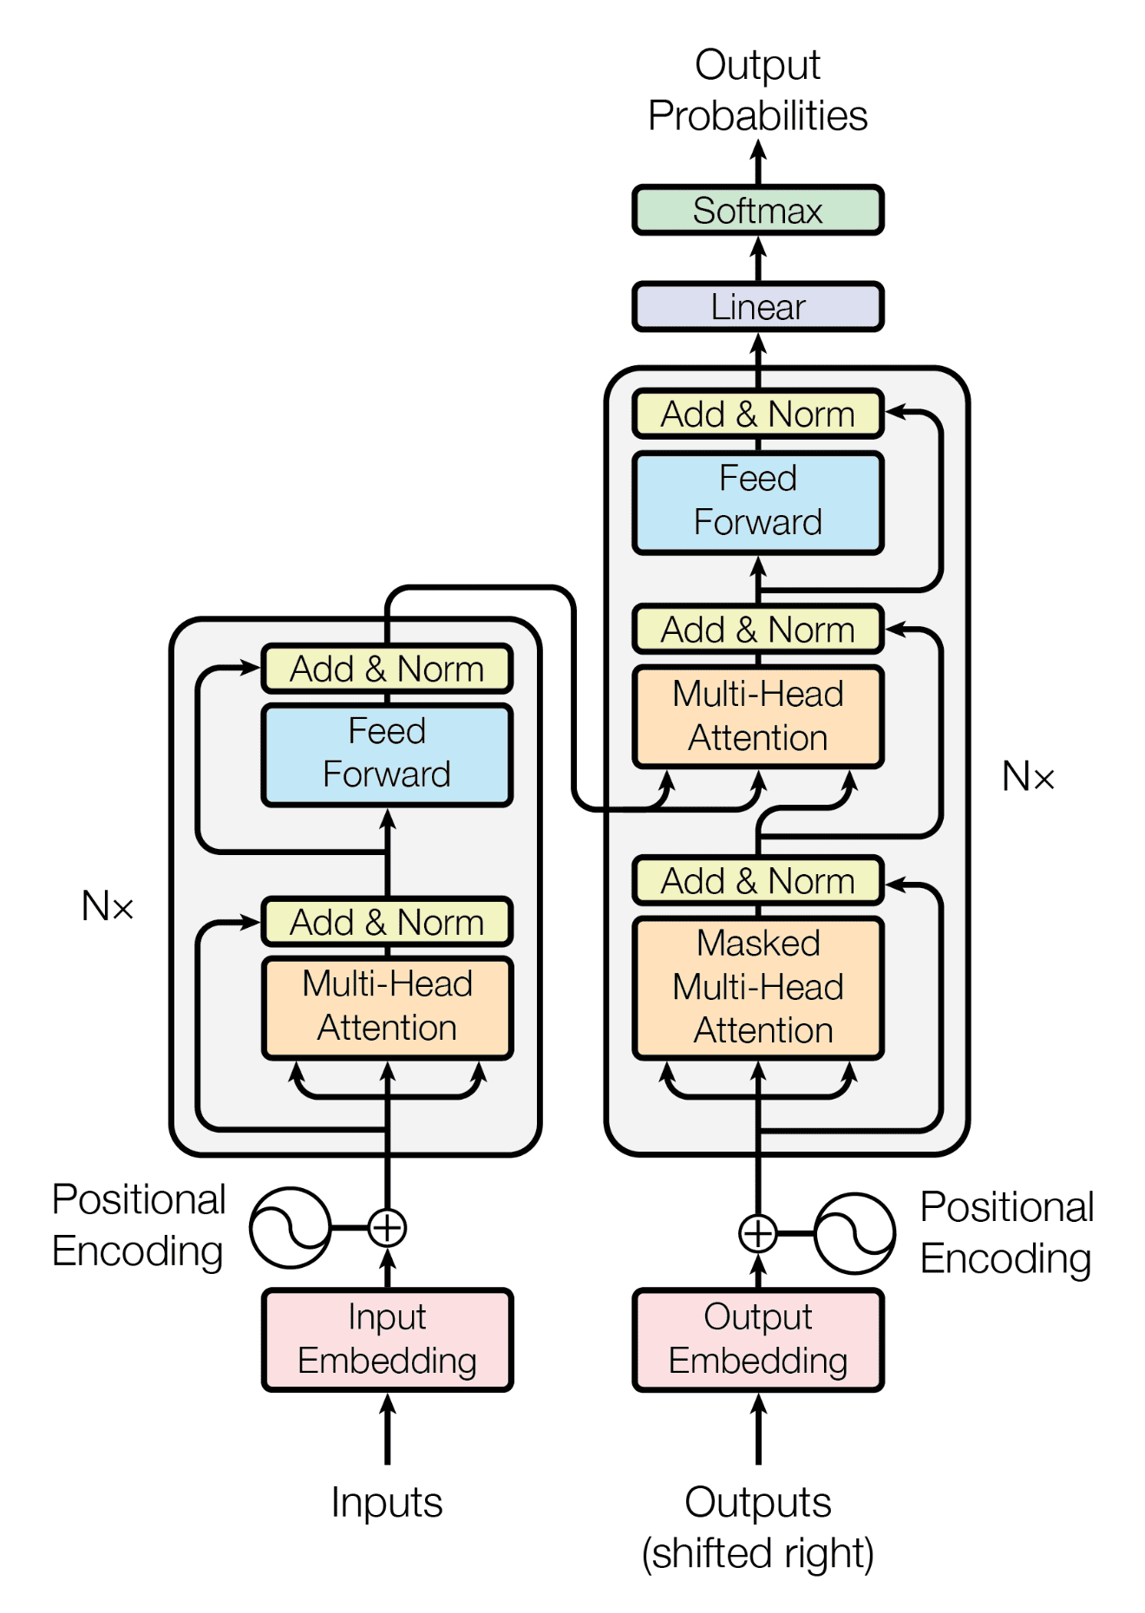
Transformer in a Nutshell
A Transformer is a category of neural networks that has proven highly effective for both natural language (initially) and images (computer vision).
  GPT-4
I prefer PyTorch, but my friend prefers Tensorflow
I prefer PyTorch, but my friend prefers Tensorflow
PyTorch
I
my friend
Tensorflow

Slide 14
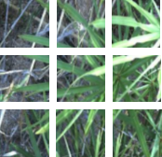
Transformer: Advantages
Global Context: Excel at capturing long-range dependencies and global context, thanks to the self-attention mechanism.
Parallelization: The architecture allows for more parallelization during training than RNNs and some forms of CNNs, speeding up training on large datasets.
State-of-the-Art Performance: In both NLP and Computer Vision, Transformers have set new benchmarks in various tasks.

Slide 15
Transformer: Disadvantages
Computational Intensity: The self-attention mechanism can be computationally intensive, especially for long sequences.
Data Hungry: Typically require large amounts of training data to perform well.
Lack of Inductive Biases: Unlike CNNs, they do not have built-in assumptions about data (like spatial hierarchies), which can be a downside for certain types of structured data.

Slide 16
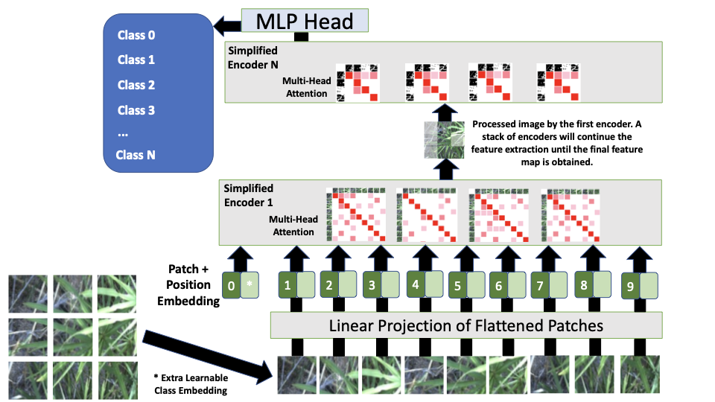

Slide 17



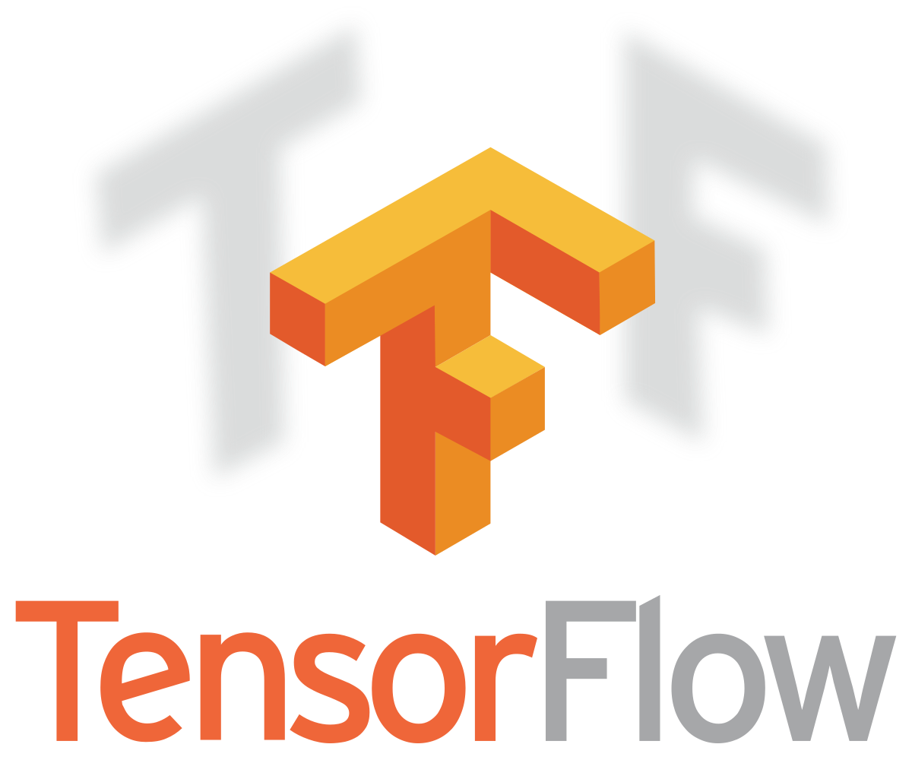

Transfer Learning: Concept
Transfer learning is a technique in the field of deep learning that involves taking a pre-trained neural network and adapting it to a new, but similar, problem.Essentially, it leverages the knowledge a model has learned from one task to improve learning in another task.
This approach is particularly beneficial when you have a limited amount of data for the new task or when training a large model from scratch is computationally expensive.

Slide 18
Transfer Learning: How it works
Pre-Trained Model: Transfer learning typically begins with a model that has been pre-trained on a large dataset. The pre-trained model has already learned to identify certain features (like edges, textures, etc., in the case of images). These learned features can be relevant to new but similar problems. Strategies:
Feature Extractor: Use the pre-trained model as a feature extractor. The final layers of the model are replaced with new ones tailored to the new task, and only these new layers are trained.
Fine-Tuning Pre-Trained Layers: After replacing the final layers, you can continue training (fine-tuning) some or all of the pre-trained layers along with the new layers to slightly adjust its learned features.

Slide 19

Transfer Learning: How it works with CNNs
-1
-1
-1
-1
-1
1
-1
8
-1
-1
3
-1
-1
-1
-1
-1
1
1
-1
-1
-1
1
-1
-1
Cat
-1
4
-1
-1
2
-1
-1
-1
-1
-1
-1
1
0
-1
0
0
-1
1
-1
2
2
-1
5
-1
-1
-1
3
-1
-1
0
Layer 1
Layer 2

Slide 20
Transfer Learning: How it works with CNNs
-1
-1
-1
0
1
0
-1
8
-1
0
3
-1
-1
-1
-1
-1
1
0
-1
-1
-1
1
-1
-1
Tomato
-1
4
-1
-1
2
-1
-1
-1
-1
-1
-1
1
3
-1
0
0
-1
2
-1
4
2
-3
1
-1
0
-1
3
1
-1
4
Layer 1
Layer 2

Slide 21
Transfer Learning: Advantages
Efficiency: It is much faster and more efficient as it eliminates the need to train a model from scratch.
Less Data Required: Transfer learning can be particularly useful when you have a limited amount of data for the new task. The pre-trained model brings knowledge that can help even with a small dataset.
Improved Performance: Models initialized with pre-trained weights often perform better than those trained from scratch, especially when data for the new task is limited.
Flexibility: It offers a flexible framework to work with, as it allows for the adaptation of pre-trained models to a wide range of tasks. Applied on Computer Vision, Natural Language Processing, etc.

Slide 22
About limited amount of data
ImageNet: Over 14 million images. Features a wide range of images categorized into thousands of classes.
COCO (Common Objects in Context): Over 330,000 images with over 200,000 labeled. Contains images of everyday scenes with common objects in their natural context. It is widely used for object detection, segmentation, and captioning tasks.
VS
PlantVillage Dataset: Contains 54,303 of images of healthy and diseased crop leaves categorized by plant type and disease. It's one of the most widely used datasets for plant disease detection.
DeepWeeds Dataset: Consists of 17,509 images containing eight different weed species native to Australia, captured under varying conditions.

Slide 23
Transfer Learning: Limitations
Task Relevance: The effectiveness of transfer learning depends on the relevance of the features learned in the pre-training task to the new task.
Model Complexity: Fine-tuning large pre-trained models requires careful handling to avoid overfitting, especially when the new dataset is small.
Domain Shift: If the new task is very different from the task used in pre-training, transfer learning might be less effective.

Slide 24
Exercise I:
Pre-trained Model
Tomato

Slide 25

Exercise II:
Pre-trained Model
Tomato

Slide 26
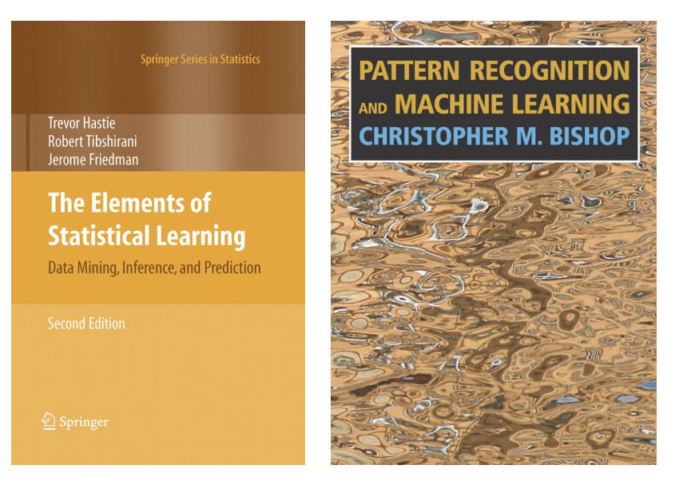
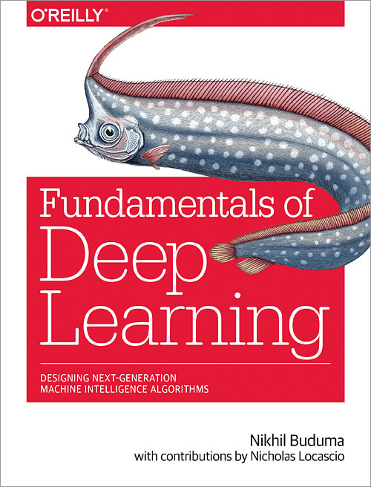
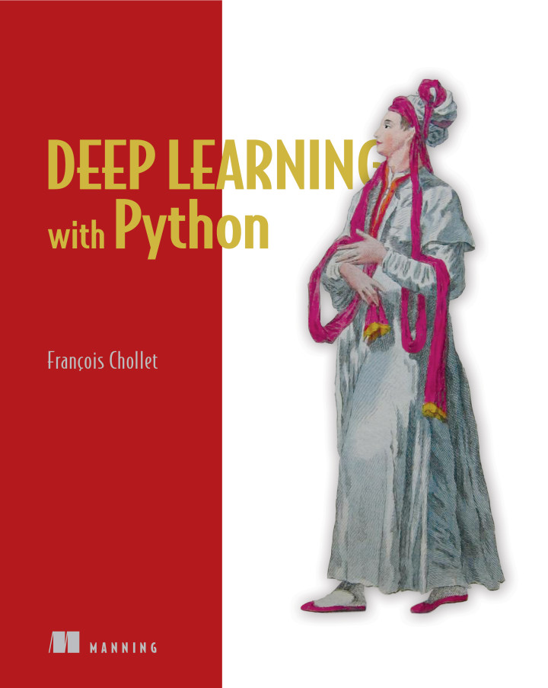
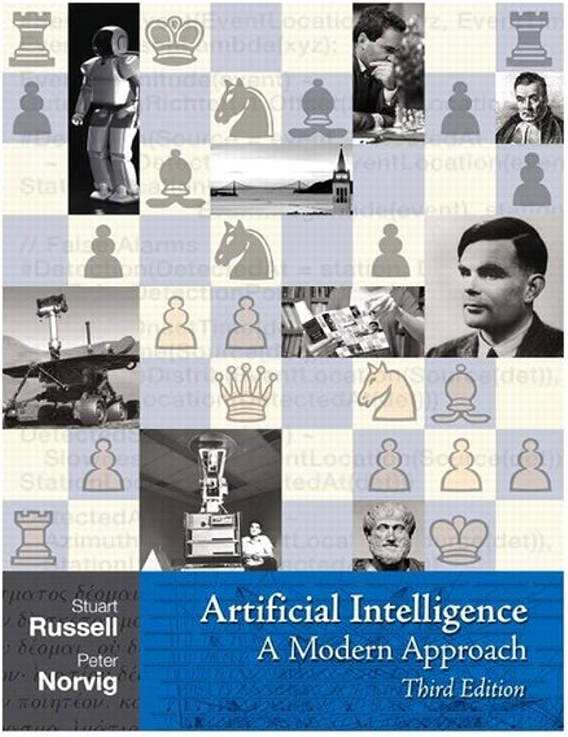
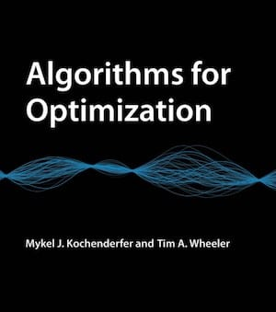
Bibliography

