Slide 1
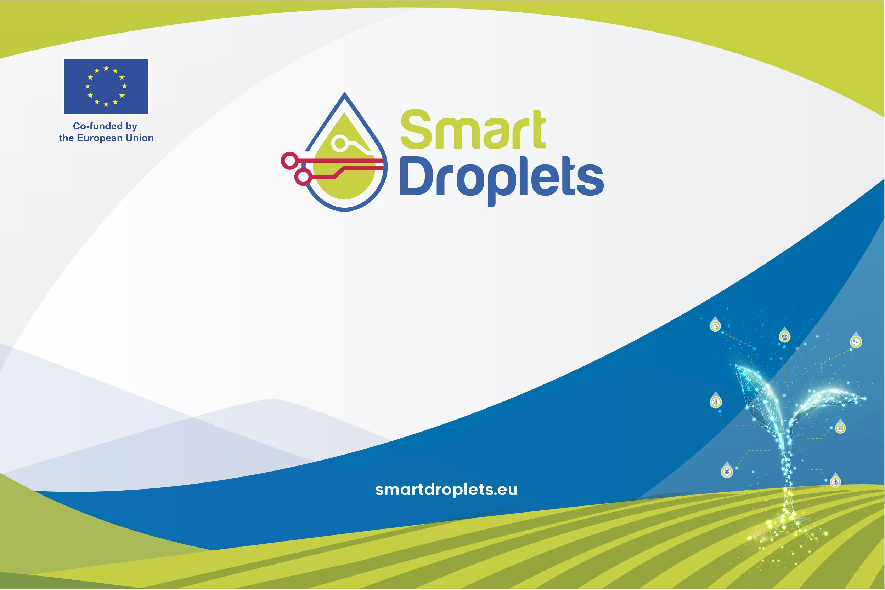
(True) stories from Smart Droplets
Michiel Kallenberg
Hilmy Baja
Ioannis Athanasiadis

Slide 2

Outline
Introduction:
  “Who are we?” & “What are we here for?”
  Highlights
Data Management Platform
  Interoperability
Digital Twin and AI recommender system
  Digital twin
  Nitrogen RL
  Pesticide RL
Achievements

Slide 3
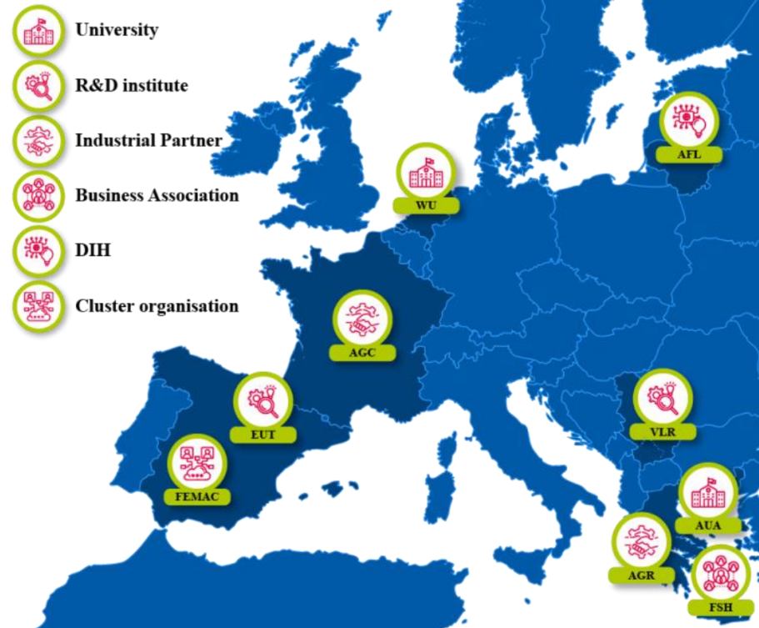



Who are we?
“Accelerating the achievement of EU Green Deal Goals for pesticide and fertilizer reduction
through robotics, computer vision, and decision support systems”
‹#›

Slide 4
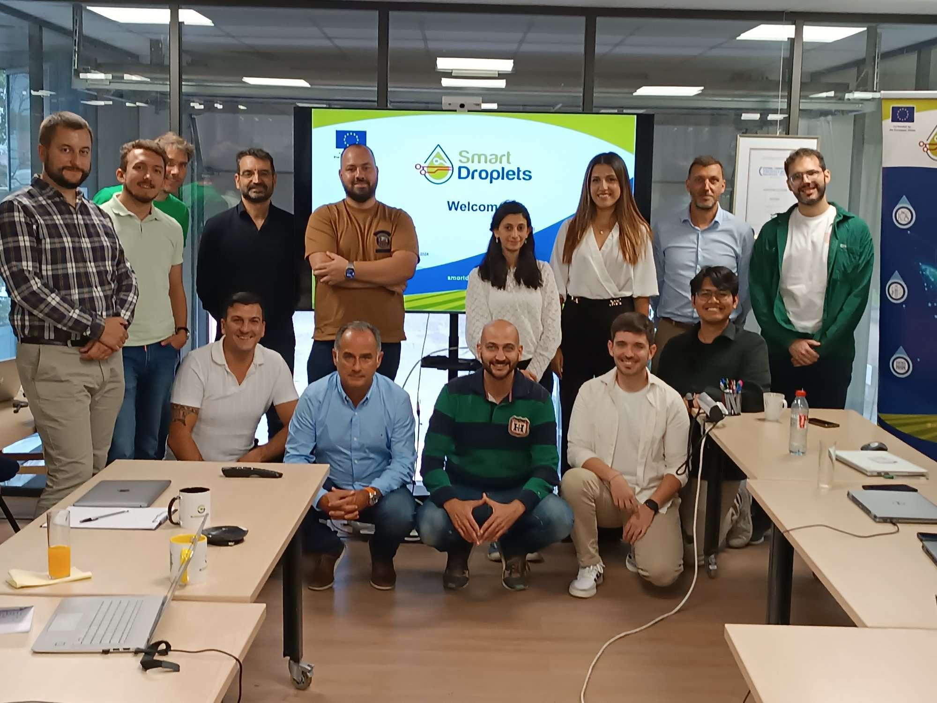

Slide 5
Highlights

Slide 6
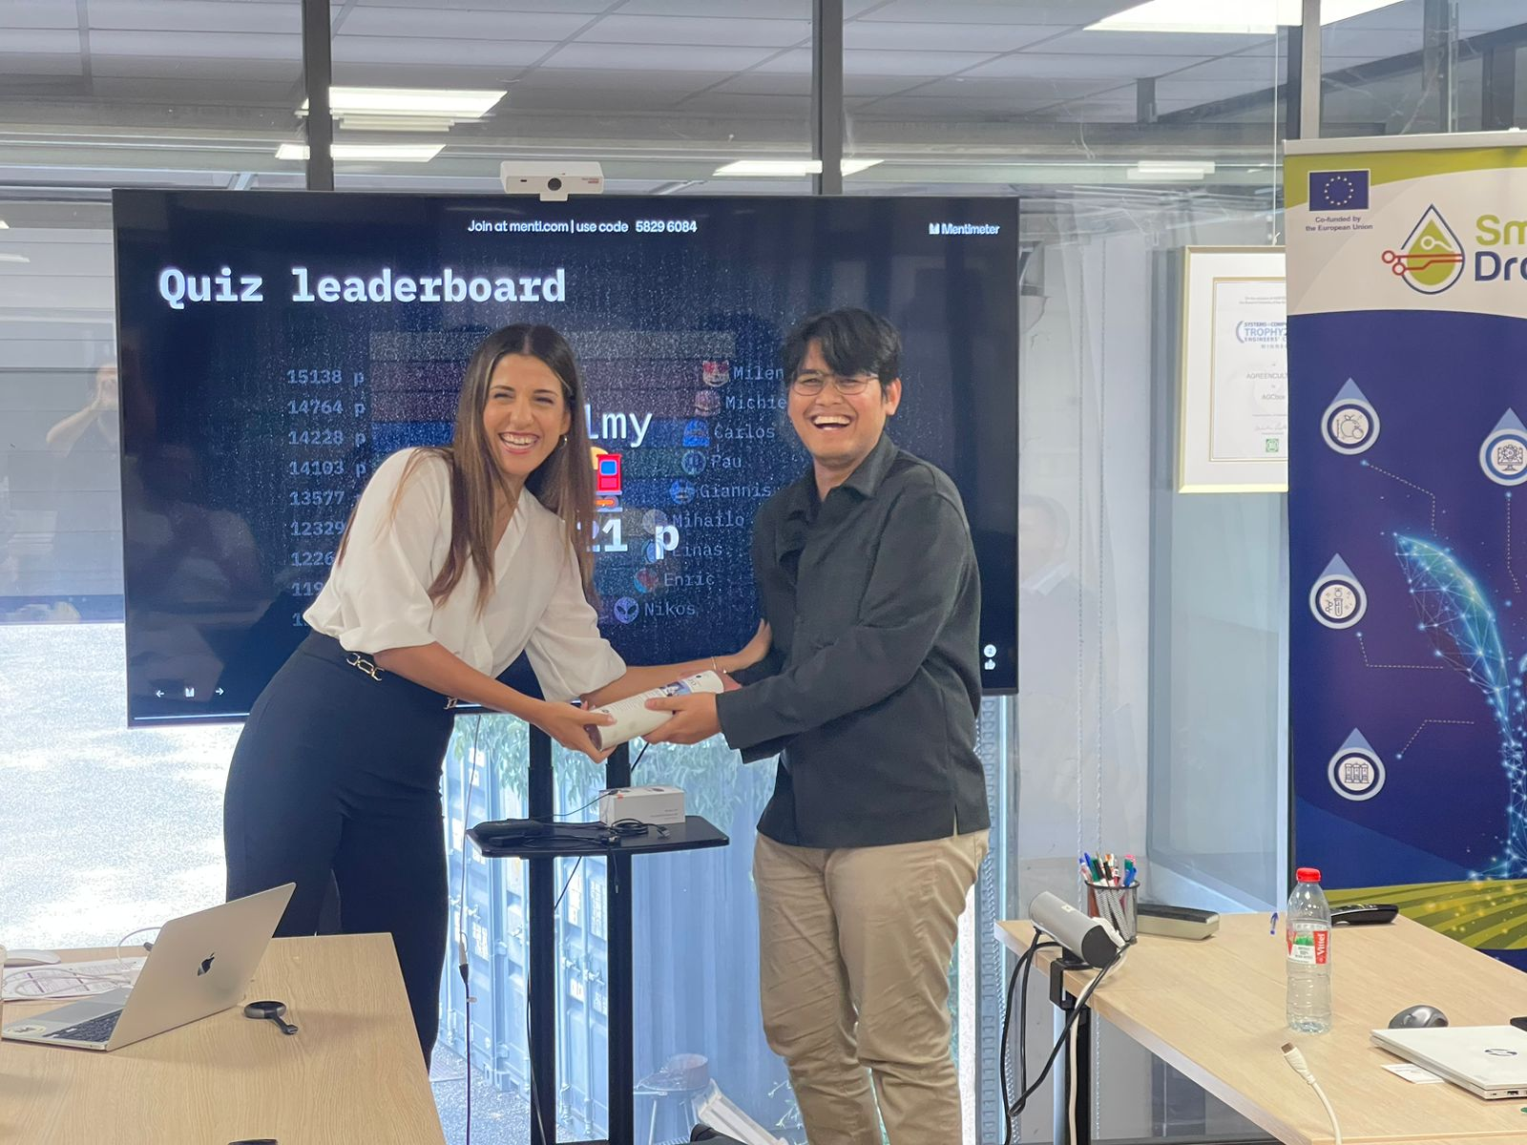
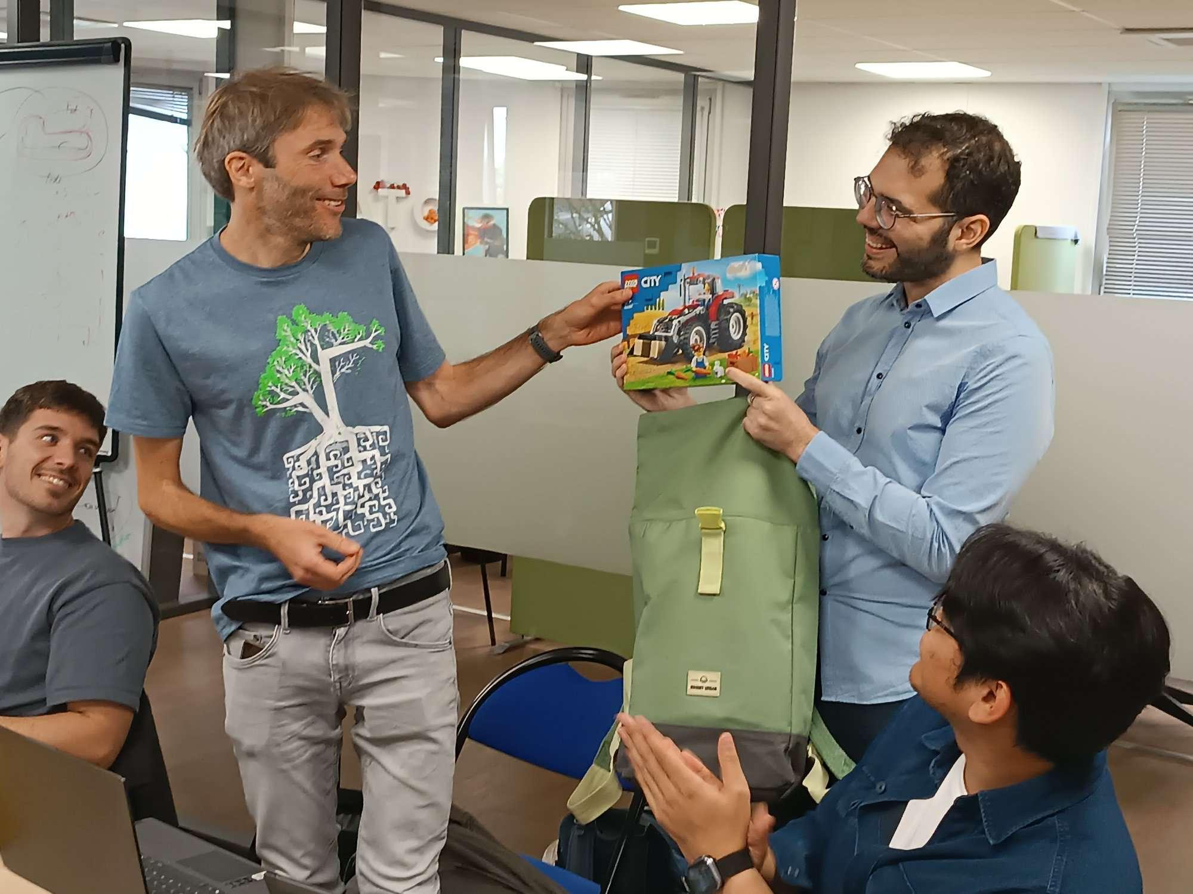
WUR is good at quizzes!

Slide 7
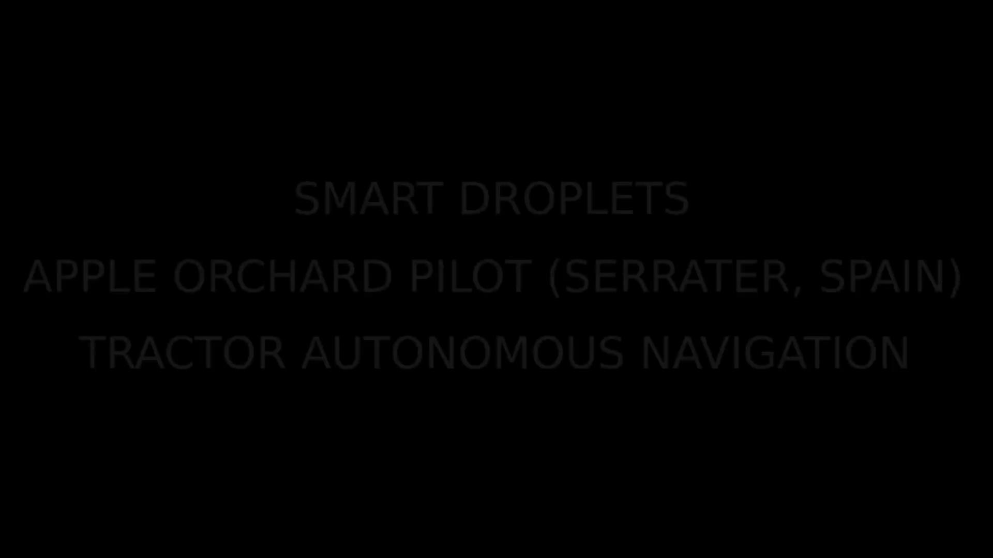
Robotics: Autonomous Navigation

Slide 8
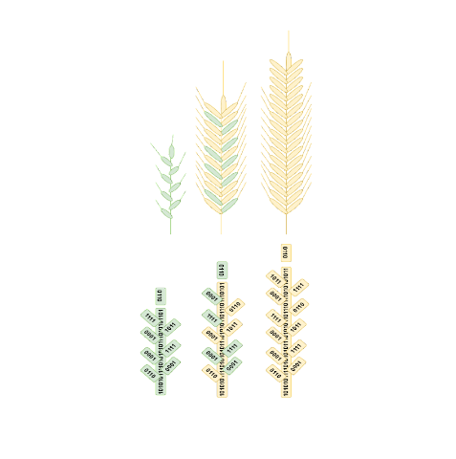

Field trials
Winter wheat
  Lithuania
  Nitrogen fertilization [WOFOST]
  Weed management
Apples
  Spain (same location as Robs4Crobs)
  Apple scab management [A-scab]

Slide 9
Role of WUR
WP3 lead Digital Platform and Digital Twin Intelligence
  T3.1: Data Management Platform
  T3.2: Digital Twin Framework
  T3.3: AI for pesticide recommendation intelligence
  T3.4: Pest Detection and Canopy Characterization for Spraying

Slide 10

Data Management Platform

Slide 11
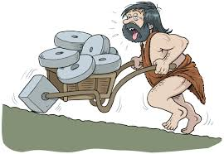
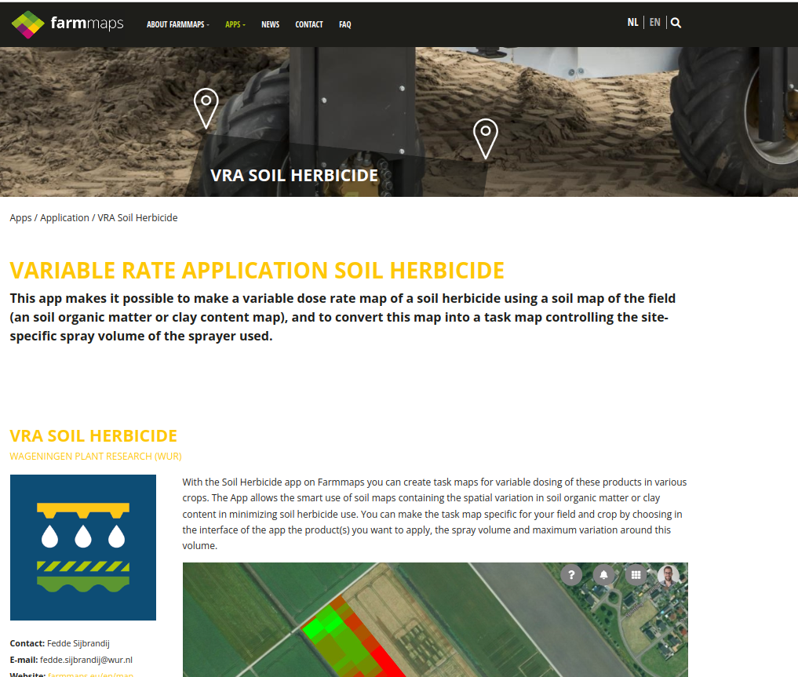
Data Management Platform: why?
YAFMS: Yet Another Farm Management System?

Slide 12
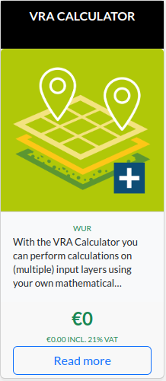
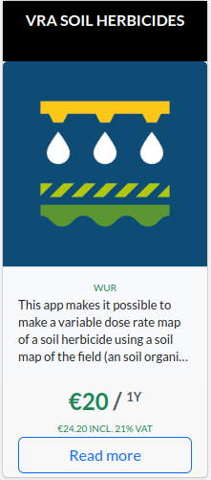
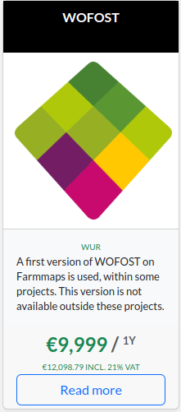
Data Management Platform: why?
YAFMS: Yet Another Farm Management System?
  Digital Twin Platform
  Data inflow from edge devices (camera system)

Slide 13
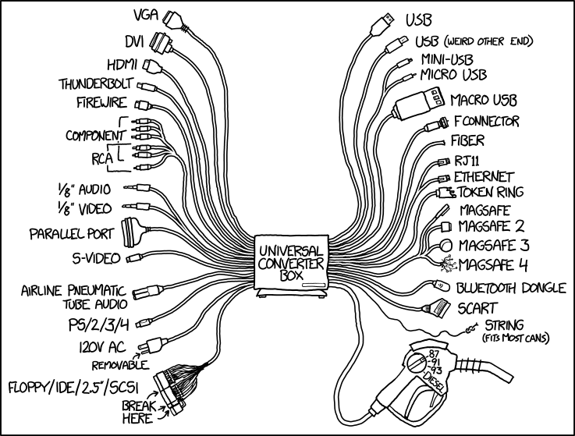
Data Management Platform: design
Three words: interoperability, interoperability, interoperability
Orion Context Broker along with FIWARE NGSI and
Smart Data Models for data exchange and integration

Slide 14
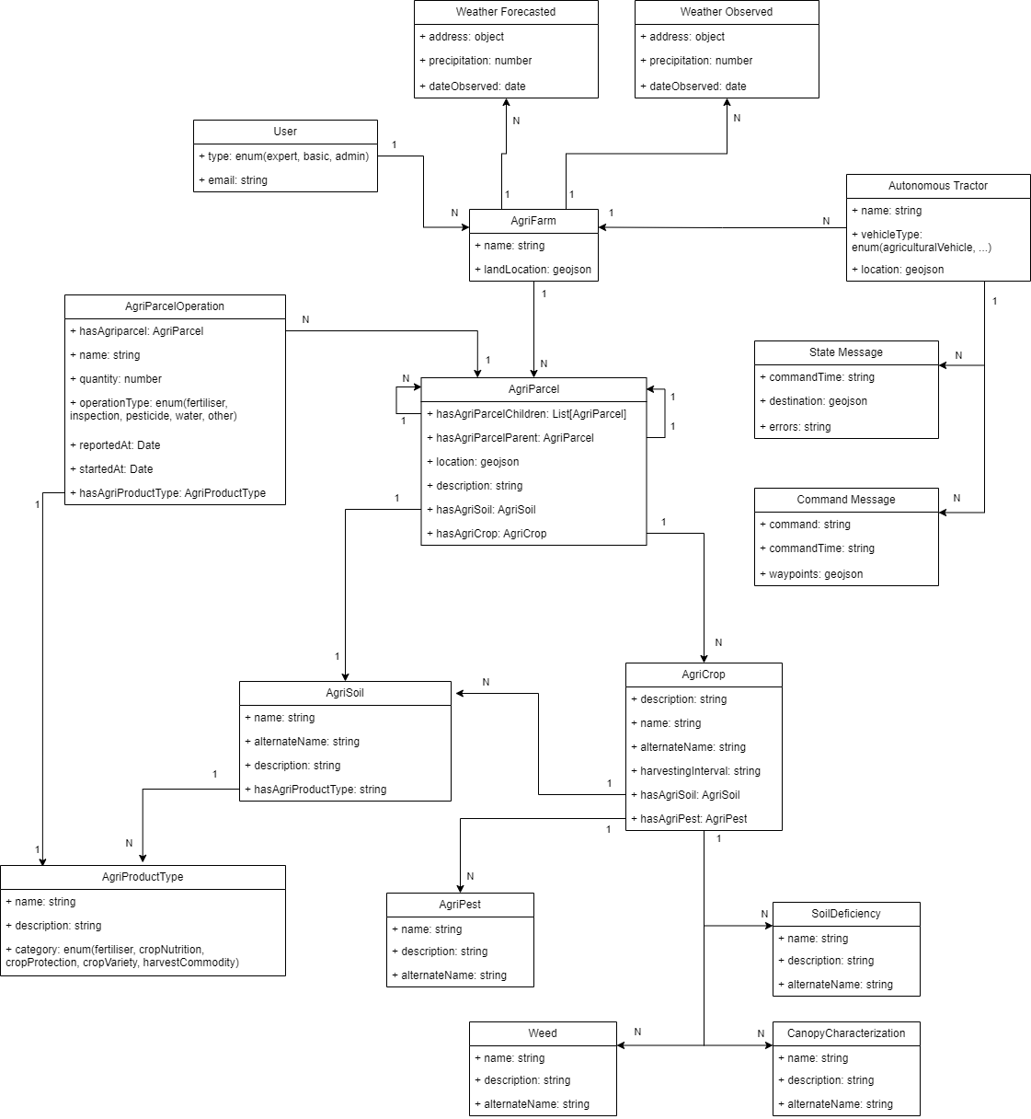

Slide 15
Data Management Platform: design
Three words: interoperability, interoperability, interoperability
Orion Context Broker along with FIWARE NGSI and
Smart Data Models for data exchange and integration
Hosted on K8s cluster @wurnet
Digital Twin Simulations (and recommendations)
  daily: cronjob
  user request: webserver
  new measurements: subscription to context broker
(triggers data assimilation)
Dashboard

Slide 16

Data Management Platform: demo

Slide 17
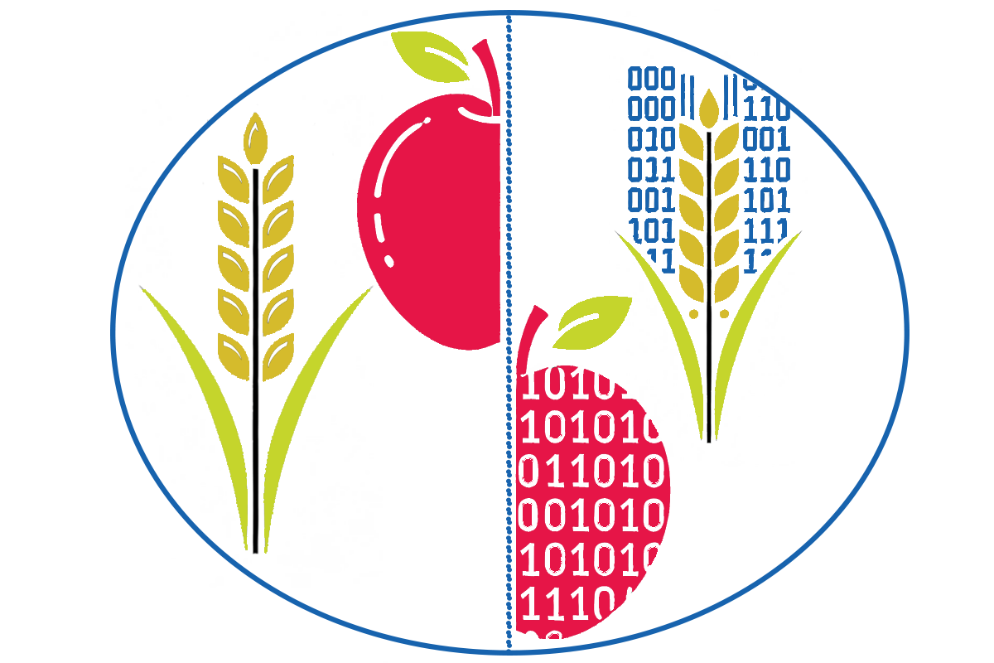
Digital Twin

Slide 18

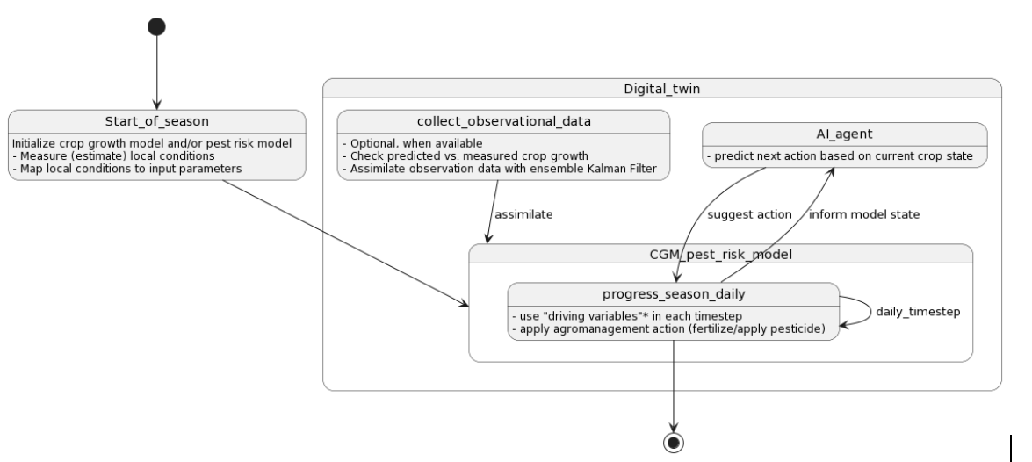


Digital Twin Framework
Reinforcement Learning Agents
What is the our definition of a Digital Twin?
  Monitoring: simulating, data collection and integration
  Controlling: recommendations, automation
Apple Trial
Wheat Trial
Digital Twin

Slide 19
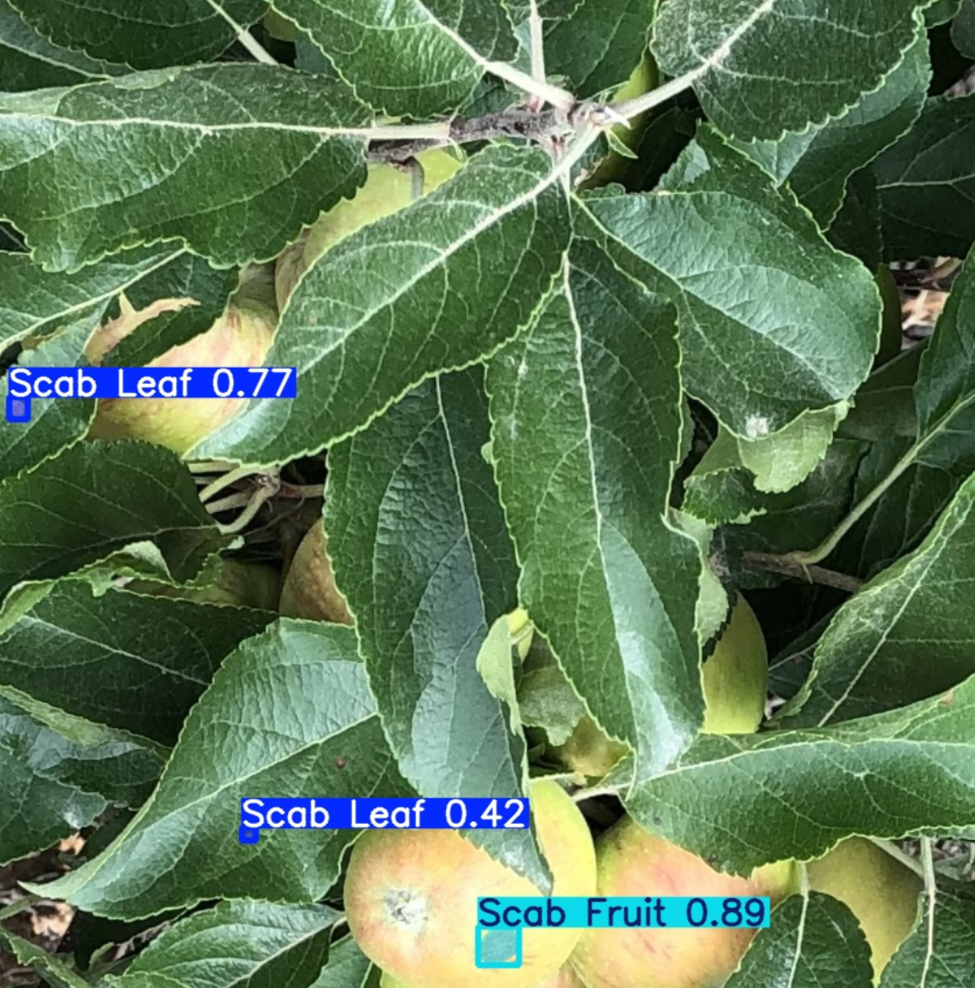
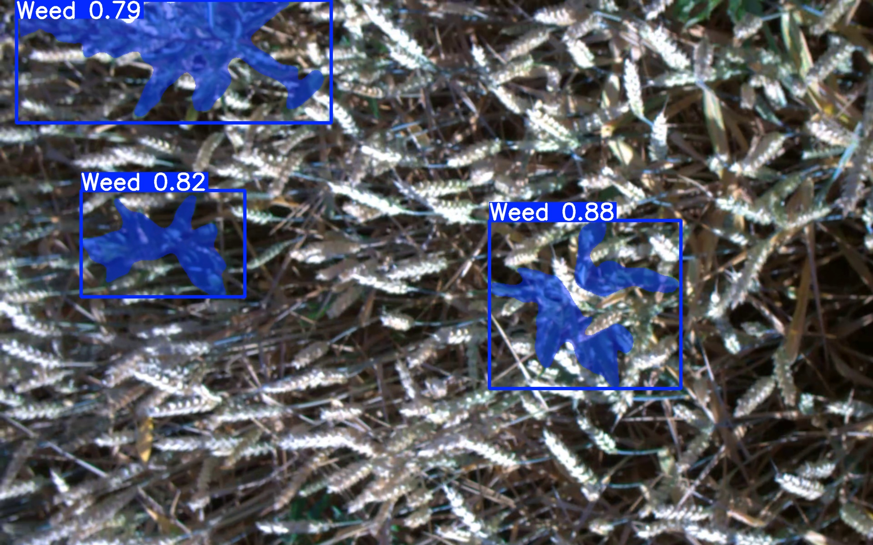
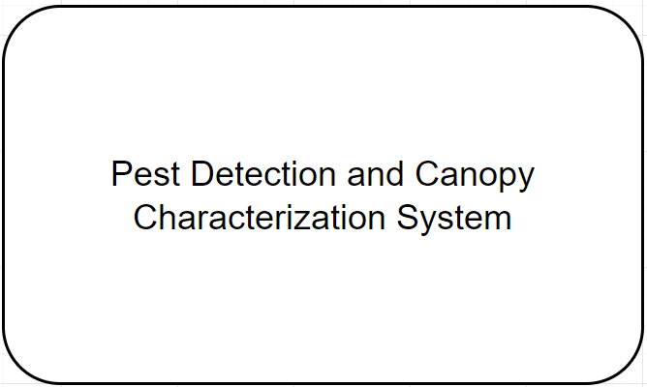
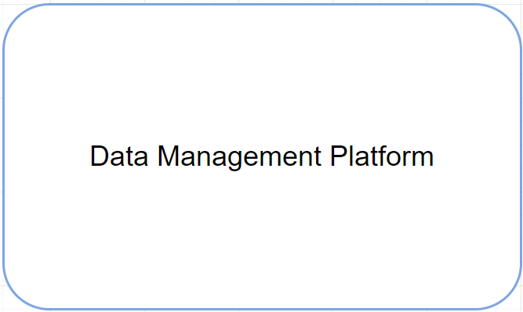
Digital Twin Framework – Holistically (Camera System)
Scab Detection
Weed Detection
Union Decision
Store Detections
Communication
Digital Twin

Slide 20
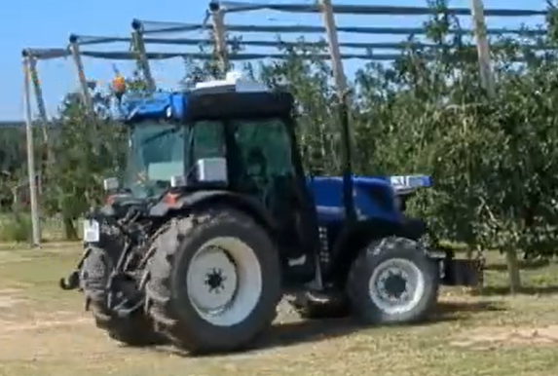
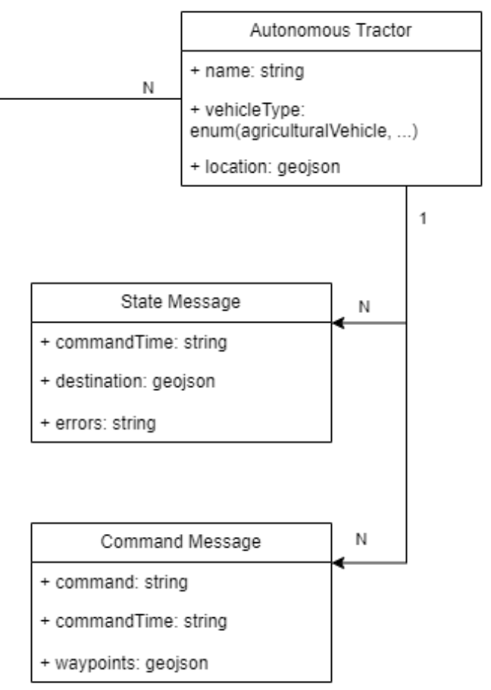
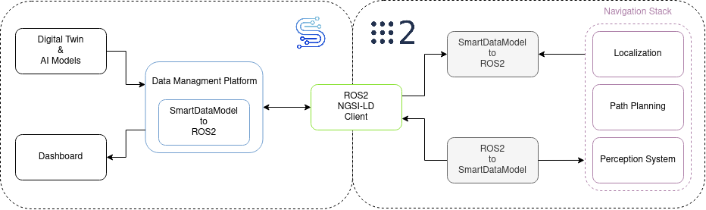
Digital Twin Framework – Holistically (Autonomous
Retrofitted Tractor)
Recommendation system sends Command Messages:
Fertilize!
Spray Pesticide!
Digital Twin

Slide 21
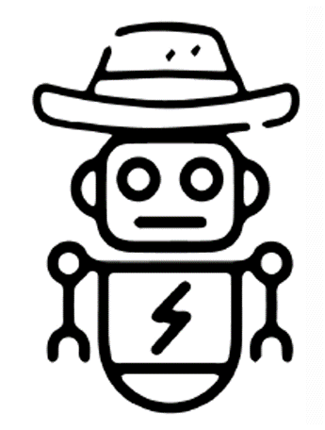

Reinforcement Learning-based Nitrogen Fertilizer Recommendations

Slide 22
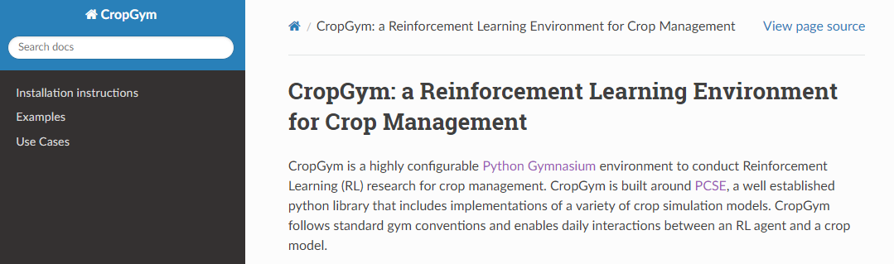
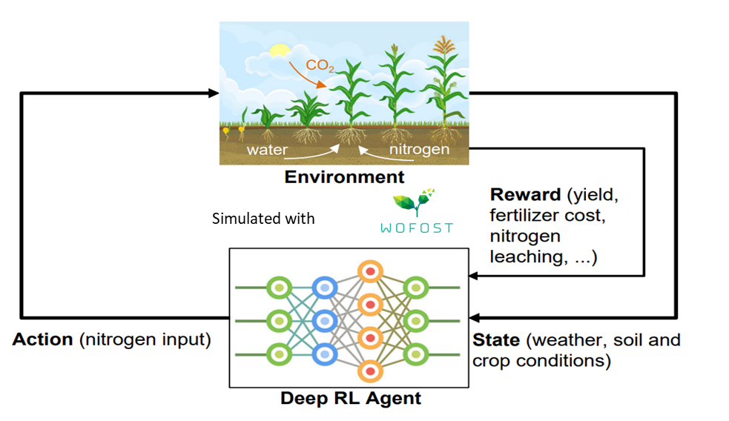
AI for fertilization recommendation intelligence (Wheat)
CropGym.ai: an RL environment for crop nitrogen fertilizer management utilizing WOFOST.

Slide 23
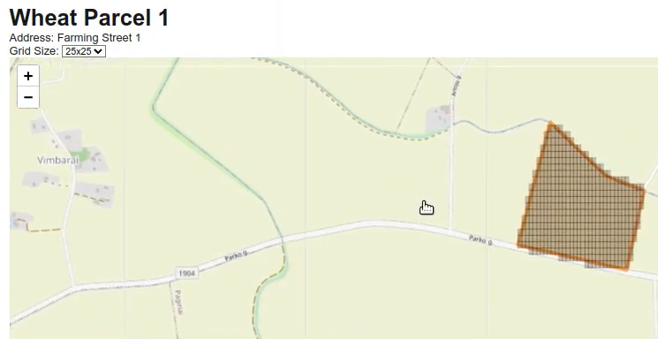
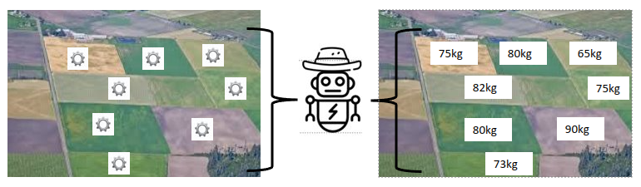
AI for fertilization recommendation intelligence (Wheat)
Each parcel initialized with an instance of WOFOST
  Initialized based on soil maps (currently from soilgrids)
Our trained RL agent is distributed to all the parcels
  Recommends fertilization amount for each parcel

Slide 24
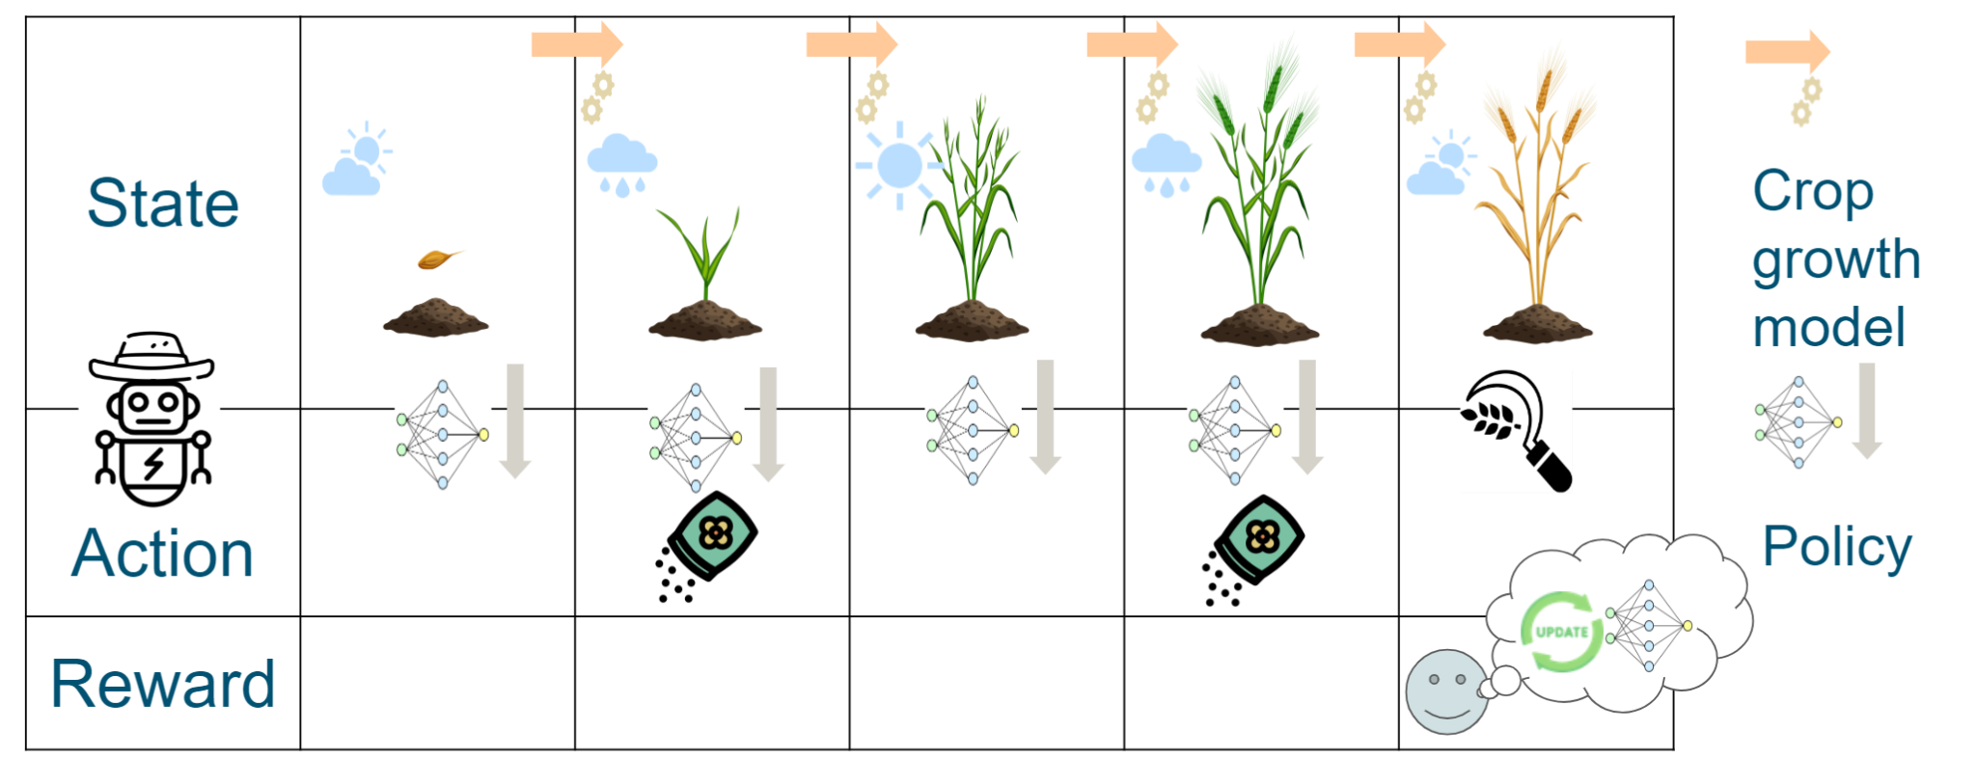
Reinforcement Learning and Crop Models
Train Agents, to apply Actions, given a State, based on Rewards
  Agent: (simplification) Function with State as input and Action as output
  State: crop features (e.g., LAI etc.), Weather features (e.g., Precipitation)
  Action: Fertilize how much (at current timestep)
  Reward: Improve Nitrogen Use Efficiency
(Playground) Simulated with WOFOST 8.1 (w/ dynamic N interactions)
  Calibrated to Lithuanian conditions

Slide 25
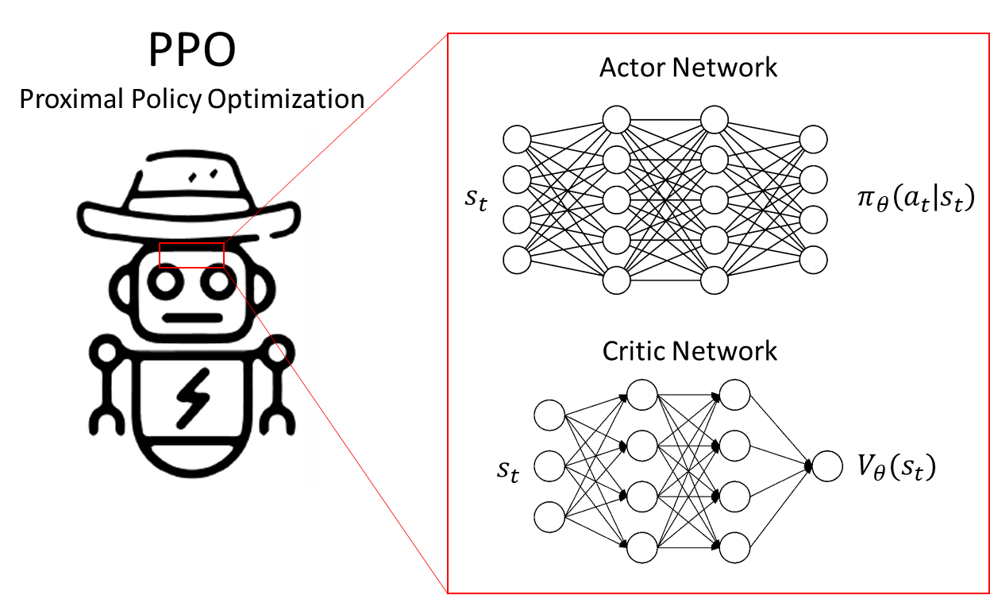
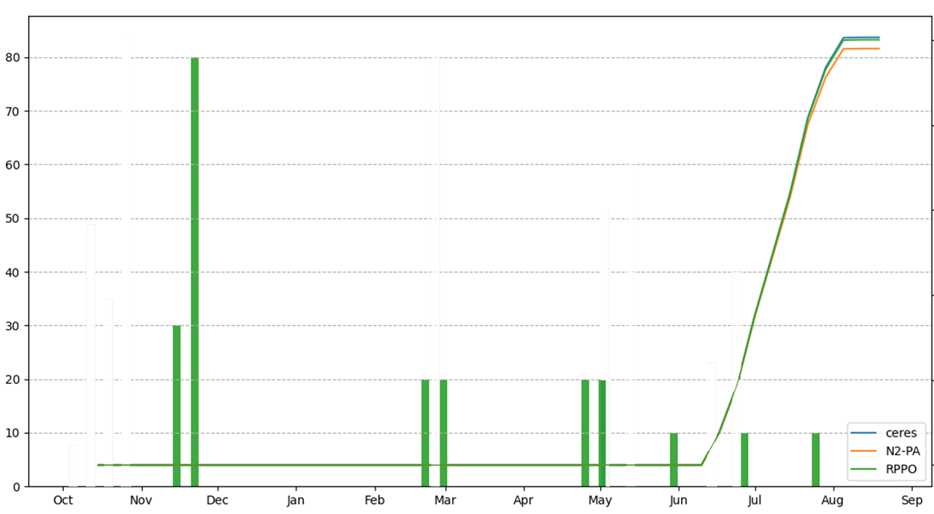
Design of our (constrained) RL agent

Slide 26
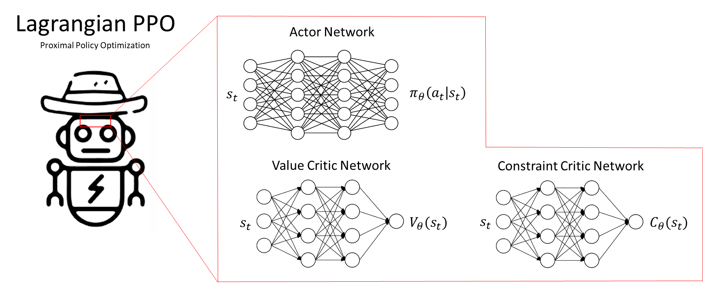
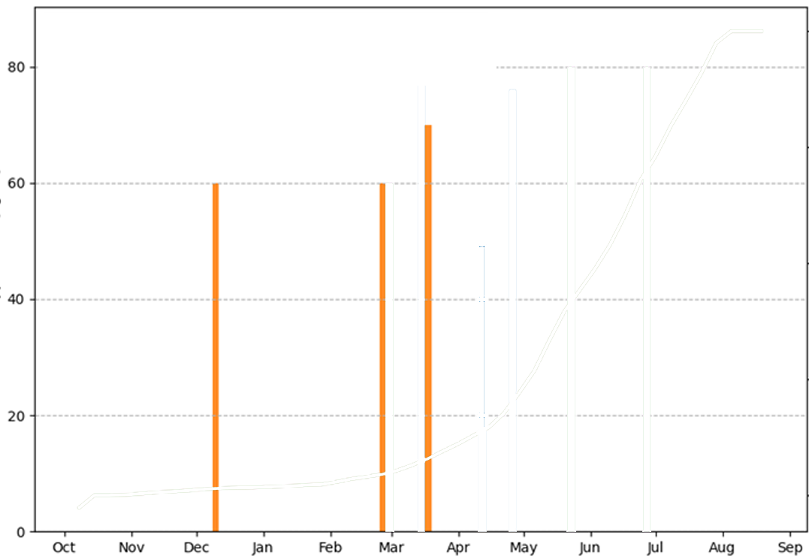
Design of our (constrained) RL agent

Slide 27
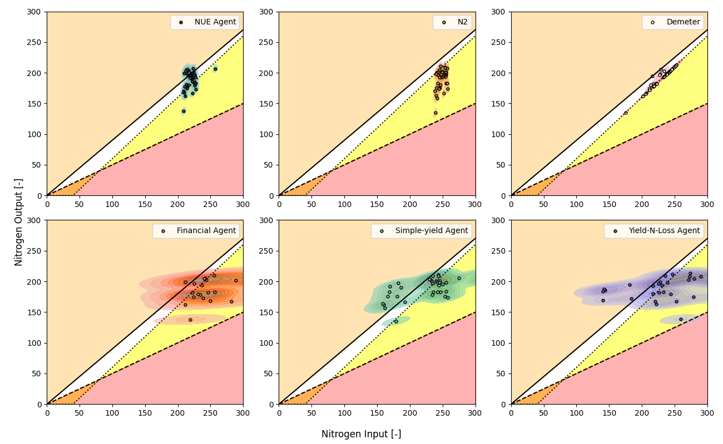
Design of our (constrained) RL agent

Slide 28
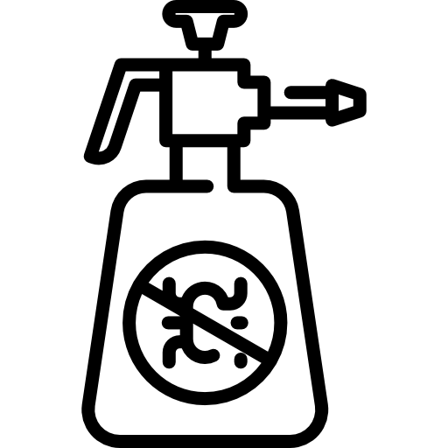
Reinforcement Learning-based Pesticide Spraying Recommendations

Slide 29
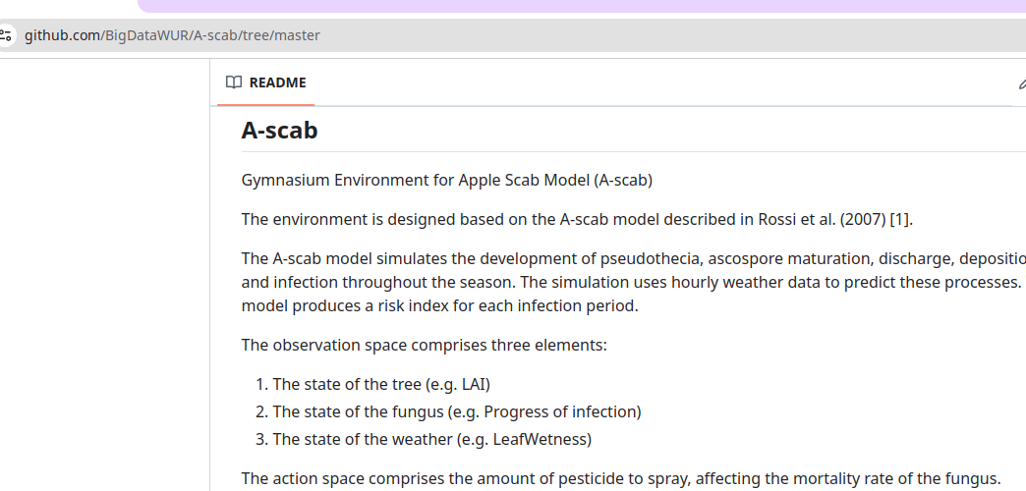
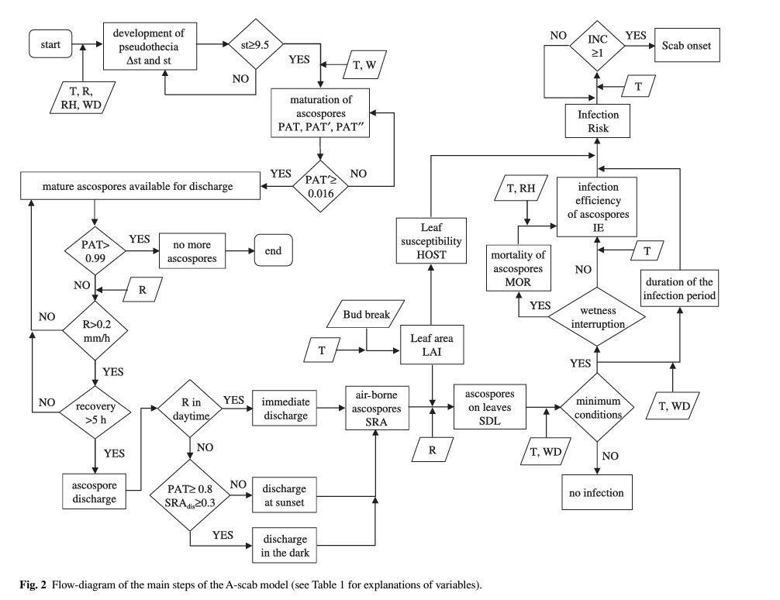
AI for pesticide recommendation intelligence
Developed software package A-scab to train a reinforcement learning (RL) agent for management of apple-scab
The A-scab model simulates the development of pseudothecia, ascospore maturation, discharge, deposition, and infection throughout the season
The simulation uses hourly weather data to predict these processes. The model produces a risk index for each infection period.

Slide 30
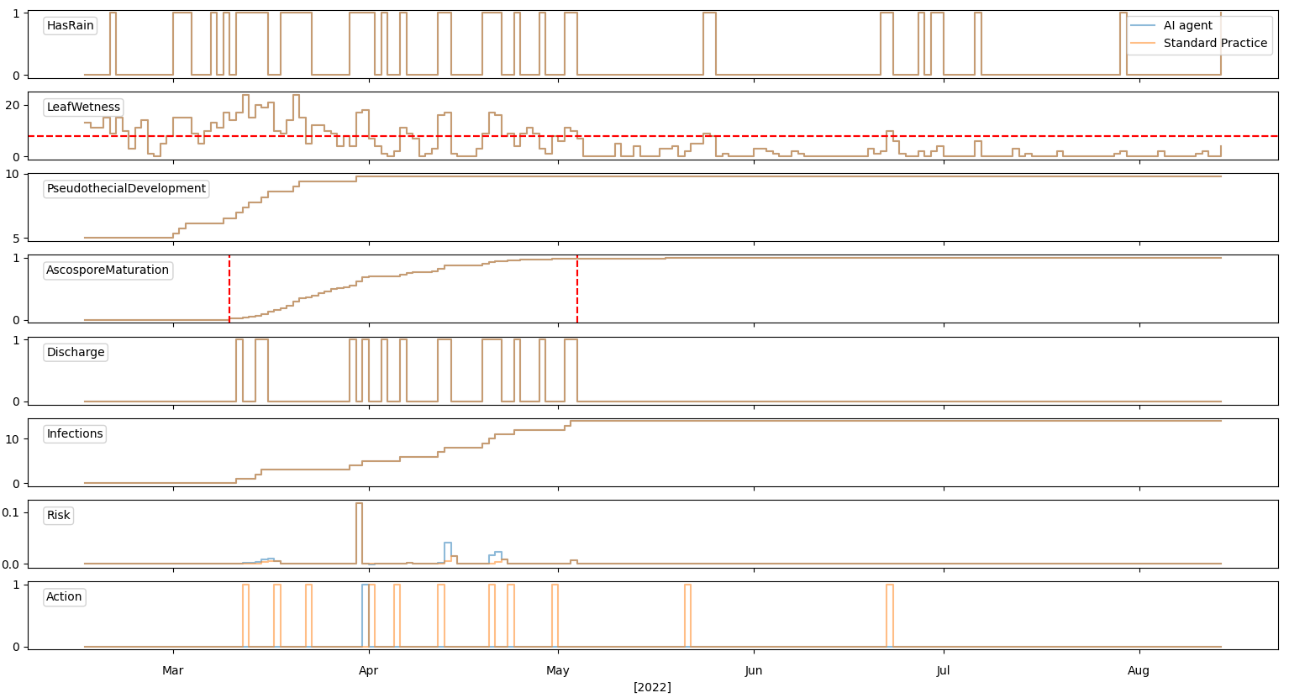
Simulations

Slide 31
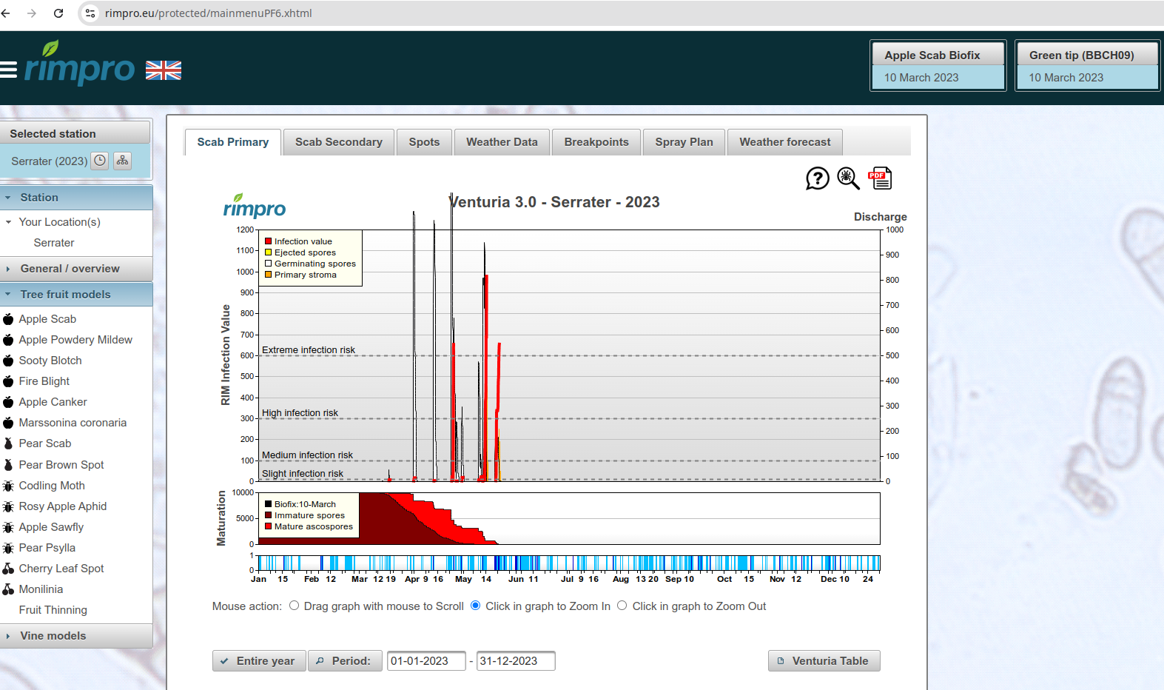
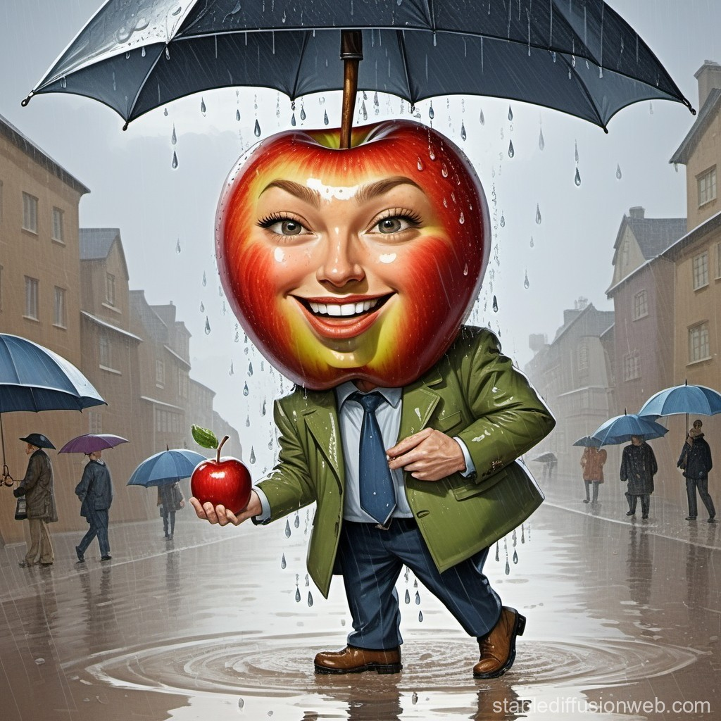

Spraying regimes
Decision support systems: RIMpro
Umbrella lovers
Phenology based
Dice based
RL based

Slide 32
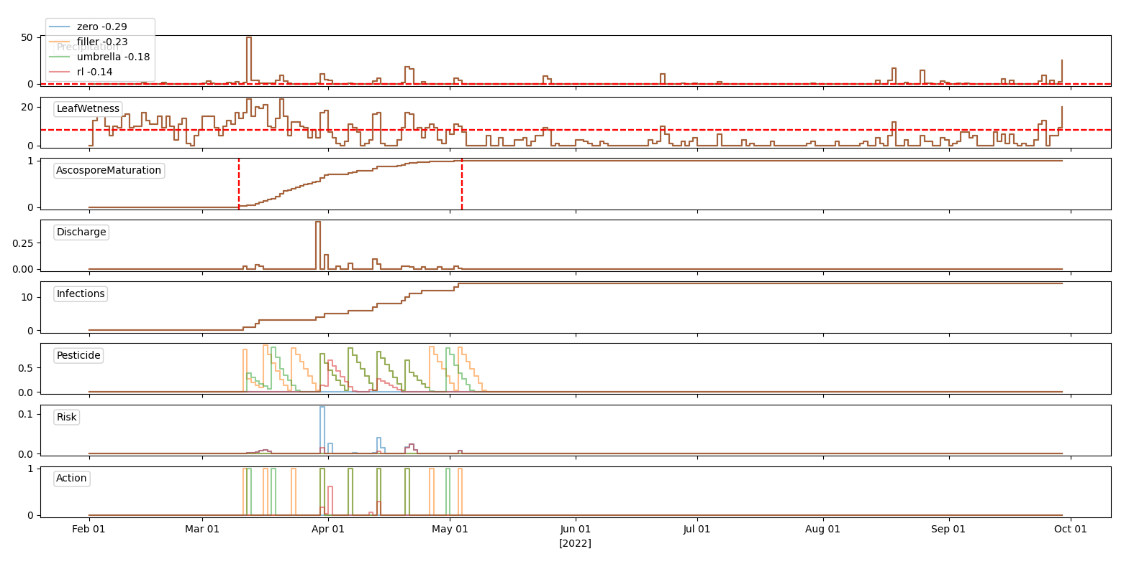
Intelligent agents

Slide 33
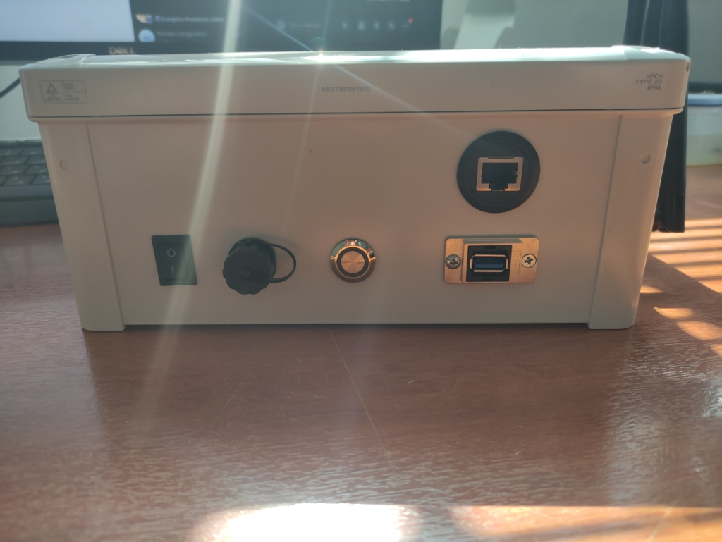
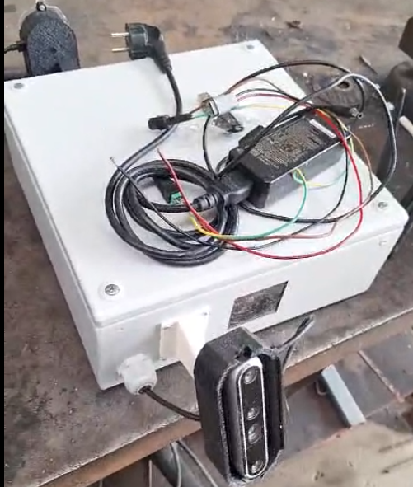
Pest Detection and Canopy Characterization for Spraying
Camera system
Detection: Yolo V8 instance segmentation model

Slide 34
Project Achievements: publications
Pylianidis, C., Kallenberg, M. G., & Athanasiadis, I. N. (2024). Domain adaptation with transfer learning for pasture digital twins. Environmental Data Science, 3, e8.
Tsoumas, I., Sitokonstantinou, V., Giannarakis, G., Lampiri, E., Athanassiou, C., Camps-Valls, G., ... & Athanasiadis, I. (2023). Causality and Explainability for Trustworthy Integrated Pest Management. arXiv preprint arXiv:2312.04343.
Kallenberg, M., Maestrini, B., van Bree, R., Ravensbergen, P., Pylianidis, C., van Evert, F., & Athanasiadis, I. N. Integrating processed-based models and machine learning for crop yield prediction. In 1st Workshop on the Synergy of Scientific and Machine Learning Modeling@ ICML2023.
Kallenberg, M. G., Overweg, H., van Bree, R., & Athanasiadis, I. N. (2023). Nitrogen management with reinforcement learning and crop growth models. Environmental Data Science, 2, e34.

Slide 35
Project Achievements: software
cropgym.ai: reinforcement learning environment for crop management (WOFOST)
a-scab: reinforcement learning environment for apple scab management (Ascab)

Slide 36
Project Achievements: publications (in process)
Data collection is expensive; when to measure data points? Use RL as a recommender for data collection for optimal crop management.
Environmental impact of nitrogen fertilization is important. RL could potentially improve Nitrogen Use Efficiency.
Current practice of pesticide spraying is excessive. RL could potentially improve current spraying practices.

Slide 37
Thank you!
Questions?

