Slide 1
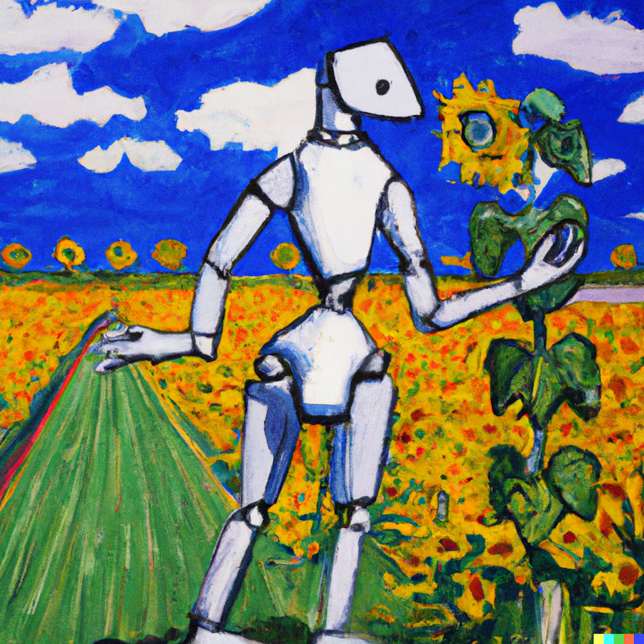

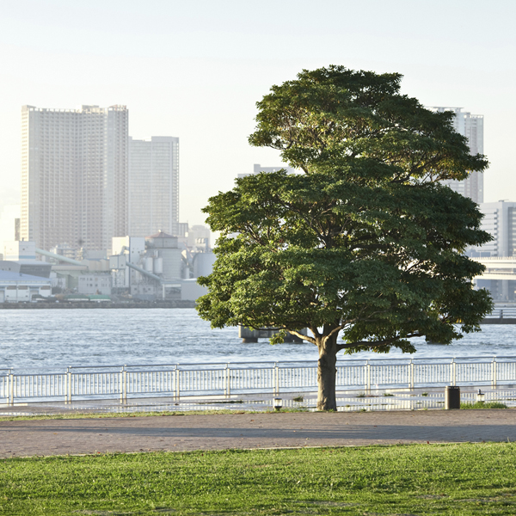
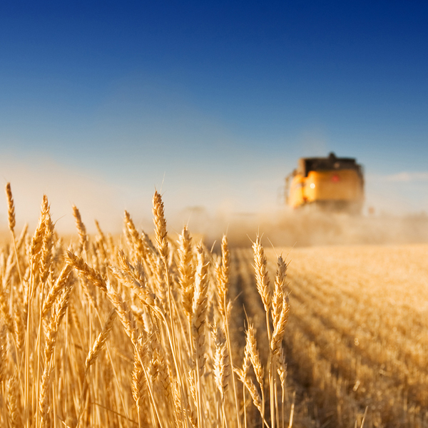

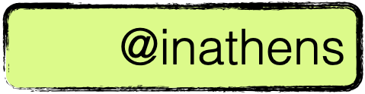

Reinforcement Learning - training intelligent agents
PhD Michiel Kallenberg, Artificial Intelligence (AIN), Radix
Prof dr Ioannis Athanasiadis and Hilmy Baja MSc
February 21, 2025

Slide 2
Personal background
Michiel Kallenberg, Artificial Intelligence (AIN), Radix
PhD: AI for medical image analysis (Nijmegen, the Netherlands)
Joined WUR three years ago
Reinforcement Learning for Farm Management
Integration of Process-Based Crop Growth Models and AI
February 21, 2025

Slide 3
Program of the Day
1. Introduction to RL
2. Actors of the game
3. How to train your agent
4. Agents in practice
5. Further outlook

Slide 4
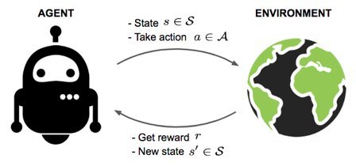
1. Introduction to ABM and
Reinforcement Learning

Slide 5
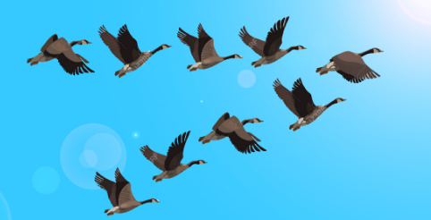
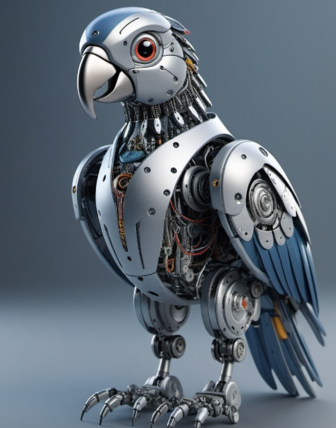
Agent Based Modeling and Reinforcement Learning
Agent based modeling:
Focus: Understanding system-level behavior and emergent patterns
Agent Complexity: predefined rules based on heuristics or expert knowledge
Reinforcement learning:
Focus: Training agents through interaction with an environment
Agent Complexity: learns adaptive strategies from data through AI

Slide 6
Agent Based Modeling and Reinforcement Learning
RL can replace fixed rule-based decision-making in ABM, making agents more flexible and responsive
Instead of explicitly encoding behavior, RL allows agents to learn from experience.
Example: A bird learns to stay in the flock because it receives rewards when its self-chosen actions keep it within the group
If distance_next_bird < 30cm:
move
Free as a bird: I just collect rewards

Slide 7
Multi-Agent Reinforcement Learning & Agent-Based Models
Agents can have cooperative and/or competitive objectives
e.g. Multiple agents aiming to reach a destination on time.
Agents can also pursue individual objectives
e.g. A bird receiving rewards for avoiding headwind
A set of RL agents can form an Agent-Based Model
RL enables emergent behavior in ABM simulations.
This lecture focuses on training a single RL agent

Slide 8
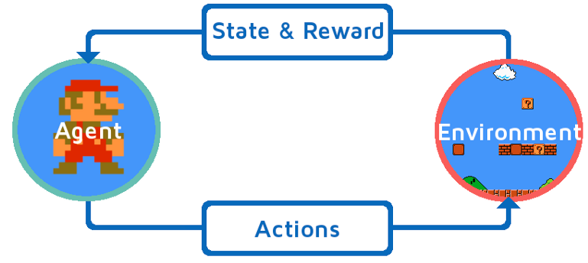
2. Actors of the game

Slide 9
Actors in Reinforcement Learning
Train agents to take actions given a state
Learn from rewards
Training by interaction with environment, by trial and error

Slide 10
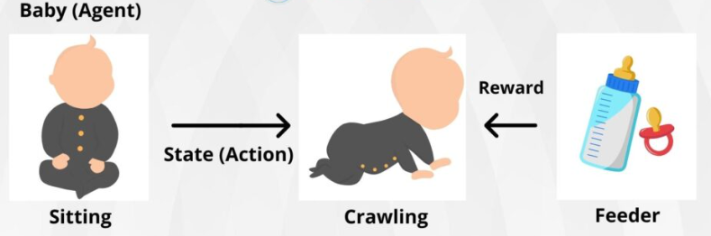
Actors in Classical Examples
Human development

Slide 11
Actors in Classical Examples
Gaming

Slide 12
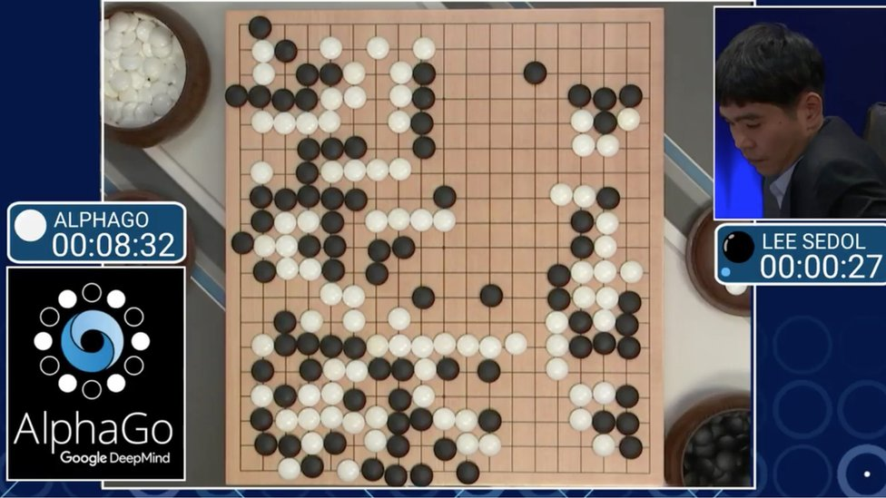
Actors in Classical Examples
Gaming

Slide 13
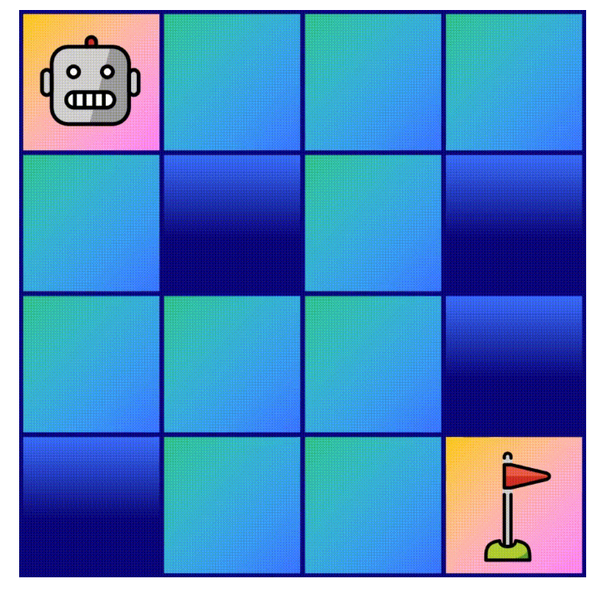
Actors in Classical Examples
Gaming
Question: What is the "state" in these examples?

Slide 14


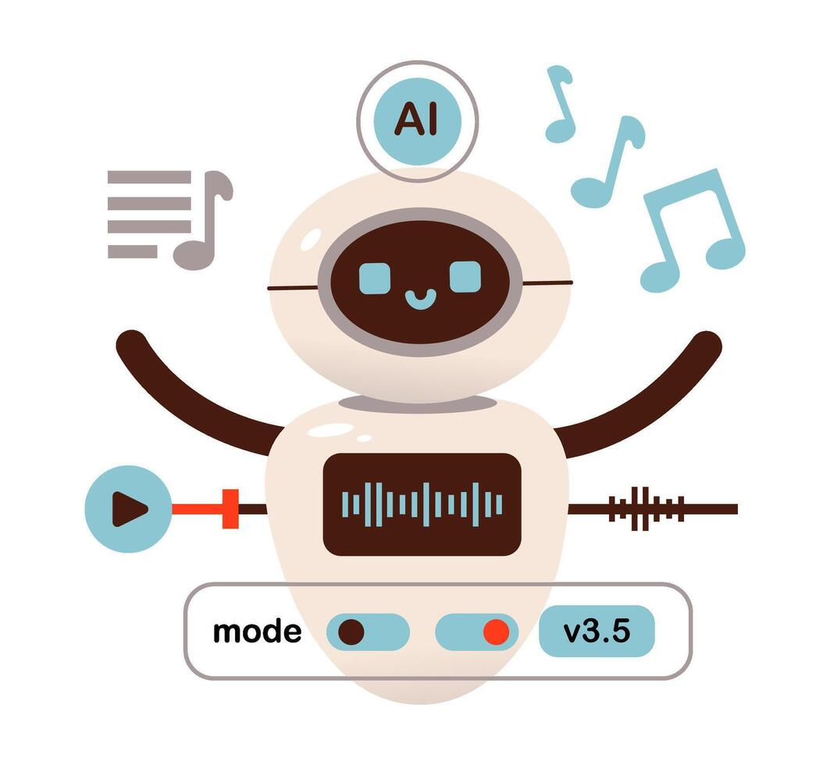

Actors in Classical Examples
Recommendation systems
Action: Recommend song
Environment:
Question: what is the environment here?
Agent
State: "Features" of past n songs
Reward: Question: what could be a good reward signal?

Slide 15




Actors in a current example
Green Life Sciences
Action: Irrigate, fertilize
Environment: Crop Growth Model
Agent
State: Water stress, Nitrogen content
Reward: Yield

Slide 16
Conditions in which reinforcement learning is effective
Sequence of actions: loop: S,A,R,S,A,R...
e.g. a crop season ("episode") covers multiple stages ("steps")
Actions have long term consequences
e.g. fertilization affects crop growth
Rewards are typically delayed, and sparse
e.g. yield only at end of year, for most steps no reward signal
Agent must balance immediate vs long term reward:
e.g. fertilize (...costly...) to achieve more yield later

Slide 17
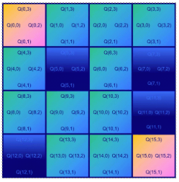
3. How to train your agent

Slide 18
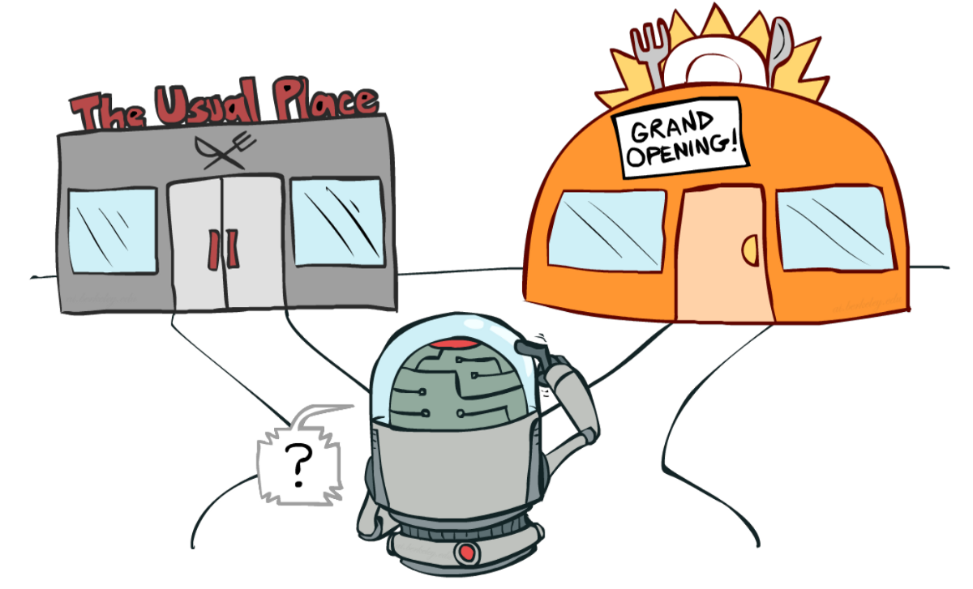
Training process
Trial-and-error: learn from experiences
Actions of agent affects training data it receives
Exploration vs exploitation: diverge, then converge

Slide 19
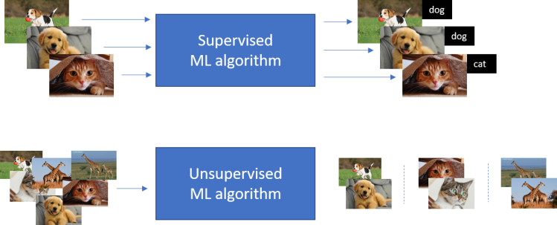
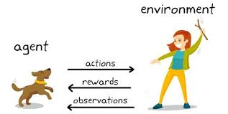
Training process
No supervisor; only a reward signal
Supervised Learning
Train an algorithm to perform classification and regression with a labelled data set
Supervised Learning
Train an algorithm to perform classification and regression with a labelled data set
Unsupervised Learning
Train an algorithm to find patterns and structure in unlabeled data without explicit supervision
Reinforcement Learning
Train an algorithm to take certain actions in an environment without a dataset

Slide 20
Agent
An agent contains typically (one of) the following:
Model: agent's representation of the environment
Policy 𝜋: determines how an agent chooses its actions: 𝜋(a|s)
Value function: how good is each state/action: Q(s,a)

Slide 21
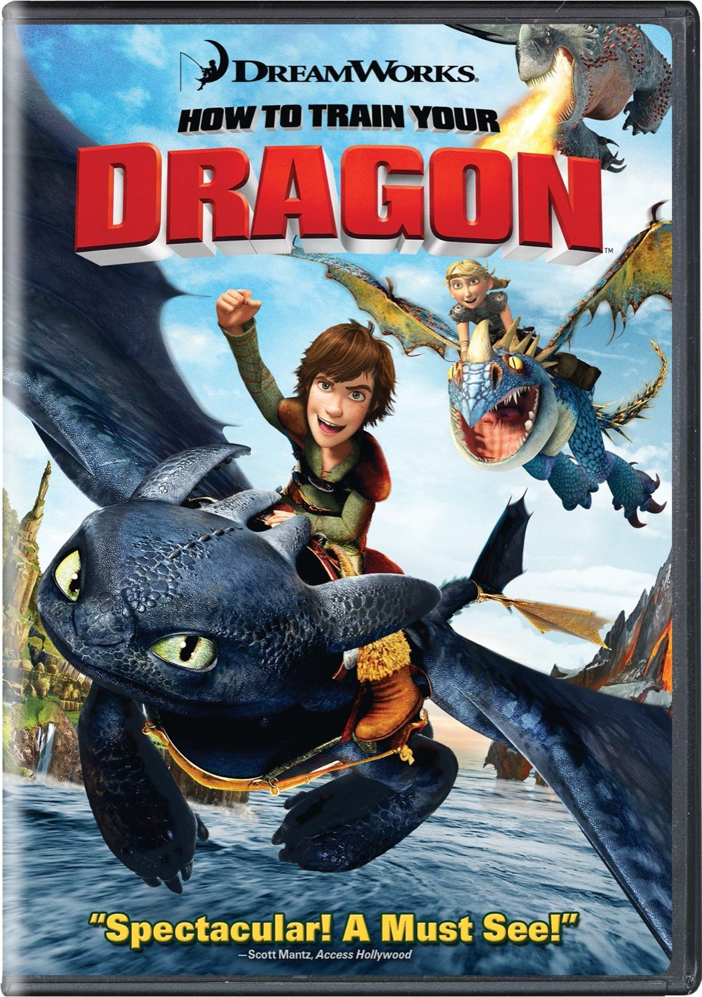

How to train you agent: Q-learning

Slide 22
Q-learning: Q(s,a)
Estimate "quality of an action" for each state-action pair Q(s,a)
Once we know Q(s,a) for each pair:
Just pick for each state the action with the highest Q

Slide 23
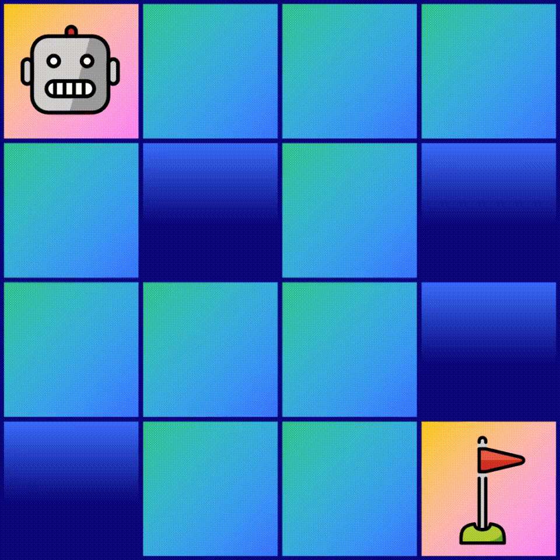
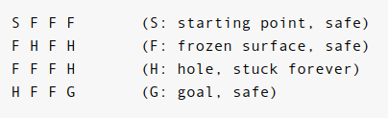
Q-learning: Q(s,a)
Frozen lake: very well-studied toy problem
Objective: capture the flag
Reward:
Flag: +1
Else: +0
Hole: END
Penalty:
γ (=discount factor): 0.9
≈ penalty for each step
https://towardsdatascience.com/q-learning-for-beginners-2837b777741/

Slide 24
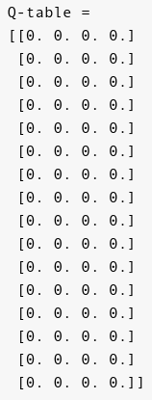
Q-learning: Q(s,a)
Construct Q-table, which holds "quality of an action" for each state-action pair Q(s,a)
Question: How many Q values do we have?
https://towardsdatascience.com/q-learning-for-beginners-2837b777741/

Slide 25
Q-learning: Q(s,a)
Construct Q-table, which holds "quality of an action" for each state-action pair Q(s,a)
Question: How many Q values do we have?
Answer: 16 states * 4 actions = 64 values
https://towardsdatascience.com/q-learning-for-beginners-2837b777741/

Slide 26
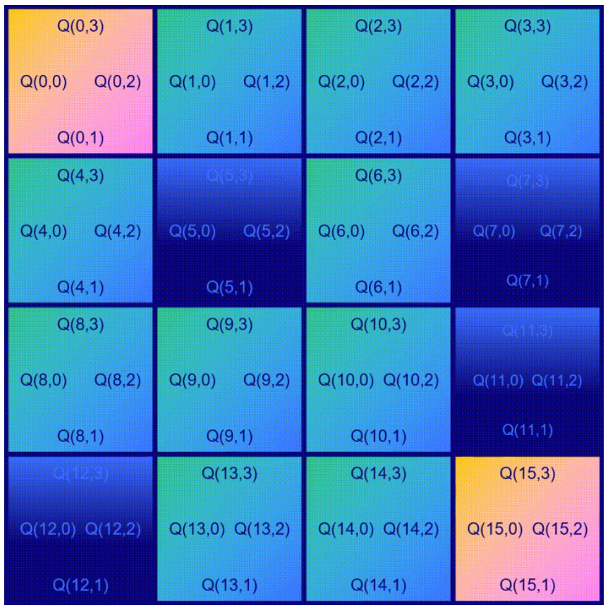
Q-learning: Q(s,a)
Construct Q-table, which holds "quality of an action" for each state-action pair Q(s,a)
Question: What could be a good measure of "quality of an action"?
https://towardsdatascience.com/q-learning-for-beginners-2837b777741/

Slide 27
Q-learning: Q(s,a)
Construct Q-table, which holds "quality of an action" for each state-action pair Q(s,a)
Question: What could be a good measure of "quality of an action"?
Answer: Expected total reward
https://towardsdatascience.com/q-learning-for-beginners-2837b777741/

Slide 28

Q-learning: Q(s,a)
Construct Q-table, which holds "quality of an action" for each state-action pair Q(s,a)
Question: What could be a good measure of "quality of an action"?
Answer: Expected total reward
the future reward, estimated by inspecting the best Q-value for the next state
the direct reward received after taking action a
https://towardsdatascience.com/q-learning-for-beginners-2837b777741/

Slide 29
Q-learning: Q(s,a)
Question: Can you fill in some numbers? (of trained system)
the future reward, estimated by inspecting the best Q-value for the next state
the direct reward received after taking action a
https://towardsdatascience.com/q-learning-for-beginners-2837b777741/

Slide 30
Q-learning: Q(s,a)
Question: Can you fill in some numbers? (of trained system)
the future reward, estimated by inspecting the best Q-value for the next state
the direct reward received after taking action a
1.0 = 1.0 + 0.9*0.0
https://towardsdatascience.com/q-learning-for-beginners-2837b777741/

Slide 31
Q-learning: Q(s,a)
Question: Can you fill in some numbers? (of trained system)
the future reward, estimated by inspecting the best Q-value for the next state
the direct reward received after taking action a
1.0 = 1.0 + 0.9*0.0
0.0 = 0.0 + 0.9*0.0
https://towardsdatascience.com/q-learning-for-beginners-2837b777741/

Slide 32
Q-learning: Q(s,a)
Question: Can you fill in some numbers? (of trained system)
the future reward, estimated by inspecting the best Q-value for the next state
the direct reward received after taking action a
1.0 = 1.0 + 0.9*0.0
0.0 = 0.0 + 0.9*0.0
0.9 = 0.0 + 0.9*1.0
https://towardsdatascience.com/q-learning-for-beginners-2837b777741/

Slide 33
Q-learning: Q(s,a)
Question: Can you fill in some numbers? (of trained system)
the future reward, estimated by inspecting the best Q-value for the next state
the direct reward received after taking action a
1.0 = 1.0 + 0.9*0.0
0.0 = 0.0 + 0.9*0.0
0.9 = 0.0 + 0.9*1.0
https://towardsdatascience.com/q-learning-for-beginners-2837b777741/

Slide 34
Q-learning: Q(s,a)
Question: Can you fill in some numbers? (of trained system)
the future reward, estimated by inspecting the best Q-value for the next state
the direct reward received after taking action a
1.0 = 1.0 + 0.9*0.0
0.0 = 0.0 + 0.9*0.0
0.9 = 0.0 + 0.9*1.0
0.81 = 0.0 + 0.9*0.9
https://towardsdatascience.com/q-learning-for-beginners-2837b777741/

Slide 35
Q-learning: Q(s,a)
If reward structure and environment dynamics are known we can compute Q(s,a) (using dynamic programming methods)
When unknown we need to learn Q(s,a)
In Reinforcement Learning we learn by trial-and-error
https://towardsdatascience.com/q-learning-for-beginners-2837b777741/

Slide 36
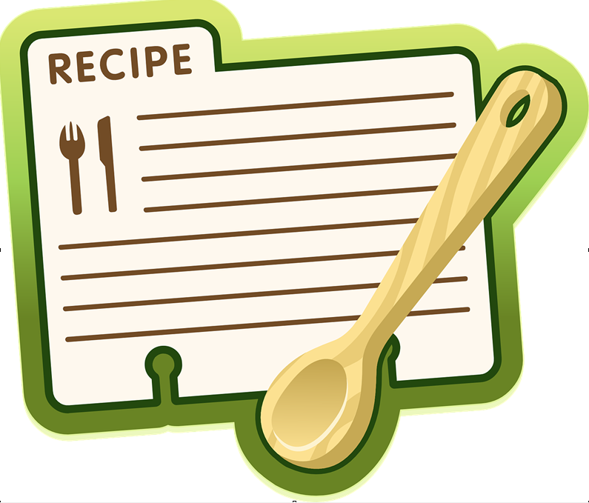

Q-learning: recipe for Q(s,a)
Initialize Q table with zeros
https://towardsdatascience.com/q-learning-for-beginners-2837b777741/

Slide 37
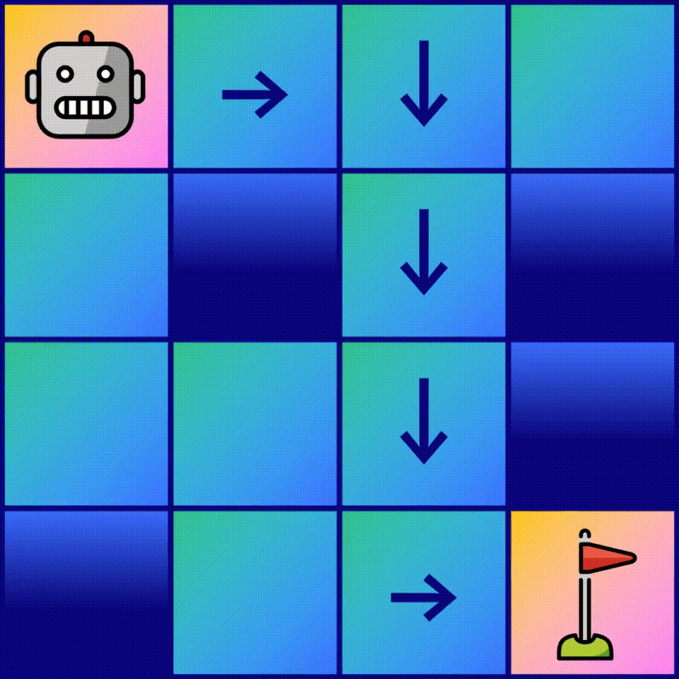

Q-learning: recipe for Q(s,a)
Start sampling actions and collects "episodes"
For each "episode": once we reached our goal....
Update each entry in our Q-table Q(s,a); Start at the end (G)...and go to start
https://towardsdatascience.com/q-learning-for-beginners-2837b777741/

Slide 38
Q-learning: Towards update rule
the future reward, estimated by inspecting the best Q-value for the next state
the direct reward received after taking action a
new estimate
Option: Use function we just learned: overwrite current Q value with "new estimate":
Example: * Q(s,a) = 0.5; * r+γmaxQ(s',a') = 0.6 * new_value ← 0.6
Can get rather noisy
Would throw away old estimate/experience
https://towardsdatascience.com/q-learning-for-beginners-2837b777741/

Slide 39
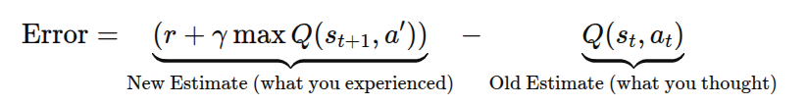
Q-learning: Update rule
the future reward, estimated by inspecting the best Q-value for the next state
the direct reward received after taking action a
New value = Current value + "error term" (aka TD-error)
Example: new_value ← 0.5 + α(0.6-0.5) Question: What if we set α to 1?
https://towardsdatascience.com/q-learning-for-beginners-2837b777741/

Slide 40
Q-learning: Update rule
the future reward, estimated by inspecting the best Q-value for the next state
the direct reward received after taking action a
New value = Current value + "error term" (aka TD-error)
Example: new_value ← 0.5 + α(0.6-0.5) Question: What if we set α to 1? Answer: Just becomes our "old" function --> Overwrite
https://towardsdatascience.com/q-learning-for-beginners-2837b777741/

Slide 41
Q-learning: Update rule
the future reward, estimated by inspecting the best Q-value for the next state
the direct reward received after taking action a
New value = Current value + "error term" (aka TD-error)
Example: new_value ← 0.5 + α(0.6-0.5) Question: What if we set α to 0?
https://towardsdatascience.com/q-learning-for-beginners-2837b777741/

Slide 42
Q-learning: Update rule
the future reward, estimated by inspecting the best Q-value for the next state
the direct reward received after taking action a
New value = Current value + "error term" (aka TD-error)
Example: new_value ← 0.5 + α(0.6-0.5) Question: What if we set α to 0? Answer: Doesn't learn anything; just keep old estimate
https://towardsdatascience.com/q-learning-for-beginners-2837b777741/

Slide 43
Q-learning: Update rule
the future reward, estimated by inspecting the best Q-value for the next state
the direct reward received after taking action a
New value = Current value + "error term" (aka TD-error)
Example: new_value ← 0.5 + α(0.6-0.5) α = 1.0: fully overwrite; α = 0.5: balance between old estimate and new estimate
https://towardsdatascience.com/q-learning-for-beginners-2837b777741/

Slide 44
Q-learning: numerical example
1st visit:
Q(G-1, aₜ) = 0 + 0.5 · (1 + 0.9 · 0 − 0) = 0.5
2nd visit:
Q(G-1, aₜ) = 0.5 + 0.5 · (1 + 0.9 · 0 − 0.5) = 0.75
then 0.875, 0.9375, 0.96875, etc.
https://towardsdatascience.com/q-learning-for-beginners-2837b777741/

Slide 45
Q-learning: key takeaways
Goal: Learn "expected reward" for each Q(state,action)-pair
How?
Learn by trial-and-error trough interaction with environment
Update Q-values iteratively based on observed rewards

Slide 46
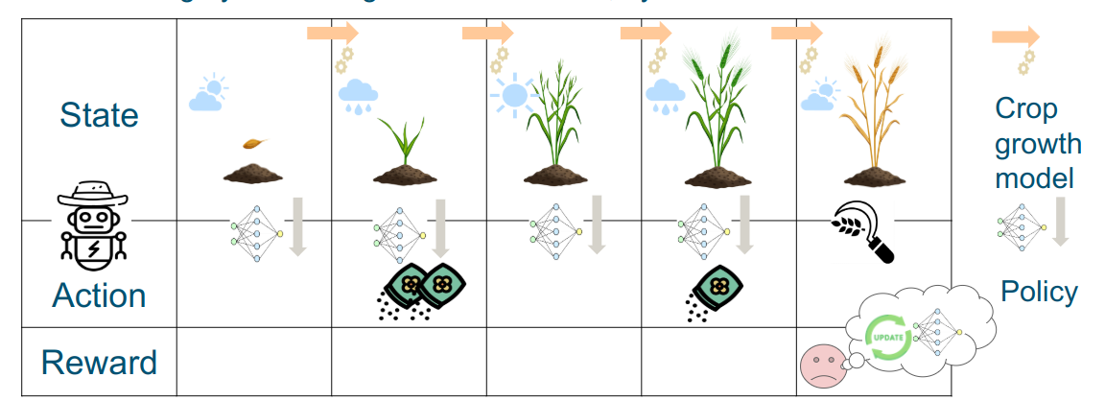



From frozen lakes to ….
In "frozen lake": Q(s,a) = Q(position, direction)
In crop management: Q(s,a) = Q(nitrogen level, fertilization), or In crop management: Q(s,a) = Q(soil moisture, irrigation), or …
With reinforcement learning, you can discover an optimal policy for sequential decision-making in a data-driven way In crop management

Slide 47
From Q-Tables to Function Approximation
Q(0, 0)=0.4 | Q(0, 10)=0.6 | Q(0, 20)=0.8 | Q(0, 40)=1.0
Q(1, 0)=0.3 | Q(1, 10)=0.5 | Q(1, 20)=1.0 | Q(1, 40)=0.9
Q(2, 0)=0.2 | Q(2, 10)=0.4 | Q(2, 20)=0.9 | Q(2, 40)=0.8
In stead of filling in a Q-table we can also use a function to approximate the Q values, e.g: a₁*nitrogen_content + a₂*fertilization_action = Q_value
We still use our training process
But instead of updating table values.... we adjust a₁ and a₂ to produce our Q-values

Slide 48
Function approximation: advantages
Works for large state spaces where Q-tables become impractical
Generalizes better than Q-table
Easily extendable with more state features:
e.g. nitrogen_content, soil_moisture, rainfall, fertilizer_price, etc....
Q(0, 0)=0.4 | Q(0, 10)=0.6 | Q(0, 20)=0.8 | Q(0, 40)=1.0
Q(1, 0)=0.3 | Q(1, 10)=0.5 | Q(1, 20)=1.0 | Q(1, 40)=0.9
Q(2, 0)=0.2 | Q(2, 10)=0.4 | Q(2, 20)=0.9 | Q(0, 40)=0.8
(…) | (…) | (…) | (…)

Slide 49
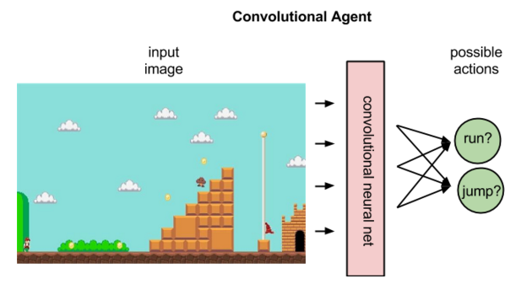
Deep Q-learning: example with neural nets
https://wiki.pathmind.com/deep-reinforcement-learning

Slide 50
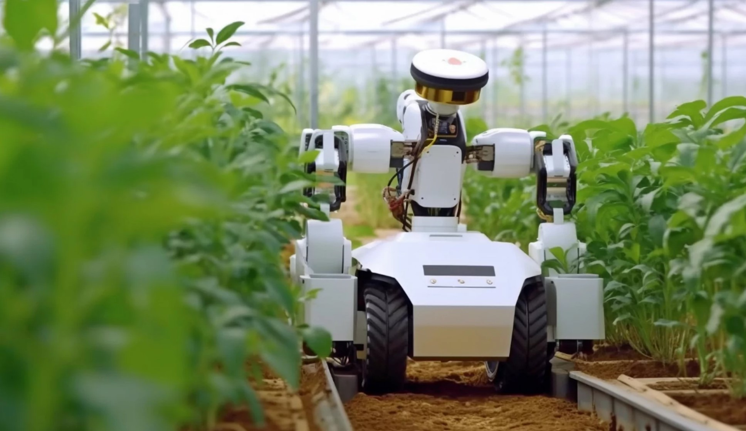
4. Agents in practice
Nitrogen management in winter wheat
Autonomous Greenhouse Challenge
Notes:
I added the two examples

Slide 51
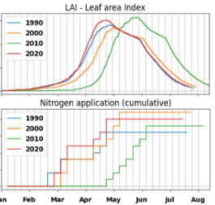
Nitrogen management in winter wheat
RL-agent trained on simulations from crop growth model
Kallenberg, M. G., Overweg, H., van Bree, R., & Athanasiadis, I. N. (2023). Nitrogen management with reinforcement learning and crop growth models. Environmental Data Science, 2, e34.

Slide 52
Nitrogen management in winter wheat
RL-agent adjusts timing and amount to crop status
Cold winter --> Delayed development --> Fertilize later
Dry year --> Reduced expected yield --> Fertilize less
RL-agent closer to optimum than standard practice
Kallenberg, M. G., Overweg, H., van Bree, R., & Athanasiadis, I. N. (2023). Nitrogen management with reinforcement learning and crop growth models. Environmental Data Science, 2, e34.

Slide 53
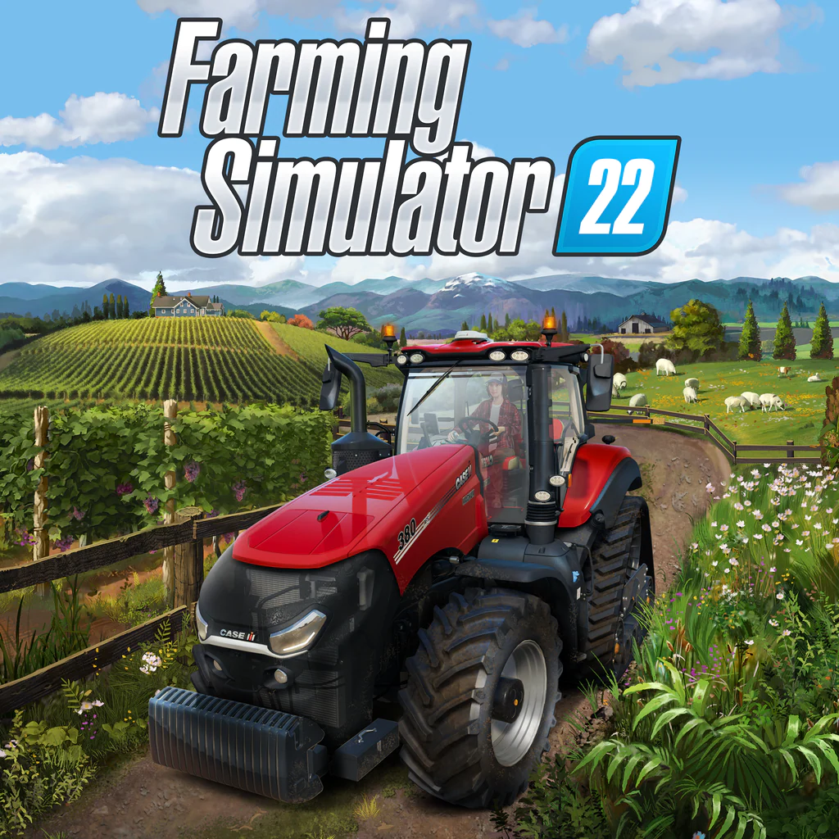
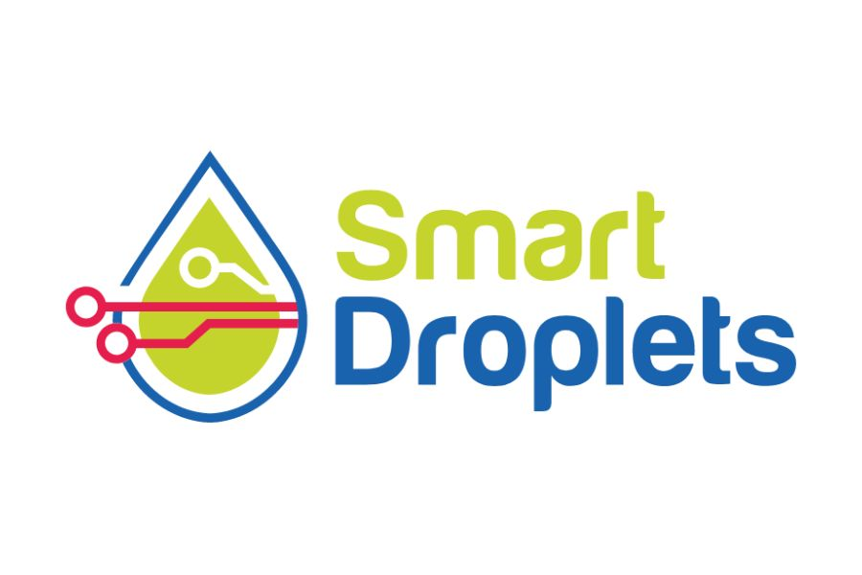
Nitrogen management in winter wheat
Study done in silico (i.e. with synthetic data)
Sim2Real gap:
Crop model may be off (e.g. predicts yield that won’t be realized in practice)
Access to full crop-status not always possible (or noisy)
Pilot study underway to evaluate algorithm in the field

Slide 54
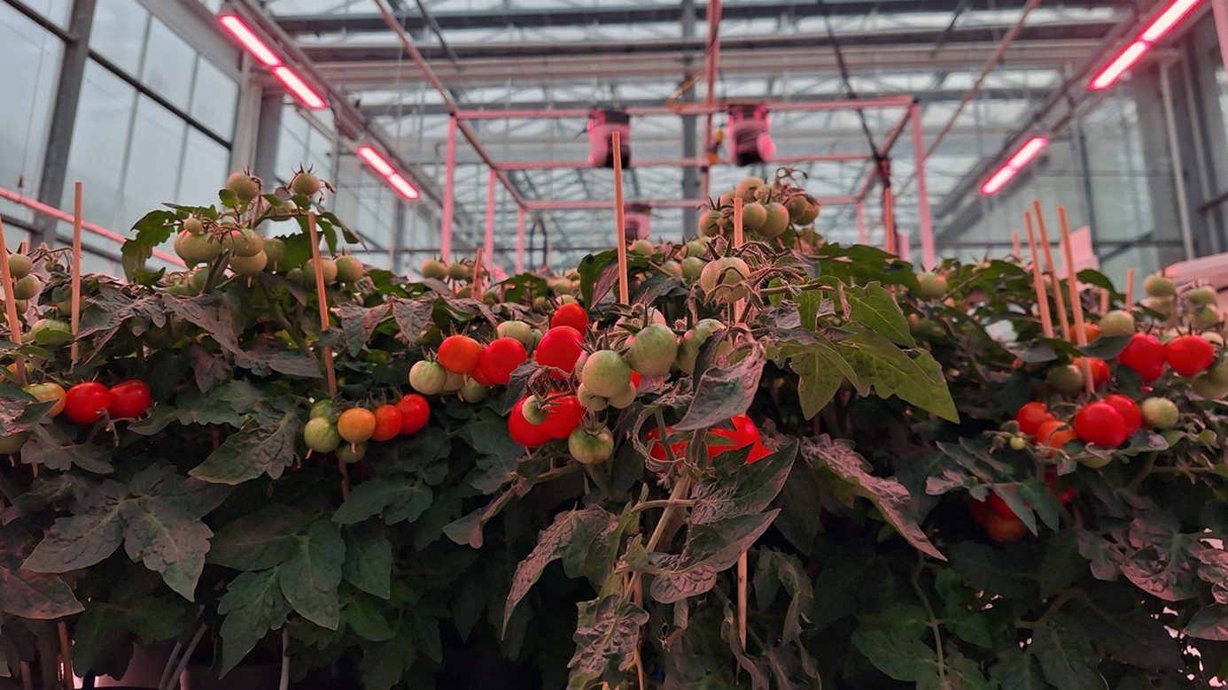
Autonomous Greenhouse Challenge
Maximize net profit of dwarf tomatoes
Actions: control light intensity, CO₂ levels, etc...
RL has been successful in greenhouse climate control
Several teams (presumably) adopted RL-trained agents

Slide 55
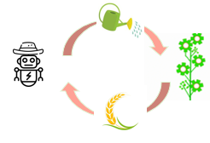
5. Future outlook

Slide 56
Reinforcement Learning and Agent Based Modeling

Slide 57


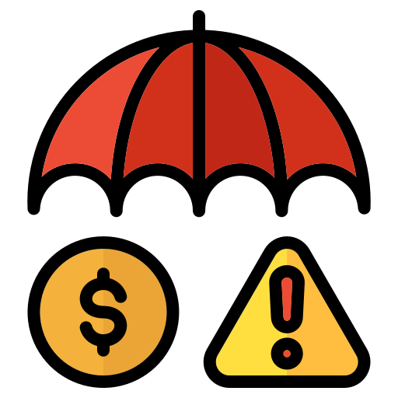
Training diverse set of agents
Agents learn from rewards
By changing reward we change agents
BlablablaBlaEcological farmer: reward for least nitrogen leaching
BlablablaBlaEconomic farmer: reward for highest profit
BlablablaBlaRisk averse farmer: reward for stable income BlablablaBlaacross different weather conditions
In ABM agents policy of agents typically hard-coded
In RL policy is learned in data-driven way

Slide 58
Training multiple agents
Multi-Agent Reinforcement Learning (MARL): emerging and growing field within RL
Complexities beyond Single-Agent RL
MARL involves multiple agents learning simultaneously
Credit assignment: Who contributed most to success in a cooperative setting?

Slide 59
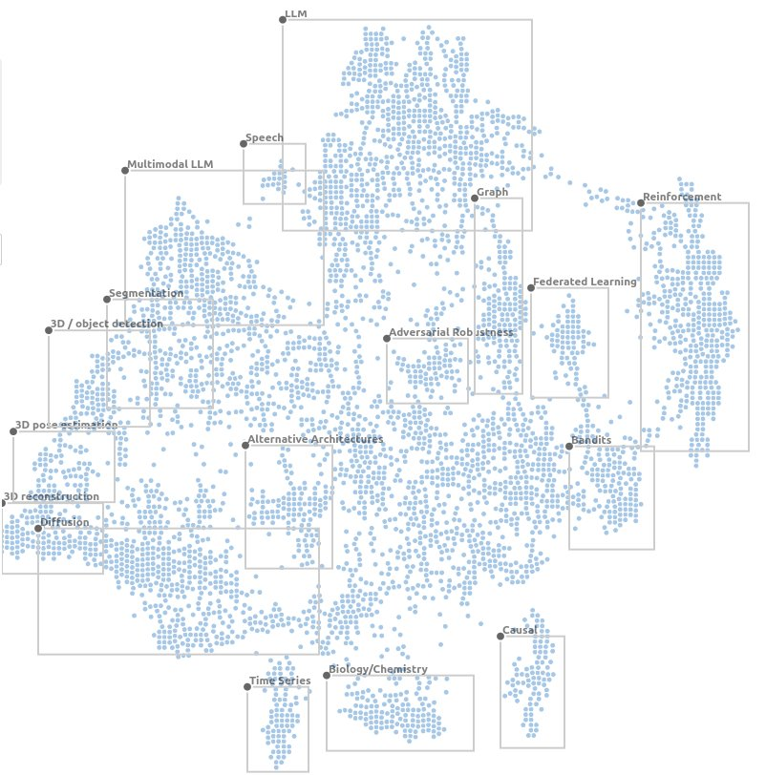
Further outlook

Slide 60
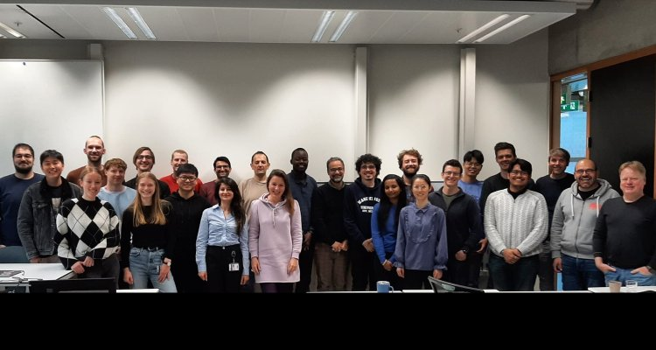
Further outlook
AIN chairgroup: https://www.wur.ai/
FTE40306 Advanced Machine Learning Period 6 afternoon

Slide 61
Reinforcement Learning - training intelligent agents
Thank you!
Michiel Kallenberg
michiel.kallenberg@wur.nl

