Slide 1
Object Detection and
Weeds Identification
Smart Droplets
Borja Espejo-García, PhD

Slide 2
Agenda
13:00 - 13:20: Computer Vision Recap
13:20 - 13:40: Object Detection
13:40 - 13:50: Working with YOLO
13:50 - 14:10: Training YOLO on a Custom Dataset
14:10 - 14:20: Break
14:20 - 14:50: Implementing an Object Detector from scratch
14:50 - 15:00: Questions

Slide 3
Ingredients for building an Object Detector
Machine Learning Model
Convolutional Neural Networks/Transformers
Transfer Learning

Slide 4
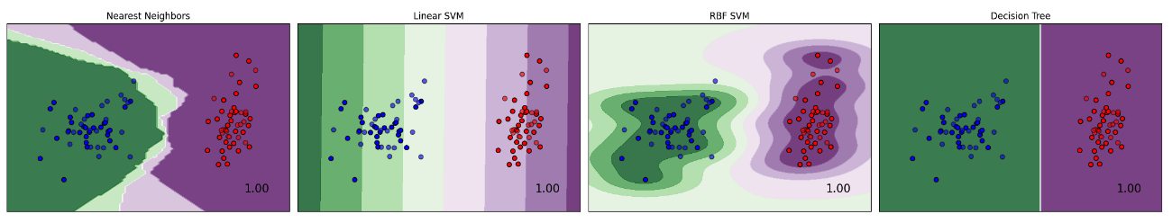
1. Representation
A classifier needs to be described in a language that is computationally interpretable. Selecting a representation for a learner essentially means determining the range of classifiers it can learn: learner's hypothesis space (e.g.: Decision trees, rules, hyper-planes, distances to instances etc.).

Slide 5
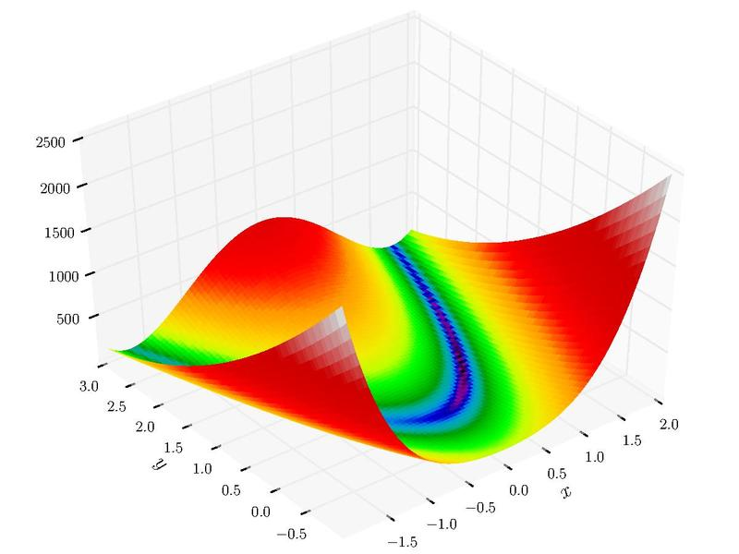
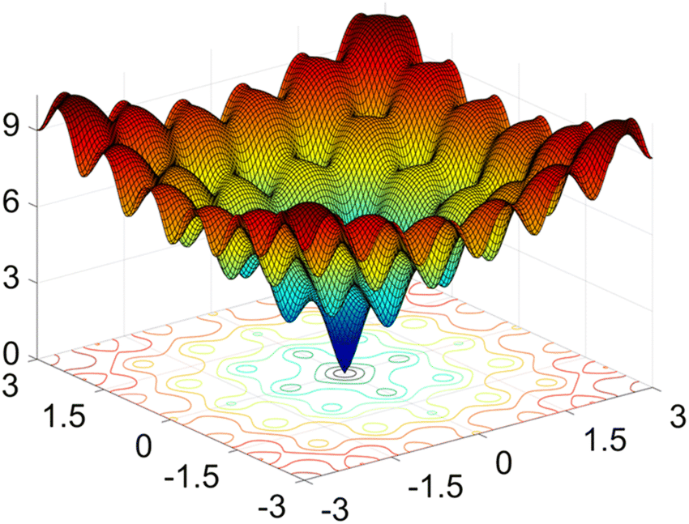
2. Evaluation/Loss function
A loss function is essential to differentiate between effective and ineffective models. To simplify the optimization process, the loss employed within the algorithm might vary from the external one we actually desire the model to optimize.
Examples:
Accuracy
Mean Squared Error
Mean Average Precision
Cross Entropy
Cosine Distance

Slide 6
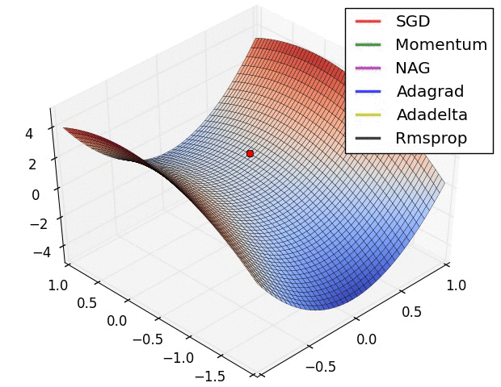
3. Optimization
We need a strategy to find the classifiers in the given representation language to find the one with the highest evaluation score.
Types:
Hill Climbing
Simulated Annealing
Stochastic Gradient Descent
Adam
Genetic Programming
Image Source: https://www.analyticsvidhya.com/blog/2021/10/a-comprehensive-guide-on-deep-learning-optimizers/

Slide 7
Ingredients for building an Object Detector
Machine Learning Model
Convolutional Neural Networks/Transformers
Transfer Learning

Slide 8
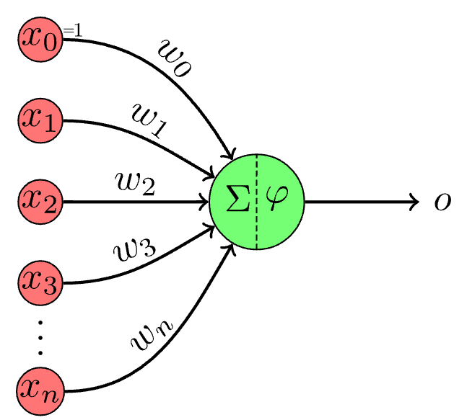
Perceptron: The most basic Neural Network
Neural Network (NN) is a computational model inspired by the way biological neural networks in the human brain work.The process of learning in neural networks typically involves the following:
1. Feedforward: The input is passed through the network, layer by layer, from the input layer to the output layer. Each neuron applies a weighted sum of its input (plus a bias), and an activation function, to produce its output.
2. Loss Calculation: A loss function evaluates the difference between the network’s prediction and the actual target values. It provides a measure of how well the network is performing.
3. Backpropagation: Backpropagation is an algorithm used to minimize the error by adjusting all weights in the network. By computing the gradient of the loss function with respect to each weight by the chain rule, the weights of the network are adjusted to minimize the loss.
4. Iterative Optimization: The process of forward pass, loss calculation, backpropagation, and weight adjustment is iteratively performed, often over multiple epochs (where an epoch is one pass through the full training dataset), to refine the weights and reduce the training error.

Slide 9
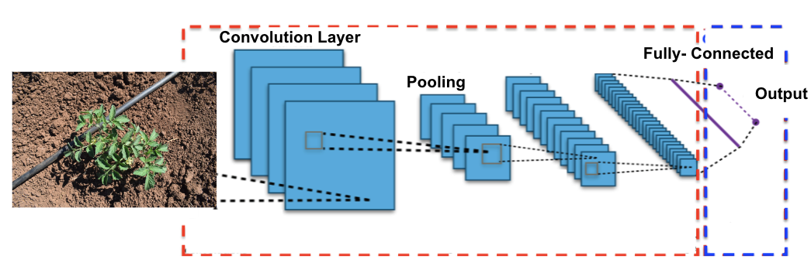
Convolutional Neural Networks (i)
A Convolutional Neural Network (CNN) is a category of neural networks that has proven highly effective for processing grid-like data, such as images. CNNs are specifically designed to automatically and adaptively learn spatial hierarchies of features from input images, which is a crucial advantage in computer vision tasks.
CNNs are designed to process data in a grid-like topology (e.g., image data).
They use convolutional layers to apply convolutional filters (kernels) that detect patterns such as edges, textures, and other features in images.

Slide 10
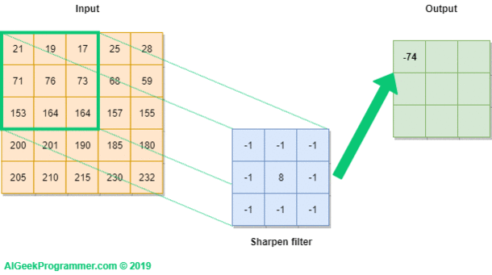
Convolutional Neural Networks (ii)

Slide 11
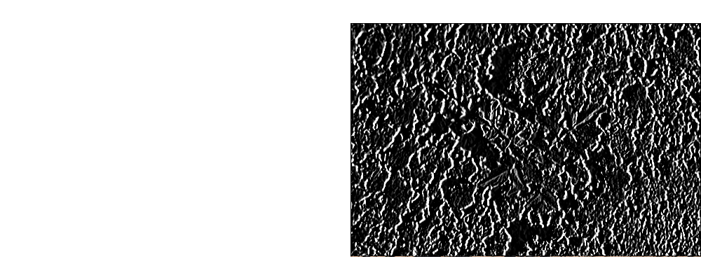
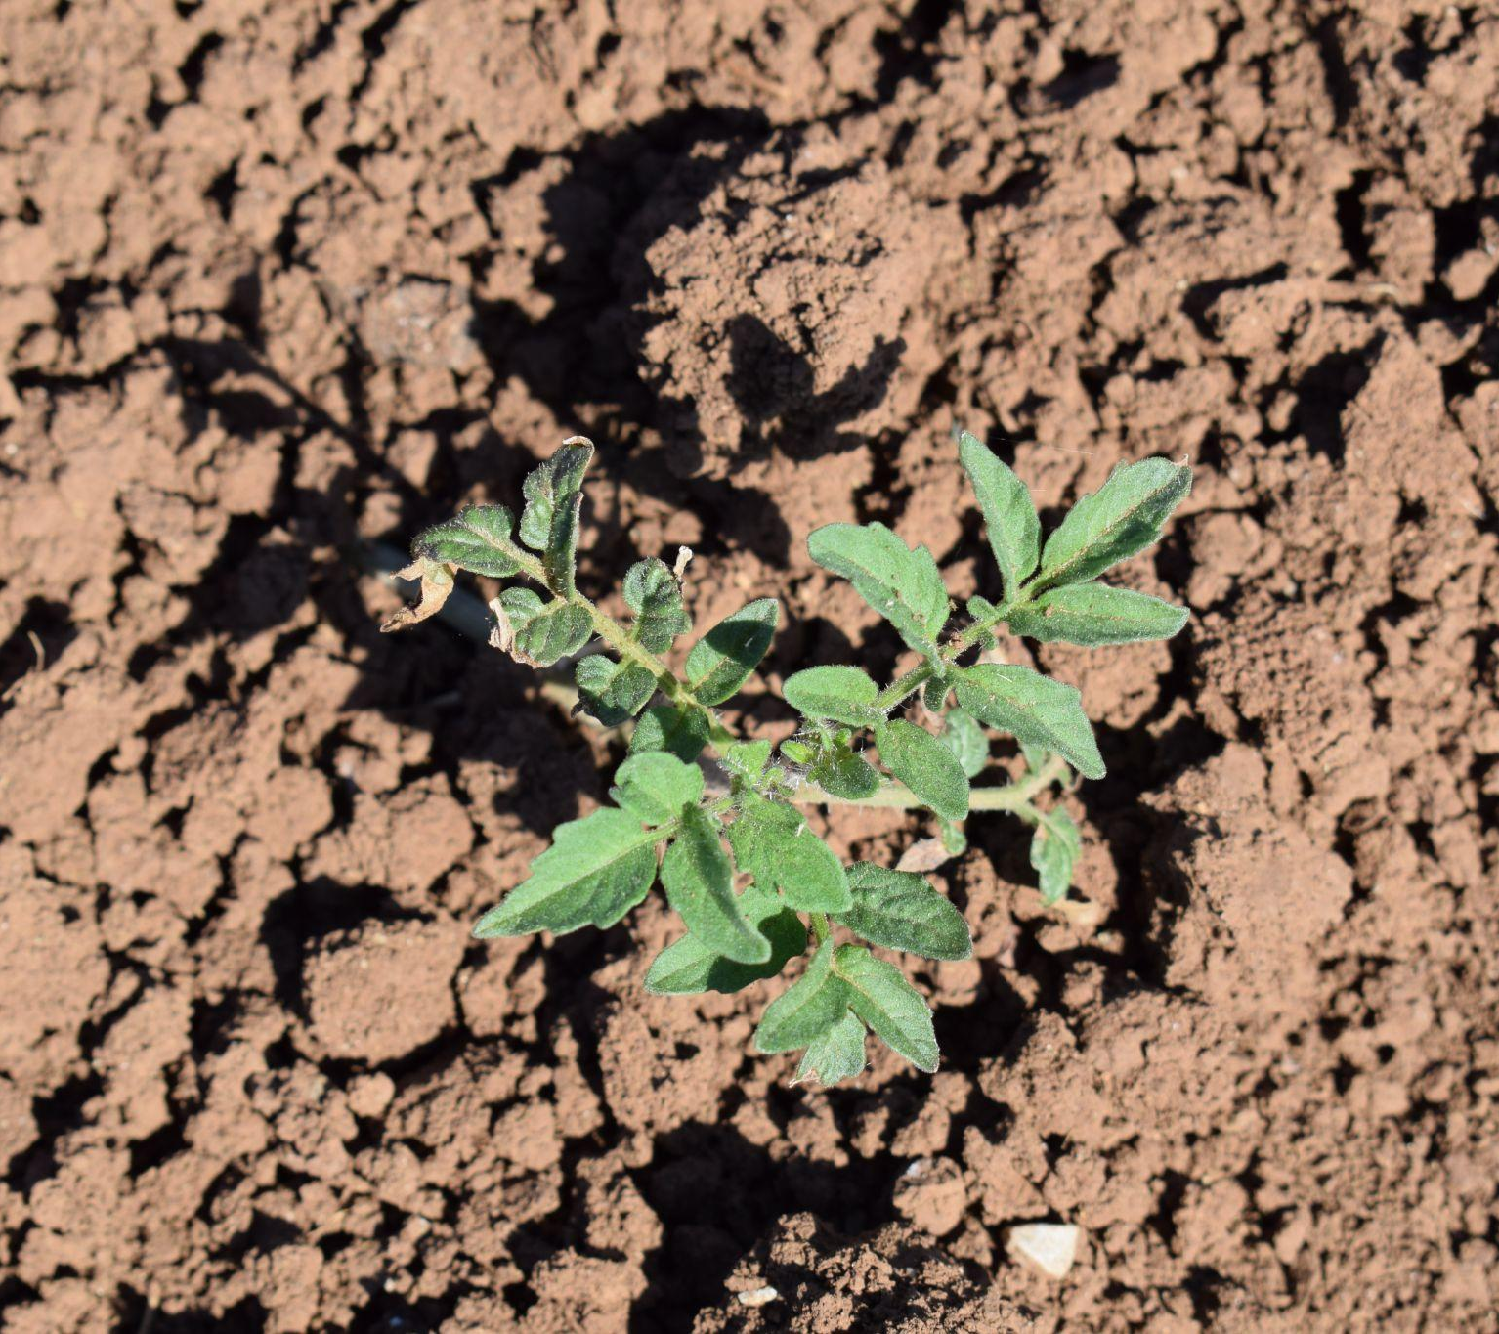
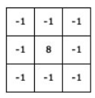
Convolutional Neural Networks (iii)
+
=
https://setosa.io/ev/image-kernels/

Slide 12
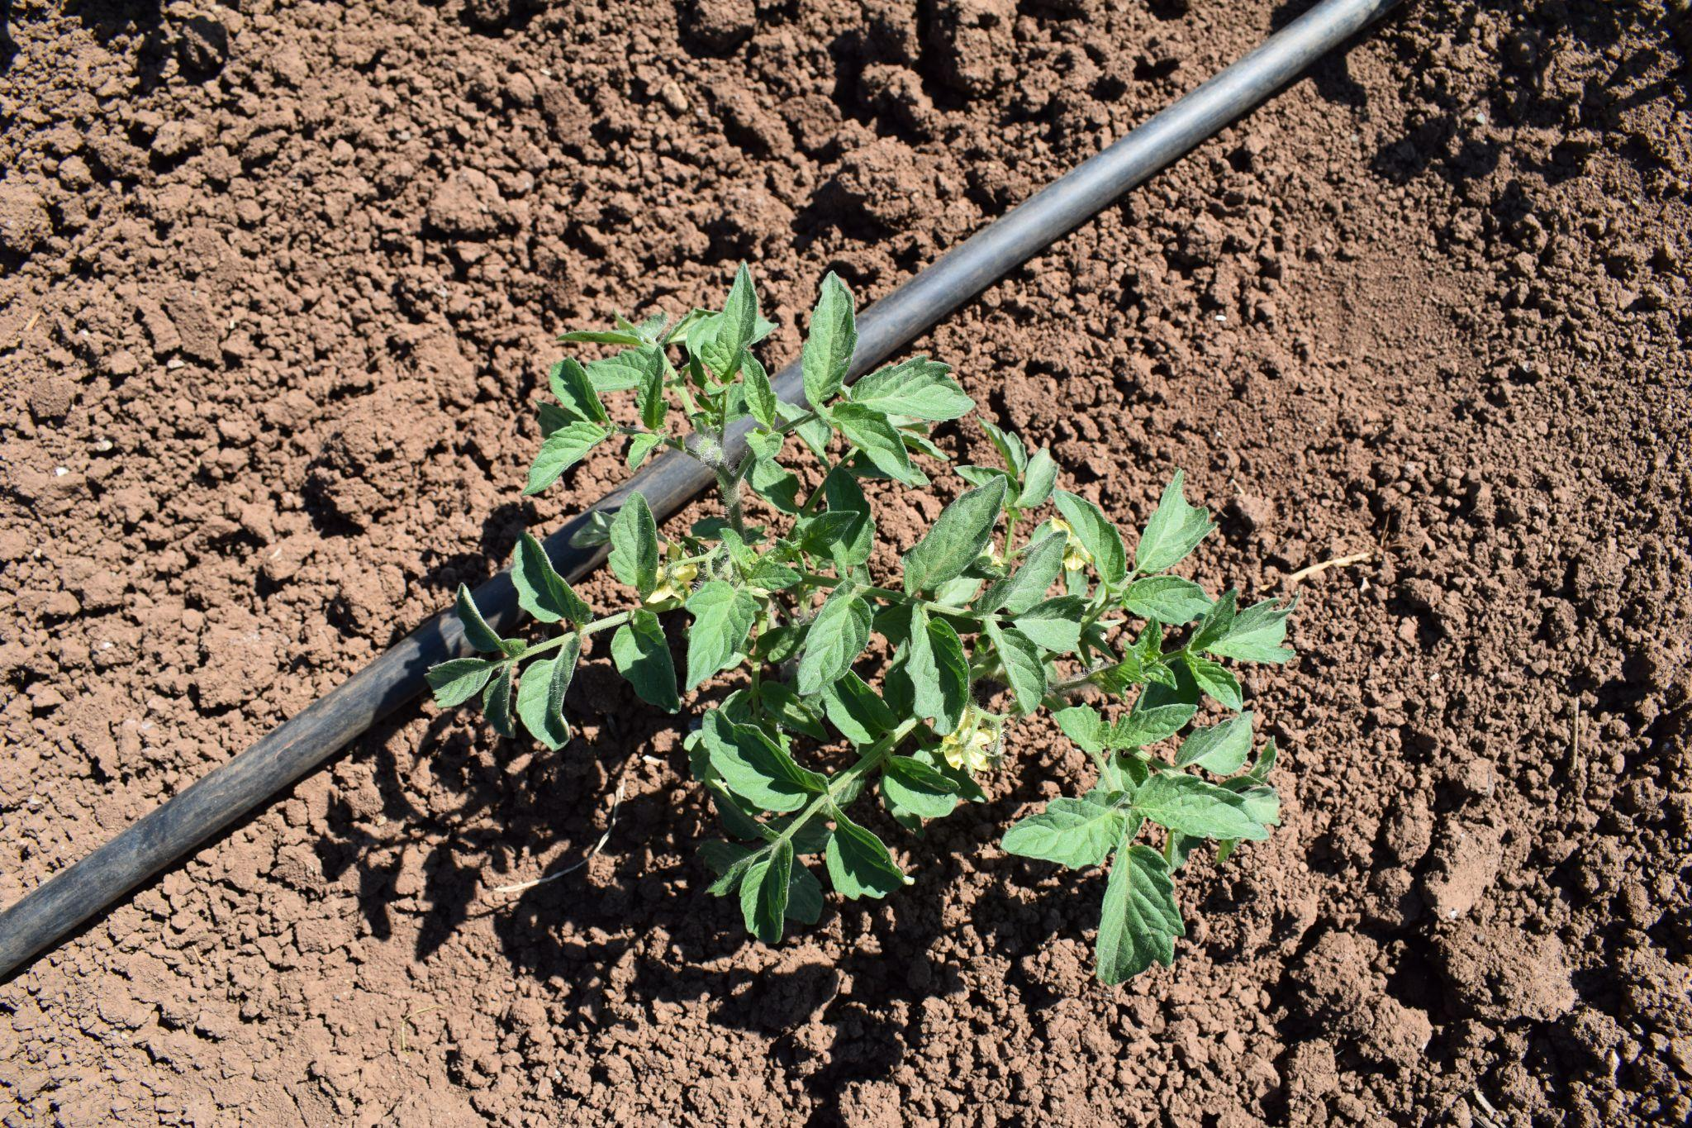
Convolutional Neural Networks (iv)
-1
-1
-1
-1
-1
1
-1
8
-1
-1
3
-1
-1
-1
-1
-1
1
1
-1
-1
-1
1
-1
-1
Tomato
-1
4
-1
-1
2
-1
-1
-1
-1
-1
-1
1
0
-1
0
0
-1
1
-1
2
2
-1
5
-1
-1
-1
3
-1
-1
0
Layer 1
Layer 2

Slide 13
CNNs: Advantages
Local Feature Extraction: Excellent at capturing local dependencies and spatial hierarchies in image data.
Parameter Efficiency: Shared weights in convolutional layers make CNNs more parameter-efficient than fully connected networks.
Translation Invariance: Through pooling layers, they achieve some degree of translation invariance, making them robust to the location of features in the input.
Well-suited for Image Data: Particularly effective for tasks like image classification, object detection, and more.

Slide 14
CNNs: Disadvantages
Limited Contextual Understanding: Struggle with capturing global context or long-range dependencies without very deep architectures.
Fixed-size Input: Typically require a fixed-size input (e.g., images need to be resized).
Invariance Limitation: While translation invariance is a strength, it can be a limitation for tasks where the position of objects is crucial.

Slide 15
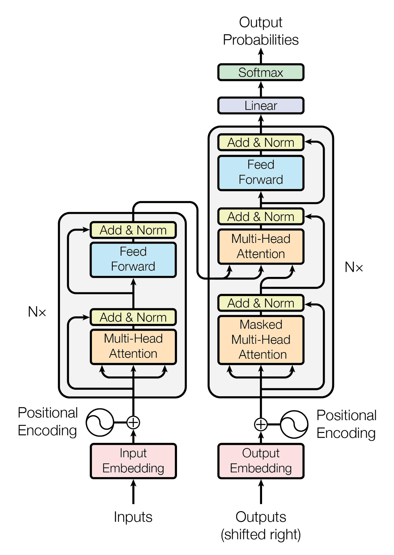
Transformer in a Nutshell
A Transformer is a category of neural networks that has proven highly effective for both natural language (initially) and images (computer vision).
GPT-4
I prefer PyTorch, but my friend prefers Tensorflow
I prefer PyTorch, but my friend prefers Tensorflow
PyTorch
I
my friend
Tensorflow

Slide 16
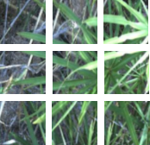
Transformer: Advantages
Global Context: Excel at capturing long-range dependencies and global context, thanks to the self-attention mechanism.
Parallelization: The architecture allows for more parallelization during training than RNNs and some forms of CNNs, speeding up training on large datasets.
State-of-the-Art Performance: In both NLP and Computer Vision, Transformers have set new benchmarks in various tasks.

Slide 17
Transformer: Disadvantages
Computational Intensity: The self-attention mechanism can be computationally intensive, especially for long sequences.
Data Hungry: Typically require large amounts of training data to perform well.
Lack of Inductive Biases: Unlike CNNs, they do not have built-in assumptions about data (like spatial hierarchies), which can be a downside for certain types of structured data.

Slide 18
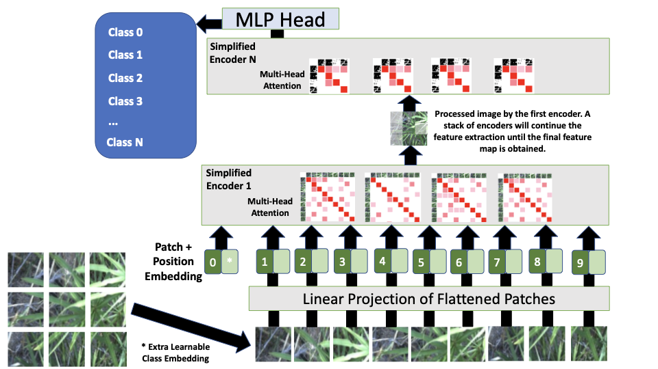

Slide 19
Ingredients for building an Object Detector
Machine Learning Model
Convolutional Neural Networks/Transformers
Transfer Learning

Slide 20



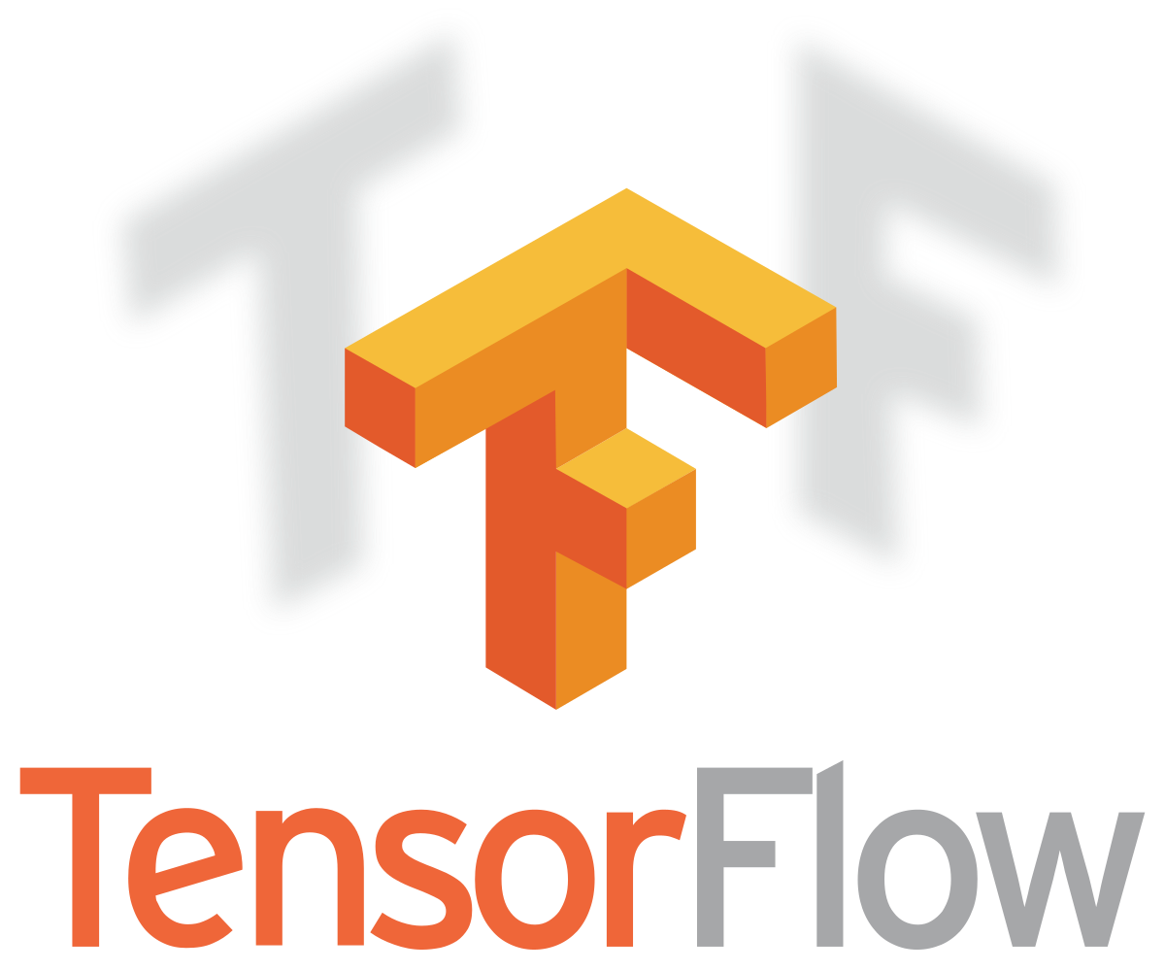

Transfer Learning: Concept
Transfer learning is a technique in the field of deep learning that involves taking a pre-trained neural network and adapting it to a new, but similar, problem.Essentially, it leverages the knowledge a model has learned from one task to improve learning in another task.
This approach is particularly beneficial when you have a limited amount of data for the new task or when training a large model from scratch is computationally expensive.

Slide 21
Transfer Learning: How it works
Pre-Trained Model: Transfer learning typically begins with a model that has been pre-trained on a large dataset. The pre-trained model has already learned to identify certain features (like edges, textures, etc., in the case of images). These learned features can be relevant to new but similar problems. Strategies:
Feature Extractor: Use the pre-trained model as a feature extractor. The final layers of the model are replaced with new ones tailored to the new task, and only these new layers are trained.
Fine-Tuning Pre-Trained Layers: After replacing the final layers, you can continue training (fine-tuning) some or all of the pre-trained layers along with the new layers to slightly adjust its learned features.

Slide 22

Transfer Learning: How it works with CNNs
-1
-1
-1
-1
-1
1
-1
8
-1
-1
3
-1
-1
-1
-1
-1
1
1
-1
-1
-1
1
-1
-1
Cat
-1
4
-1
-1
2
-1
-1
-1
-1
-1
-1
1
0
-1
0
0
-1
1
-1
2
2
-1
5
-1
-1
-1
3
-1
-1
0
Layer 1
Layer 2

Slide 23
Transfer Learning: How it works with CNNs
-1
-1
-1
0
1
0
-1
8
-1
0
3
-1
-1
-1
-1
-1
1
0
-1
-1
-1
1
-1
-1
Tomato
-1
4
-1
-1
2
-1
-1
-1
-1
-1
-1
1
3
-1
0
0
-1
2
-1
4
2
-3
1
-1
0
-1
3
1
-1
4
Layer 1
Layer 2

Slide 24
Transfer Learning: Advantages
Efficiency: It is much faster and more efficient as it eliminates the need to train a model from scratch.
Less Data Required: Transfer learning can be particularly useful when you have a limited amount of data for the new task. The pre-trained model brings knowledge that can help even with a small dataset.
Improved Performance: Models initialized with pre-trained weights often perform better than those trained from scratch, especially when data for the new task is limited.
Flexibility: It offers a flexible framework to work with, as it allows for the adaptation of pre-trained models to a wide range of tasks. Applied on Computer Vision, Natural Language Processing, etc.

Slide 25
Transfer Learning: Limitations
Task Relevance: The effectiveness of transfer learning depends on the relevance of the features learned in the pre-training task to the new task.
Model Complexity: Fine-tuning large pre-trained models requires careful handling to avoid overfitting, especially when the new dataset is small.
Domain Shift: If the new task is very different from the task used in pre-training, transfer learning might be less effective.

Slide 26
Object Detection: Introduction
It involves the ability of a computer to locate and recognize objects within an image or video frame.
Object detection is more complex than image classification (which categorizes an entire image) because it requires the detection of multiple objects within a single image and the precise localization of each object.
Classification
Object Detection
Tomato
Tomato

Slide 27
Object Detection: Core Concepts
Bounding Boxes: The most common approach to locate objects in an image is through bounding boxes. These boxes define the coordinates of the object within the image.
Class Labels: Each detected object is typically categorized into a class (e.g., apple, rumex, tomato) based on its features.
Detection Frameworks: Several frameworks and models are popular for object detection tasks, such as R-CNN (Region-based Convolutional Neural Networks), YOLO (You Only Look Once), and SSD (Single Shot MultiBox Detector).

Slide 28
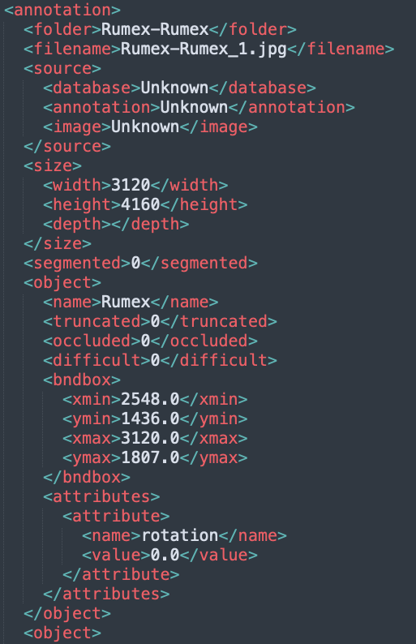
Object Detection: Annotation Formats (i)
Object detection requires annotated datasets where each object in an image is labeled with a bounding box and a class label. There are several annotation formats used in object detection, each with its unique way of representing this information.
PASCAL VOC Format: XML-Based: Annotations are stored in XML files, each corresponding to an image. Includes filename, size of the image, object class, and bounding box coordinates (xmin, ymin, xmax, ymax) which represent the top-left and bottom-right points of the rectangle enclosing the object.

Slide 29
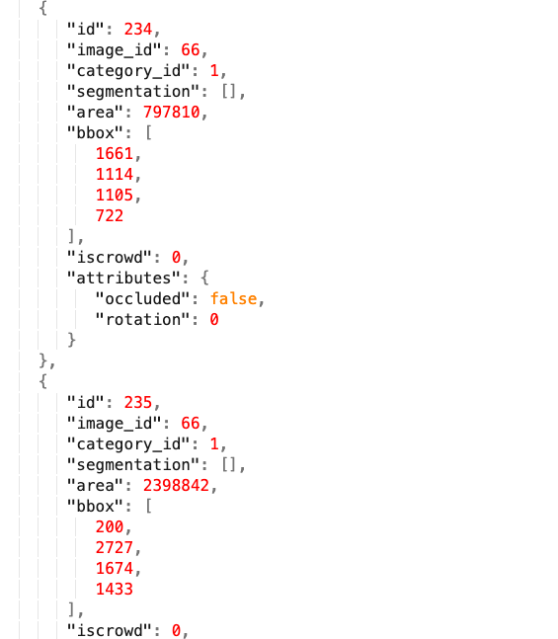
Object Detection: Annotation Formats (ii)
COCO Format: Annotations are stored in a JSON file for the entire dataset. Contains information about images, annotations (object instances), and categories. Each object instance includes an image ID, category ID, and bounding box details. Bounding boxes in COCO are defined by the top-left corner of the rectangle and its width and height (x, y, width, height).

Slide 30

Object Detection: Annotation Formats (iii)
YOLO Format: Each image has a corresponding text file with the same filename. Each line in the text file corresponds to one object and contains the class index and normalized bounding box coordinates (center x, center y, width, height). The coordinates are relative to the size of the image and are in the range [0, 1]. Primarily used with the YOLO (You Only Look Once) object detection model.

Slide 31
Object Detection: Key Stages (i)
Feature Extraction: Initially, the system extracts features from the input image using convolutional neural networks (CNNs). These features help the model understand various aspects of the image.
Region Proposal: Some methods, like R-CNN, use a region proposal step to identify areas that might contain objects.
Classification and Localization: The system classifies each proposed region into various classes and localizes the object using bounding boxes.
Non-Maximum Suppression: This is a technique used to refine the bounding boxes and reduce the number of overlapping boxes.

Slide 32
Object Detection: Key Stages (ii)
Non-Maximum Suppression:
0.5
0.8
0.8
0.3
Sort the bounding boxes according to their confidence scores.
Select the bounding box with the highest confidence score.
Remove all the bounding boxes that have a high overlap with the bounding box selected in step 2. The amount of overlap is typically determined by a predefined threshold value.
Repeat steps 2 and 3.

Slide 33
Object Detection: Evaluation (i)
Intersection over Union (IoU): It is used to measure the overlap between the predicted bounding box and the ground truth bounding box.
IOU =
>

Slide 34
Object Detection: Evaluation (ii)
Mean Average Precision (mAP):
Precision: It is the ratio of correctly predicted positive observations to the total predicted positives.
Recall: It is the ratio of correctly predicted positive observations to all observations in actual class.
Average Precision (AP): For each class, AP is calculated by plotting a precision-recall curve, which shows the trade-off between precision and recall for different thresholds. AP is the area under this curve.
Mean Average Precision (mAP): This is the mean of the AP over all classes or over a specific range of object sizes (like small, medium, or large objects).

Slide 35
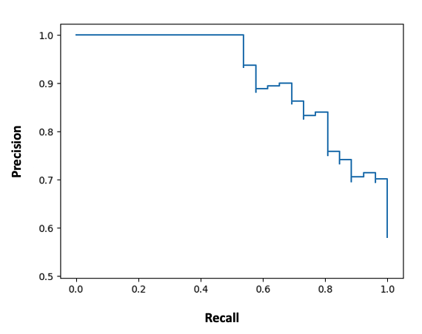
Object Detection: Evaluation (iii)
Thresholds: The precision-recall curve can change significantly based on the IoU threshold. A common practice is to evaluate AP at different IoU thresholds (e.g., 0.5, 0.75, or averaged over 0.5 to 0.95 with a step size of 0.05).
@0.5
Threshold 1
Threshold 2
Threshold 3
@0.95
Threshold N

Slide 36
Object Detection: Evaluation (iv)
Evaluation Protocols:
COCO mAP: The COCO dataset uses an average mAP calculated over multiple IoU thresholds (from 0.5 to 0.95). This gives a more comprehensive understanding of the model's performance.
PASCAL VOC mAP: Earlier versions of the PASCAL VOC challenge used a single IoU threshold of 0.5 to calculate mAP, making it less strict compared to the COCO evaluation.

Slide 37
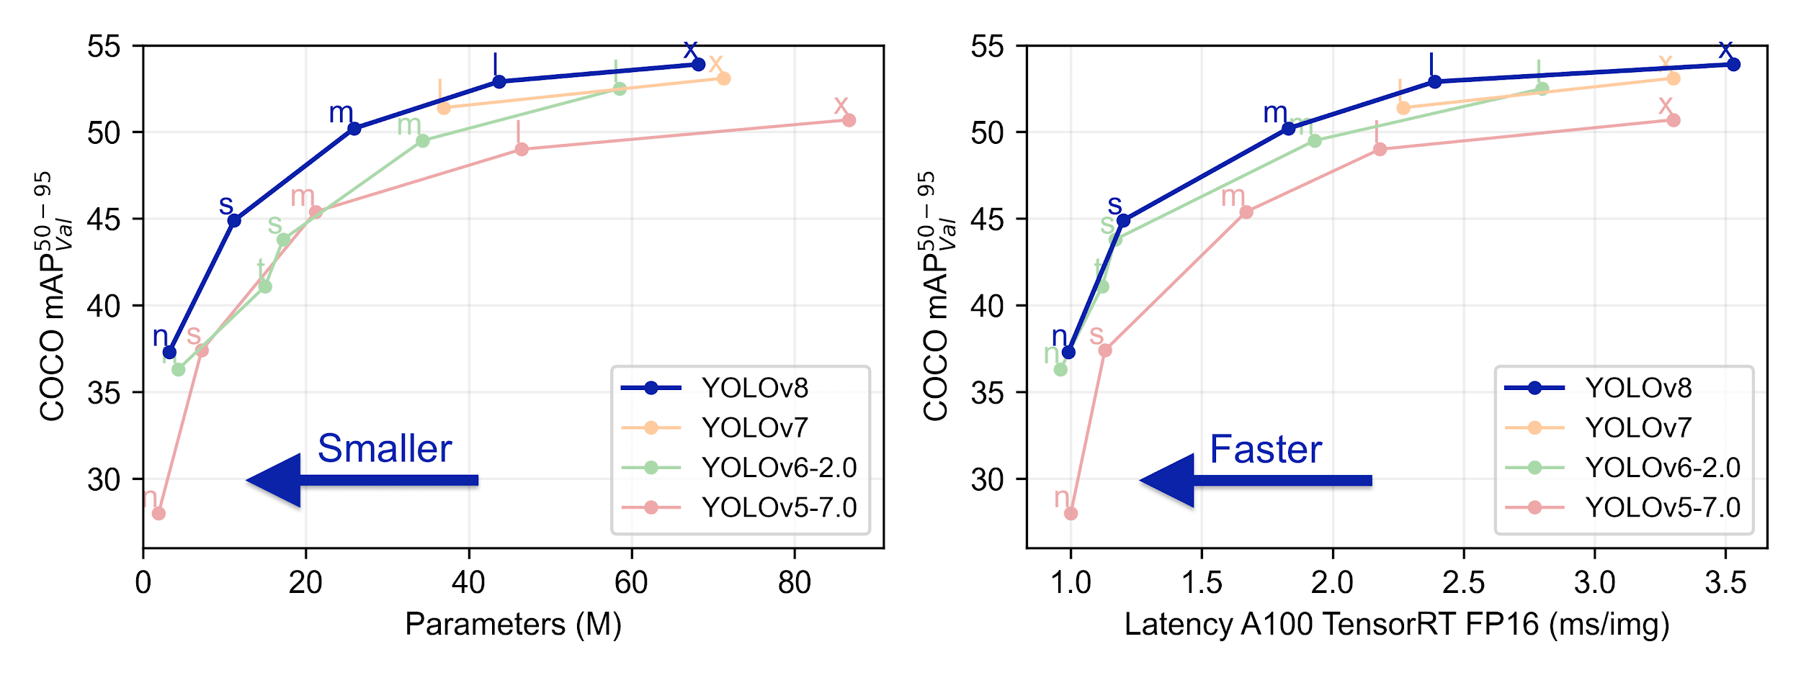
Object Detection: Evaluation (v)
Benchmarking:
Source: https://github.com/ultralytics/yolov5#yolov8--new

Slide 38
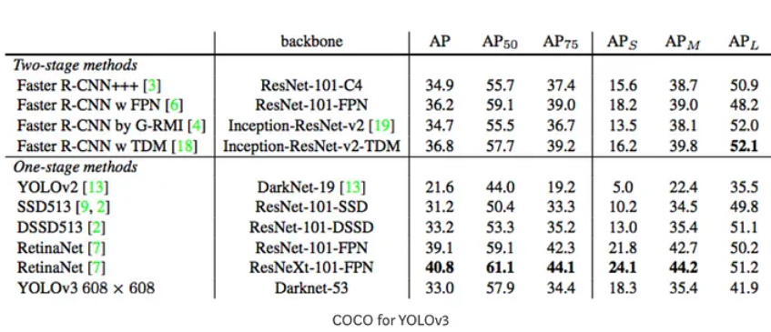
Object Detection: Evaluation (vi)
Benchmarking:
Source: https://pjreddie.com/media/files/papers/YOLOv3.pdf

Slide 39
Object Detection: Two-stage Object Detectors (i)
Stages:
First Stage - Region Proposal: The first stage involves generating potential bounding boxes or "region proposals" where there might be objects. This is typically done using a Region Proposal Network (RPN) or similar mechanisms.
Second Stage - Classification and Refinement: In the second stage, these proposed regions are analyzed to determine what object (if any) is in them, and the bounding boxes are refined for better accuracy. This involves both classification (what object is in this box?) and localization (precisely where in this box is the object?).
Examples: Prominent examples of two-stage detectors include R-CNN, Fast R-CNN, and Faster R-CNN.

Slide 40
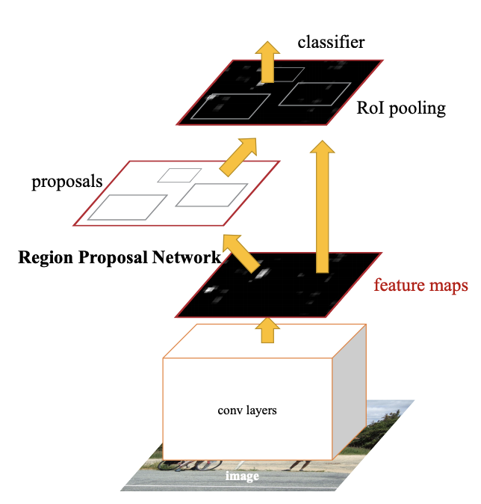
Object Detection: Two-stage Object Detectors (ii)
Faster R-CNN (successor of R-CNN and Fast R-CNN):
Image Source: https://paperswithcode.com/method/faster-r-cnn

Slide 41
Object Detection: Two-stage Object Detectors (iii)
Characteristics:
Accuracy: Generally, two-stage detectors are more accurate as they have a dedicated step for proposing regions and another for fine-tuning those proposals.
Speed: They are slower compared to single-stage detectors due to the two-step process.
Use Cases: Ideal for scenarios where accuracy is more critical than speed, such as medical imaging.
Zoo: https://github.com/tensorflow/models/blob/master/research/object_detection/g3doc/tf2_detection_zoo.md

Slide 42
Object Detection: One-stage Object Detectors (i)
Direct Prediction: One-stage detectors skip the region proposal step and directly predict the bounding boxes and class probabilities in one go. They treat object detection as a simple regression problem, predicting the coordinates of bounding boxes and class probabilities for each box.
Examples: YOLO (You Only Look Once) and SSD (Single Shot Detector).

Slide 43
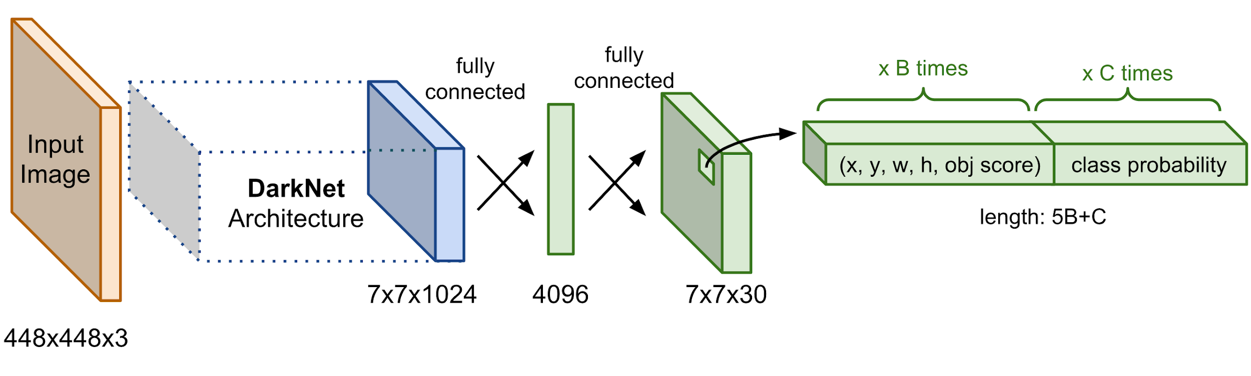
Object Detection: Single-stage Object Detectors (ii)
YOLO:
The YOLO model is made up of three key components: the head, neck, and backbone. The backbone is the part of the network made up of convolutional layers to detect key features of an image and process them. The neck uses the features from the convolution layers in the backbone with fully connected layers to make predictions on probabilities and bounding box coordinates. The head is the final output layer of the network which can be interchanged with other layers with the same input shape for transfer learning.
Image Source: https://lilianweng.github.io/posts/2018-12-27-object-recognition-part-4/

Slide 44
Object Detection: One-stage Object Detectors (iii)
Characteristics:
Speed: They are faster as they eliminate the separate region proposal stage, making them suitable for real-time object detection tasks.
Accuracy: While they have improved significantly, single-stage detectors historically lag slightly behind two-stage detectors in terms of accuracy, especially in detecting small objects.
Use Cases: Ideal for applications requiring real-time detection, like video surveillance and autonomous vehicles.

Slide 45
Object Detection: Challenges
Accuracy vs. Speed: Achieving a balance between detection accuracy and the speed of processing is a significant challenge, especially for real-time applications.
Small Object Detection: Detecting small or partially obscured objects remains a difficult task.
Dataset Diversity and Bias: The performance of object detection systems can be limited by the diversity and quality of the training datasets.

Slide 46
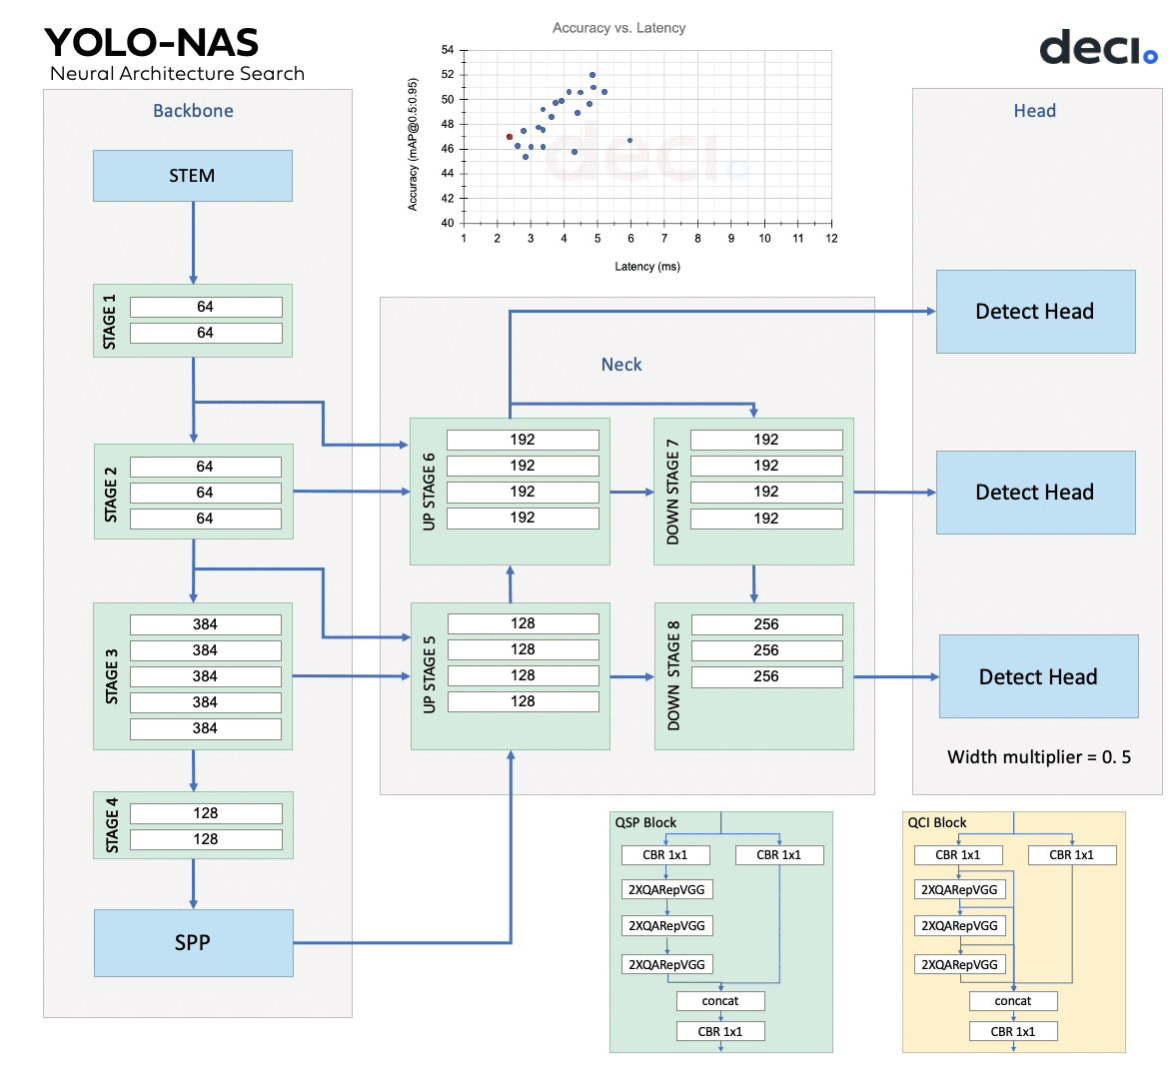
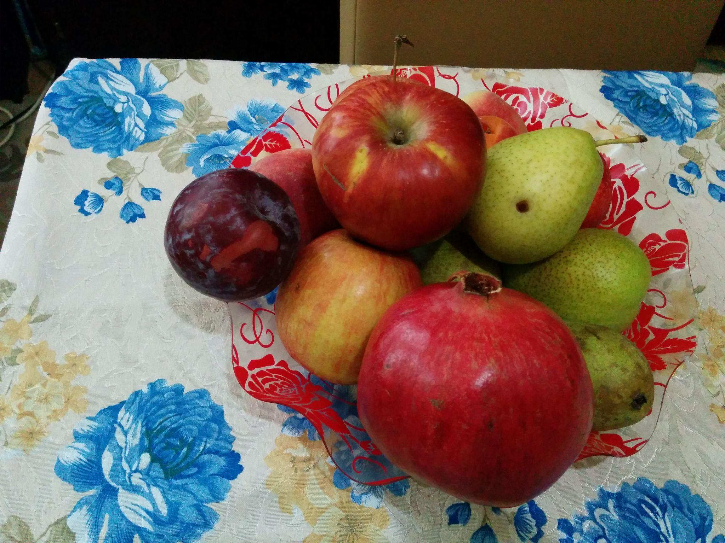
Exercise I: Object Detection with YOLO-NAS
Dataset Source:
https://www.kaggle.com/datasets/moltean/fruits

Slide 47
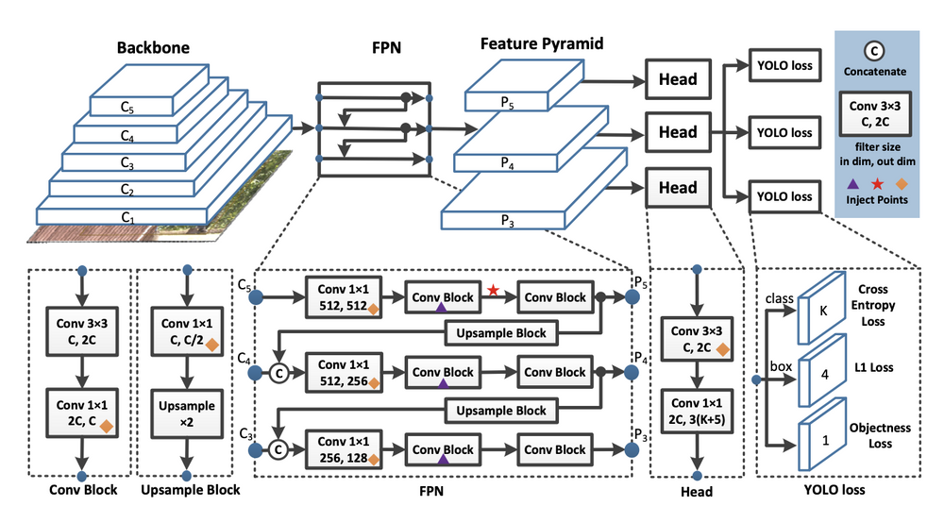
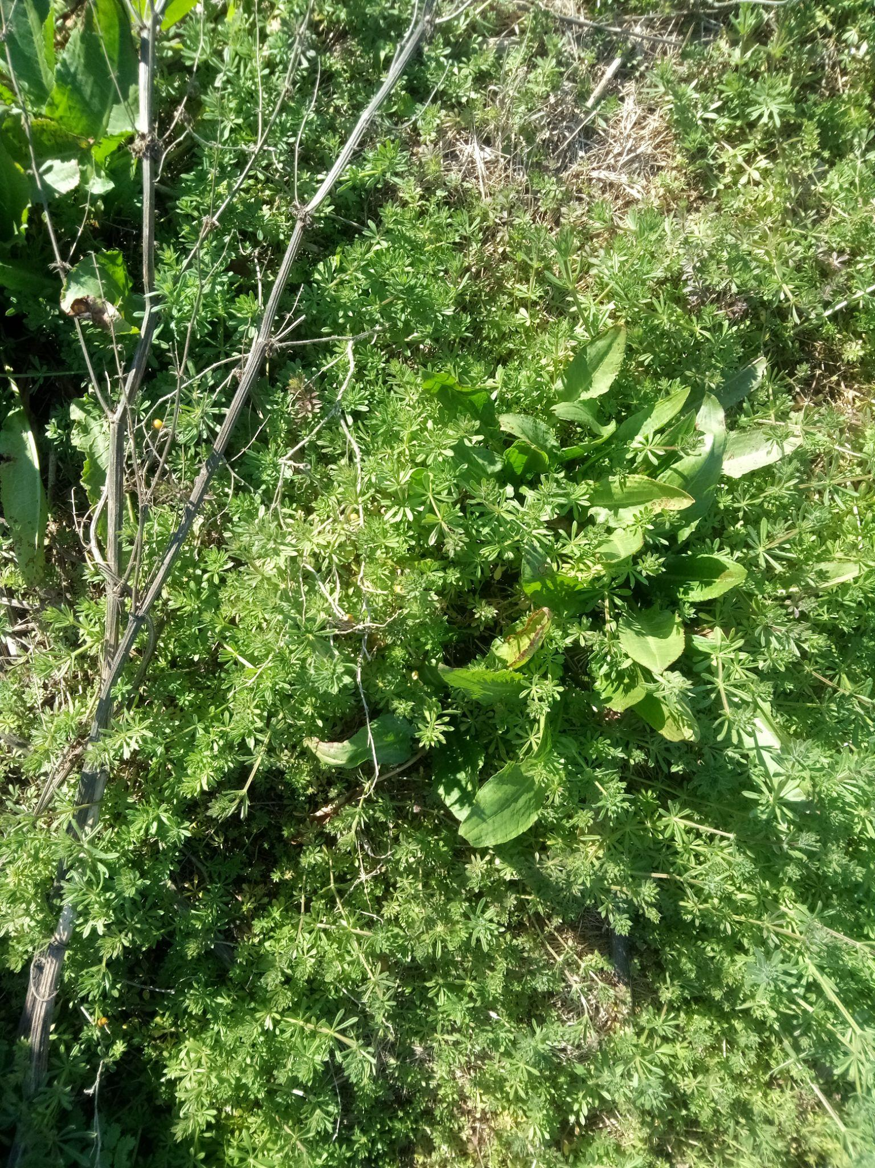

Exercise II: Fine-Tuning PP-YOLO for Weed Identification
Image Source: https://arxiv.org/pdf/2007.12099.pdf
Dataset Source: https://edenlibrary.ai/product/rumex-rumex-obtusifolius-healthy-prx-rgb-na-20210303/

Slide 48
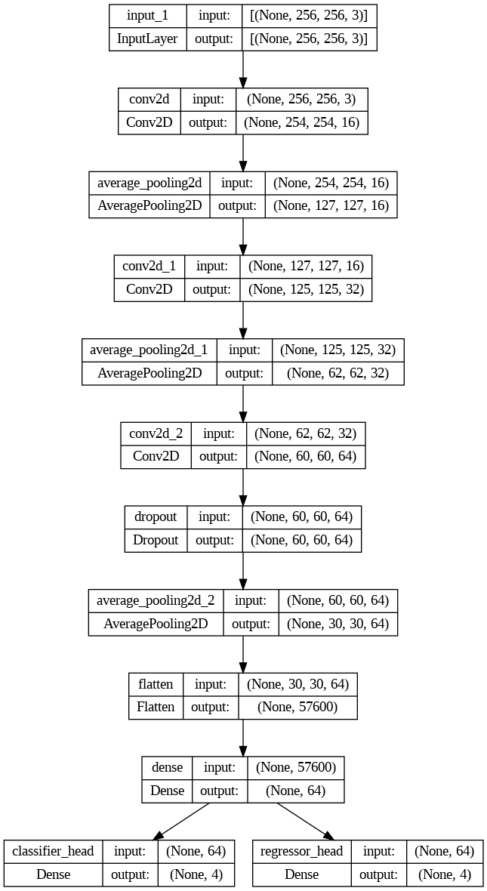
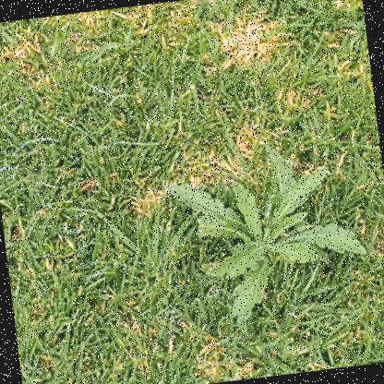

Exercise III: Object Detector from Scratch (Weed Identification)
Dataset source:
https://universe.roboflow.com/russ-hall/weeds-pub-plus

Slide 49
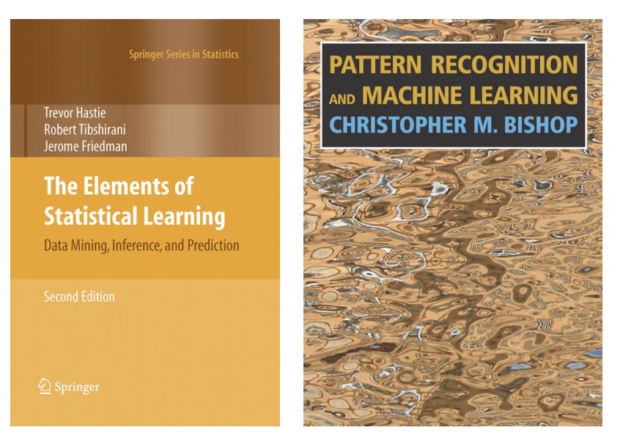
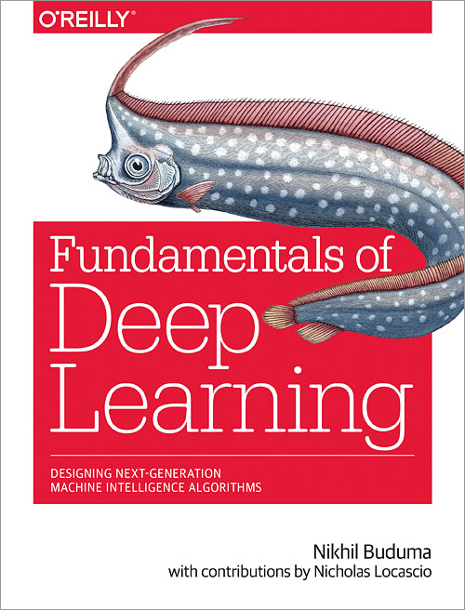
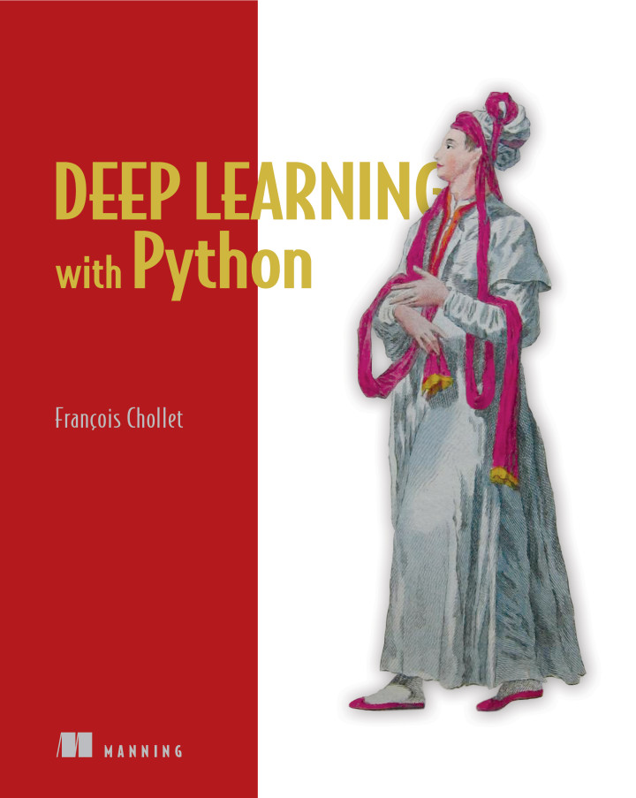
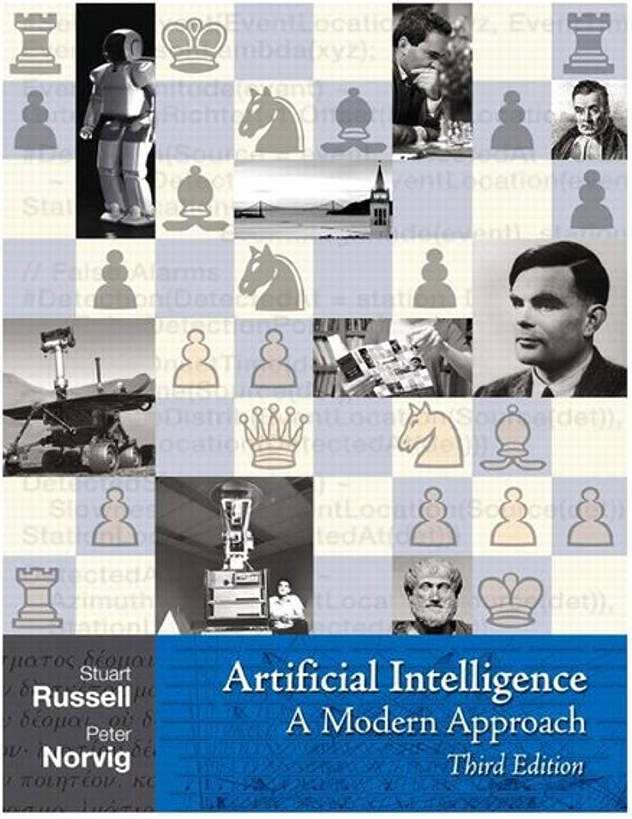
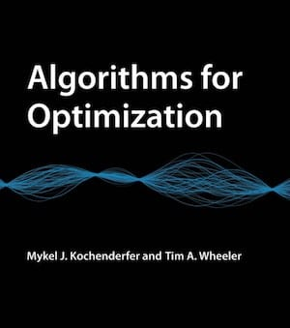
Bibliography

