Slide 1
Improving Performance: Advanced Computer Vision Techniques
Smart Droplets
Borja Espejo-García, PhD

Slide 2
Agenda
13:00 - 13:20: Computer Vision Recap
13:20 - 13:40: SOTA Techniques
13:40 - 14:00: Knowledge Distillation
14:00 - 14:10: Break
14:10 - 14:50: Foundation Models: From CLIP to DINOv2.
14:50 - 15:00: Questions

Slide 3
Ingredients for building an Object Detector
Machine Learning Model
Convolutional Neural Networks/Transformers
Transfer Learning

Slide 4
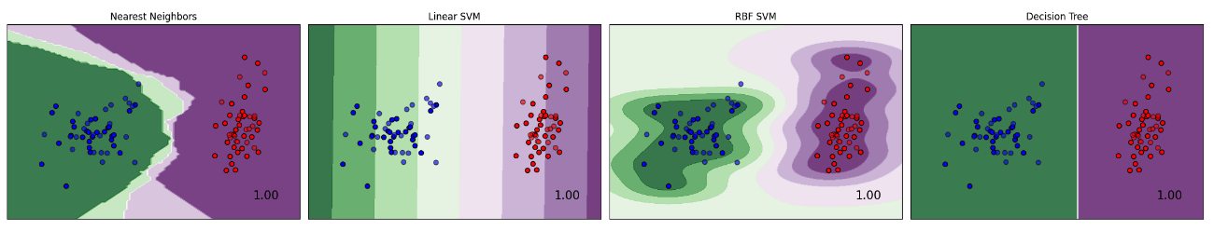
1. Representation
A classifier needs to be described in a language that is computationally interpretable. Selecting a representation for a learner essentially means determining the range of classifiers it can learn: learner's hypothesis space (e.g.: Decision trees, rules, hyper-planes, distances to instances etc.).

Slide 5
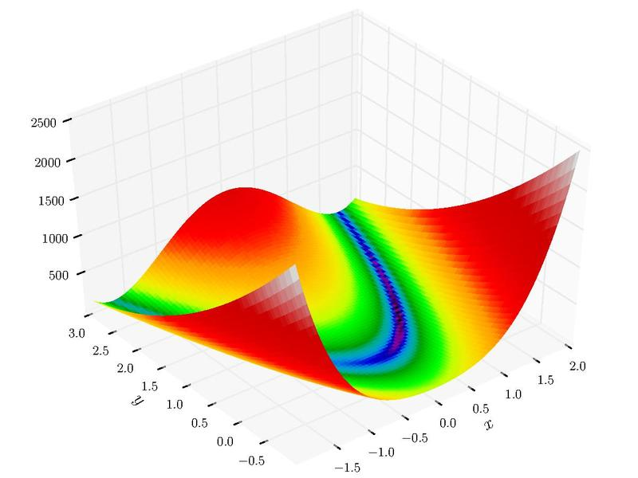
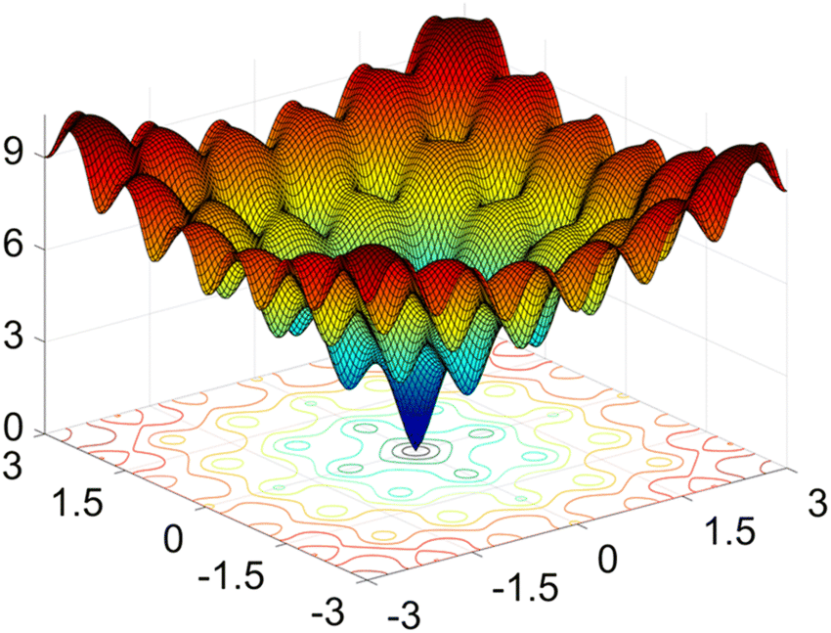
2. Evaluation/Loss function
A loss function is essential to differentiate between effective and ineffective models. To simplify the optimization process, the loss employed within the algorithm might vary from the external one we actually desire the model to optimize.
Examples:
Accuracy
Mean Squared Error
Mean Average Precision
Cross Entropy
Cosine Distance

Slide 6
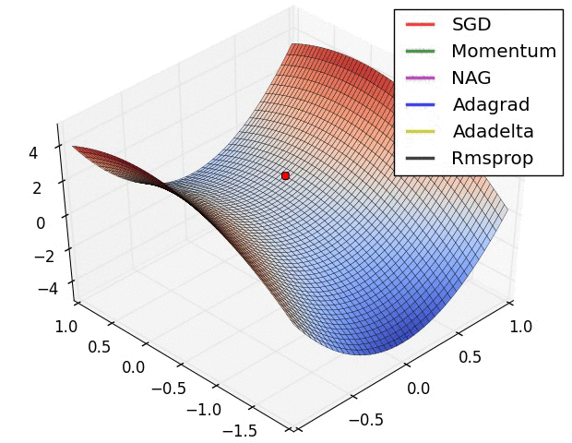
3. Optimization
We need a strategy to find the classifiers in the given representation language to find the one with the highest evaluation score.
Types:
Hill Climbing
Simulated Annealing
Stochastic Gradient Descent
Adam
Genetic Programming
Image Source: https://www.analyticsvidhya.com/blog/2021/10/a-comprehensive-guide-on-deep-learning-optimizers/

Slide 7
Ingredients for building an Object Detector
Machine Learning Model
Convolutional Neural Networks/Transformers
Transfer Learning

Slide 8
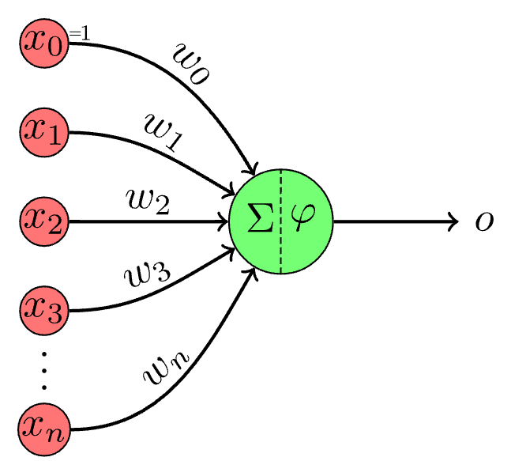
Perceptron: The most basic Neural Network
Neural Network (NN) is a computational model inspired by the way biological neural networks in the human brain work.The process of learning in neural networks typically involves the following:
1. Feedforward: The input is passed through the network, layer by layer, from the input layer to the output layer. Each neuron applies a weighted sum of its input (plus a bias), and an activation function, to produce its output.
2. Loss Calculation: A loss function evaluates the difference between the network’s prediction and the actual target values. It provides a measure of how well the network is performing.
3. Backpropagation: Backpropagation is an algorithm used to minimize the error by adjusting all weights in the network. By computing the gradient of the loss function with respect to each weight by the chain rule, the weights of the network are adjusted to minimize the loss.
4. Iterative Optimization: The process of forward pass, loss calculation, backpropagation, and weight adjustment is iteratively performed, often over multiple epochs (where an epoch is one pass through the full training dataset), to refine the weights and reduce the training error.

Slide 9
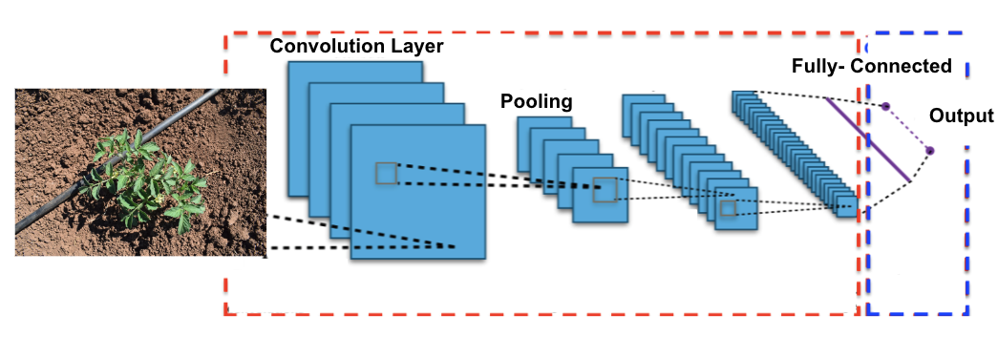
Convolutional Neural Networks (i)
A Convolutional Neural Network (CNN) is a category of neural networks that has proven highly effective for processing grid-like data, such as images. CNNs are specifically designed to automatically and adaptively learn spatial hierarchies of features from input images, which is a crucial advantage in computer vision tasks.
CNNs are designed to process data in a grid-like topology (e.g., image data).
They use convolutional layers to apply convolutional filters (kernels) that detect patterns such as edges, textures, and other features in images.

Slide 10
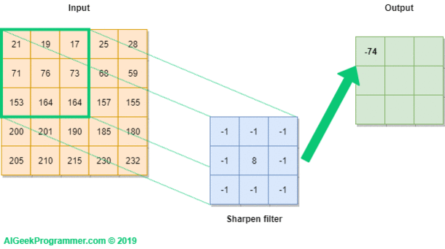
Convolutional Neural Networks (ii)

Slide 11
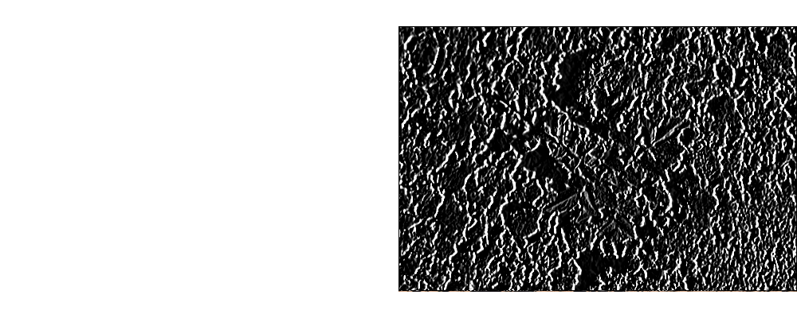
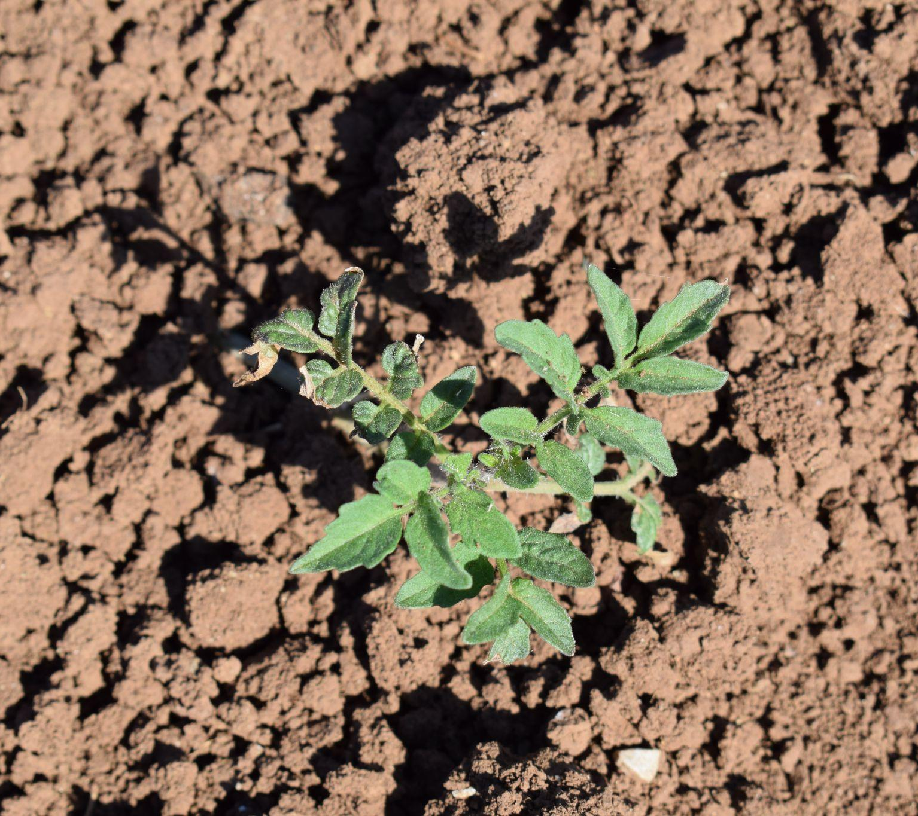
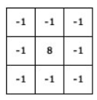
Convolutional Neural Networks (iii)
+
=
https://setosa.io/ev/image-kernels/

Slide 12
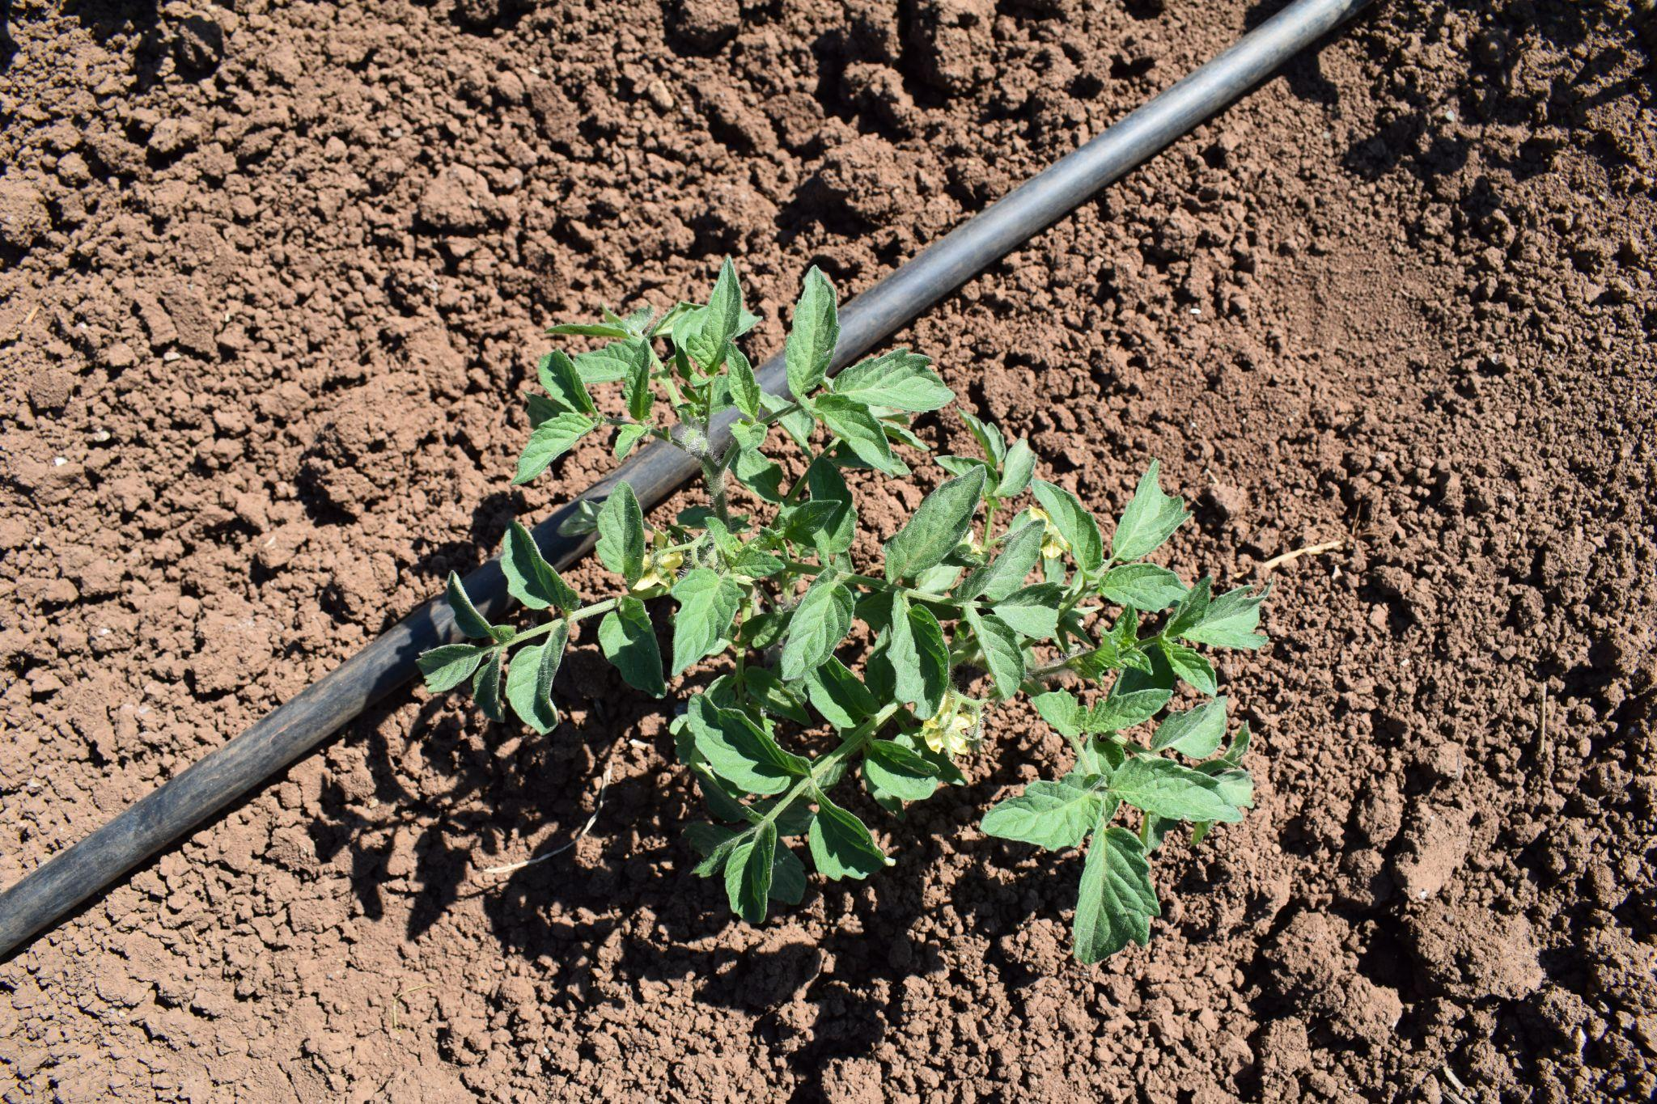
Convolutional Neural Networks (iv)
-1
-1
-1
-1
-1
1
-1
8
-1
-1
3
-1
-1
-1
-1
-1
1
1
-1
-1
-1
1
-1
-1
Tomato
-1
4
-1
-1
2
-1
-1
-1
-1
-1
-1
1
0
-1
0
0
-1
1
-1
2
2
-1
5
-1
-1
-1
3
-1
-1
0
Layer 1
Layer 2

Slide 13
CNNs: Advantages
Local Feature Extraction: Excellent at capturing local dependencies and spatial hierarchies in image data.
Parameter Efficiency: Shared weights in convolutional layers make CNNs more parameter-efficient than fully connected networks.
Translation Invariance: Through pooling layers, they achieve some degree of translation invariance, making them robust to the location of features in the input.
Well-suited for Image Data: Particularly effective for tasks like image classification, object detection, and more.

Slide 14
CNNs: Disadvantages
Limited Contextual Understanding: Struggle with capturing global context or long-range dependencies without very deep architectures.
Fixed-size Input: Typically require a fixed-size input (e.g., images need to be resized).
Invariance Limitation: While translation invariance is a strength, it can be a limitation for tasks where the position of objects is crucial.

Slide 15
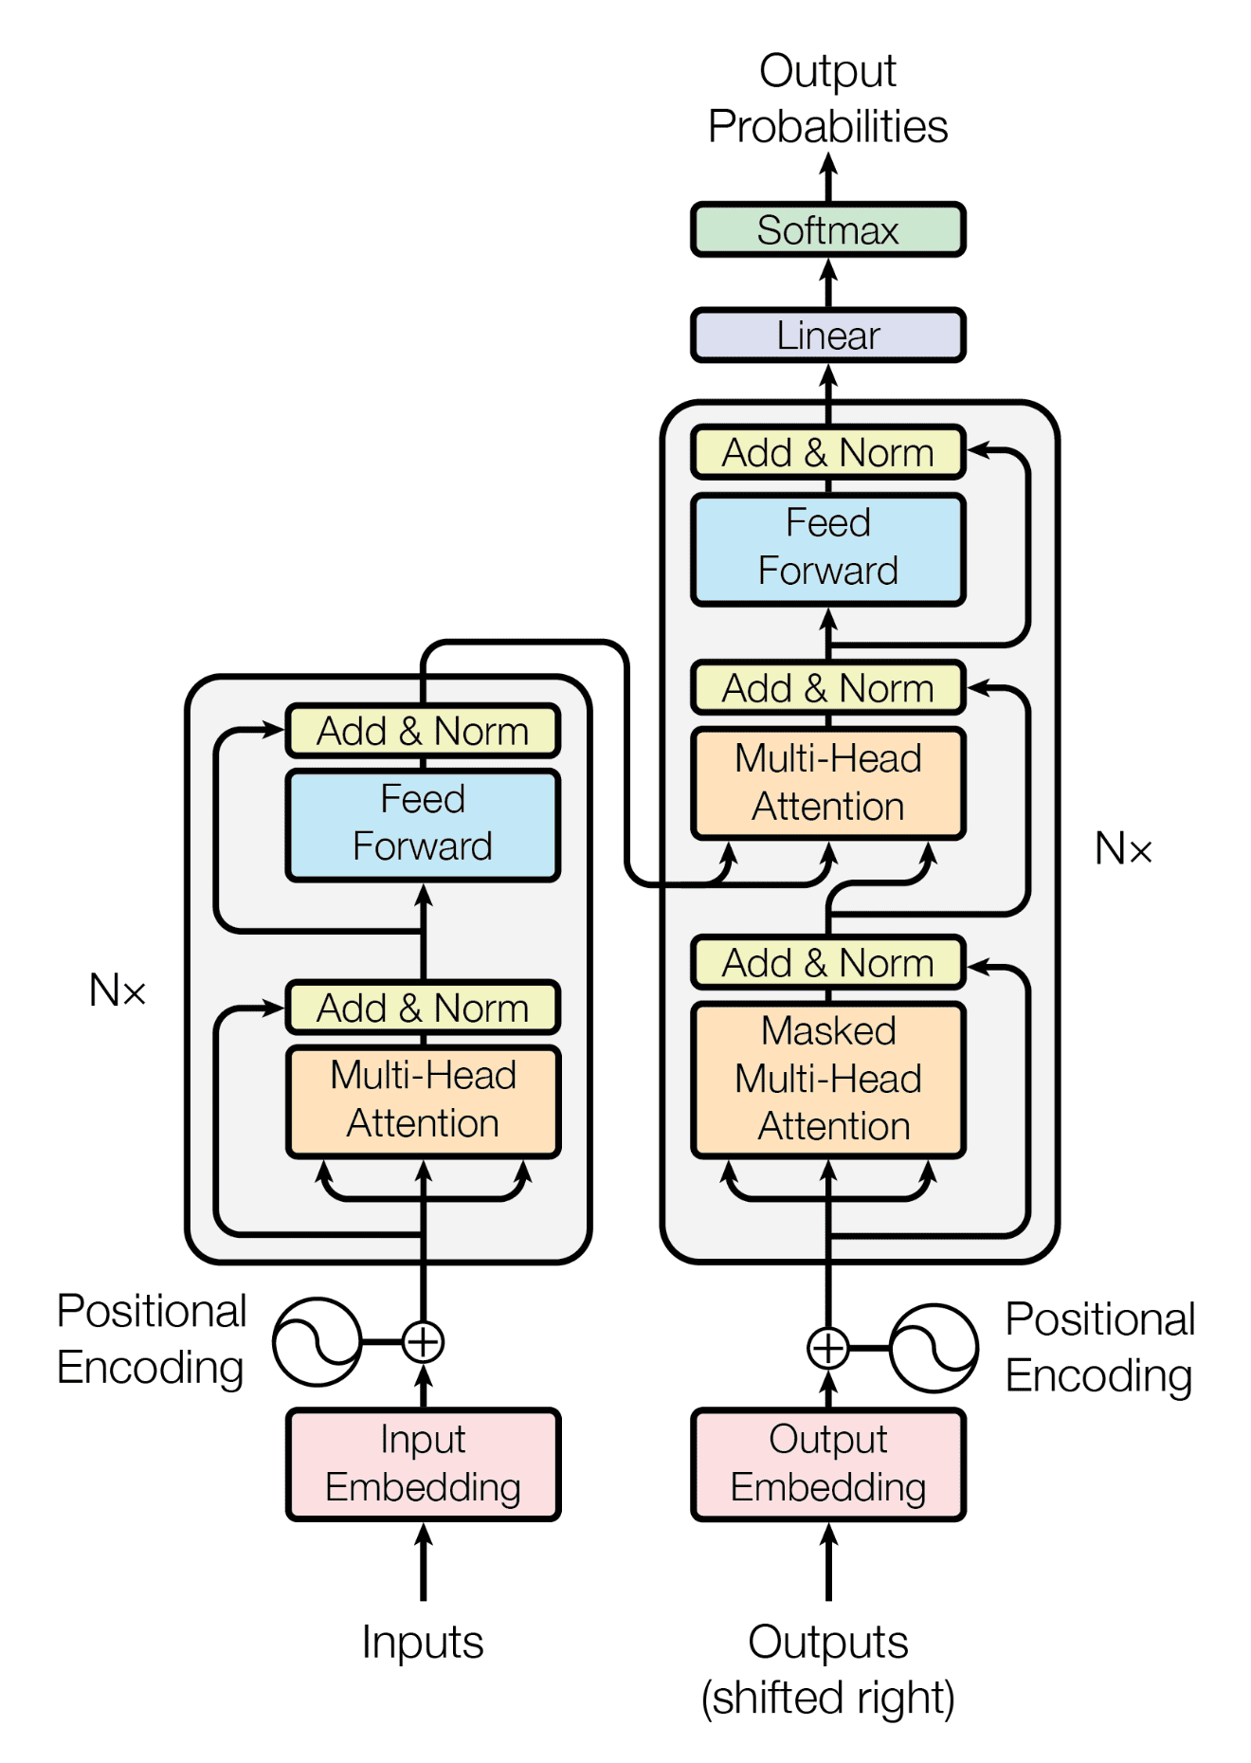
Transformer in a Nutshell
A Transformer is a category of neural networks that has proven highly effective for both natural language (initially) and images (computer vision).
GPT-4
I prefer PyTorch, but my friend prefers Tensorflow
I prefer PyTorch, but my friend prefers Tensorflow
PyTorch
I
my friend
Tensorflow

Slide 16
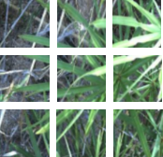
Transformer: Advantages
Global Context: Excel at capturing long-range dependencies and global context, thanks to the self-attention mechanism.
Parallelization: The architecture allows for more parallelization during training than RNNs and some forms of CNNs, speeding up training on large datasets.
State-of-the-Art Performance: In both NLP and Computer Vision, Transformers have set new benchmarks in various tasks.

Slide 17
Transformer: Disadvantages
Computational Intensity: The self-attention mechanism can be computationally intensive, especially for long sequences.
Data Hungry: Typically require large amounts of training data to perform well.
Lack of Inductive Biases: Unlike CNNs, they do not have built-in assumptions about data (like spatial hierarchies), which can be a downside for certain types of structured data.

Slide 18
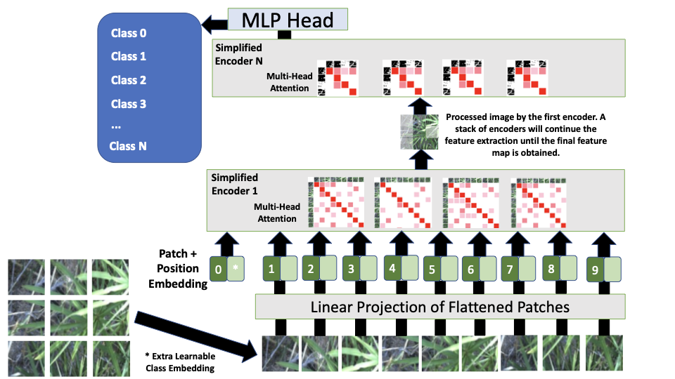

Slide 19
Ingredients for building an Object Detector
Machine Learning Model
Convolutional Neural Networks/Transformers
Transfer Learning

Slide 20



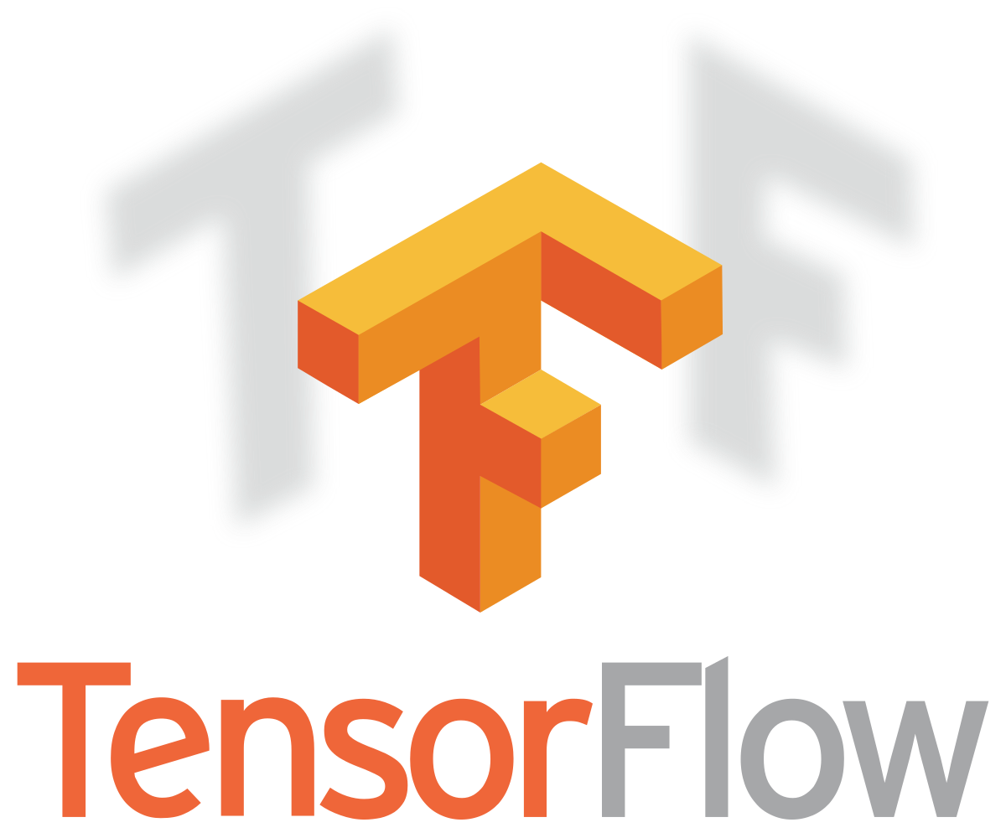

Transfer Learning: Concept
Transfer learning is a technique in the field of deep learning that involves taking a pre-trained neural network and adapting it to a new, but similar, problem.Essentially, it leverages the knowledge a model has learned from one task to improve learning in another task.
This approach is particularly beneficial when you have a limited amount of data for the new task or when training a large model from scratch is computationally expensive.

Slide 21
Transfer Learning: How it works
Pre-Trained Model: Transfer learning typically begins with a model that has been pre-trained on a large dataset. The pre-trained model has already learned to identify certain features (like edges, textures, etc., in the case of images). These learned features can be relevant to new but similar problems. Strategies:
Feature Extractor: Use the pre-trained model as a feature extractor. The final layers of the model are replaced with new ones tailored to the new task, and only these new layers are trained.
Fine-Tuning Pre-Trained Layers: After replacing the final layers, you can continue training (fine-tuning) some or all of the pre-trained layers along with the new layers to slightly adjust its learned features.

Slide 22

Transfer Learning: How it works with CNNs
-1
-1
-1
-1
-1
1
-1
8
-1
-1
3
-1
-1
-1
-1
-1
1
1
-1
-1
-1
1
-1
-1
Cat
-1
4
-1
-1
2
-1
-1
-1
-1
-1
-1
1
0
-1
0
0
-1
1
-1
2
2
-1
5
-1
-1
-1
3
-1
-1
0
Layer 1
Layer 2

Slide 23
Transfer Learning: How it works with CNNs
-1
-1
-1
0
1
0
-1
8
-1
0
3
-1
-1
-1
-1
-1
1
0
-1
-1
-1
1
-1
-1
Tomato
-1
4
-1
-1
2
-1
-1
-1
-1
-1
-1
1
3
-1
0
0
-1
2
-1
4
2
-3
1
-1
0
-1
3
1
-1
4
Layer 1
Layer 2

Slide 24
Transfer Learning: Advantages
Efficiency: It is much faster and more efficient as it eliminates the need to train a model from scratch.
Less Data Required: Transfer learning can be particularly useful when you have a limited amount of data for the new task. The pre-trained model brings knowledge that can help even with a small dataset.
Improved Performance: Models initialized with pre-trained weights often perform better than those trained from scratch, especially when data for the new task is limited.
Flexibility: It offers a flexible framework to work with, as it allows for the adaptation of pre-trained models to a wide range of tasks. Applied on Computer Vision, Natural Language Processing, etc.

Slide 25
Transfer Learning: Limitations
Task Relevance: The effectiveness of transfer learning depends on the relevance of the features learned in the pre-training task to the new task.
Model Complexity: Fine-tuning large pre-trained models requires careful handling to avoid overfitting, especially when the new dataset is small.
Domain Shift: If the new task is very different from the task used in pre-training, transfer learning might be less effective.

Slide 26
Object Detection: Introduction
It involves the ability of a computer to locate and recognize objects within an image or video frame.
Object detection is more complex than image classification (which categorizes an entire image) because it requires the detection of multiple objects within a single image and the precise localization of each object.
Classification
Object Detection
Tomato
Tomato

Slide 27
Improving Performance: Advanced Computer
Vision Techniques.
Compression

Slide 28
Knowledge Distillation
Knowledge distillation is a technique used in the field of machine learning, particularly deep learning, to transfer knowledge from a large, complex model (often referred to as the "teacher") to a smaller, simpler model (the "student"). DinoV2 has 1.1 Billion parameters and it needs more than 4GB)
The goal is to enable the student model to perform as closely as possible to the teacher model, while benefiting from the advantages of a smaller size, such as reduced memory footprint, faster inference times, and potentially lower power consumption.
This makes knowledge distillation particularly useful for deploying models on edge devices with limited resources.

Slide 29
Knowledge Distillation
The basic idea is to train the student model not only on the original dataset but also to mimic the behavior of the teacher model. This can involve matching the soft outputs (probabilities) of the teacher model, which may contain more information about the relationships between different classes than the hard labels (the actual class labels) alone.
There are various strategies and loss functions used to achieve this knowledge transfer, including matching the logits (the inputs to the final softmax function in classification tasks), minimizing the difference between the soft probabilities of the teacher and student models, or even mimicking intermediate representations of the teacher model.

Slide 30
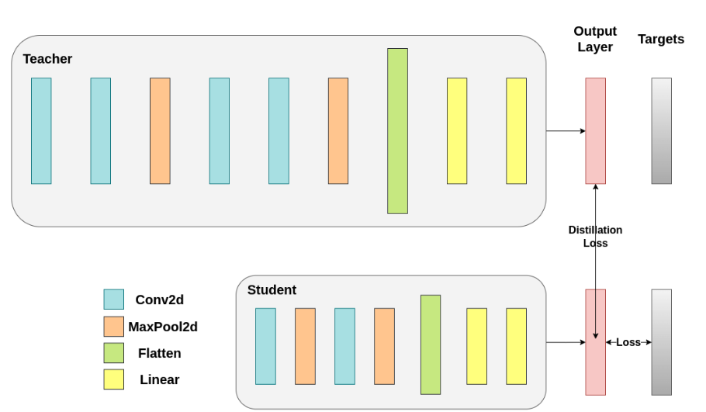
Knowledge Distillation
Image Source: https://pytorch.org/tutorials/beginner/knowledge_distillation_tutorial.html

Slide 31
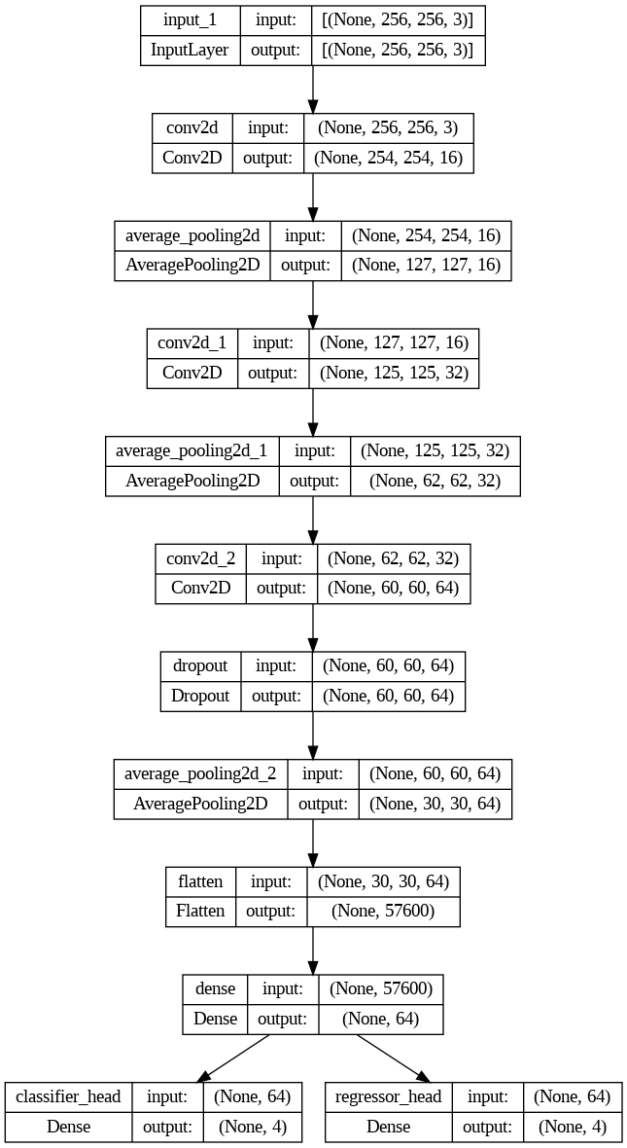
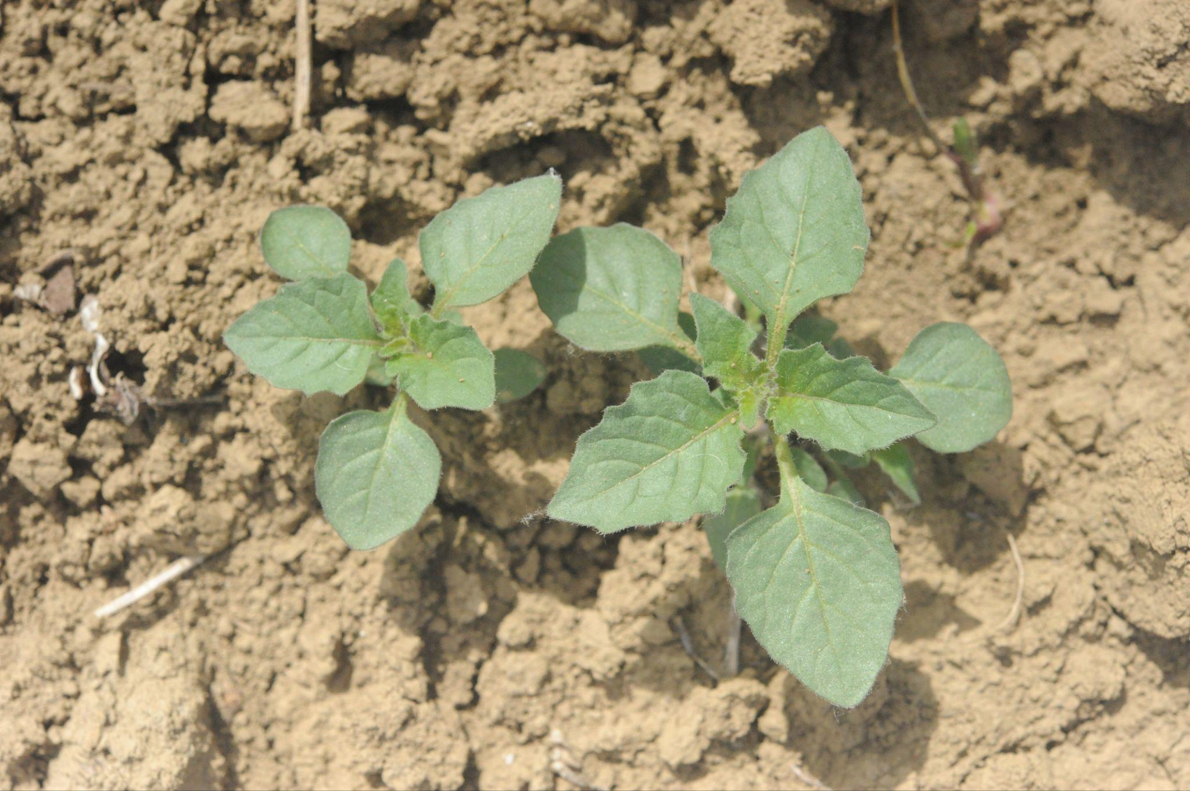

Exercise I: Teacher-Student Knowledge Distillation

Slide 32
Improving Performance: Advanced Computer
Vision Techniques.
2. Perception

Slide 33
Foundation Models: CLIP
CLIP (Contrastive Language–Image Pre-training) is a model developed by OpenAI, designed to understand and generate content across both visual (images) and textual (language) modalities. It represents a significant step in the evolution of foundation models, particularly in the realm of multimodal AI.
Multimodal Contrastive Learning: CLIP is trained on a vast dataset of images paired with textual descriptions. It learns to understand and associate visual concepts with their corresponding textual descriptions. Also, the model is trained using a contrastive learning approach. It learns to match images with their correct descriptions while distinguishing them from incorrect ones. This process enables the model to develop a nuanced understanding of the relationships between text and images.
Versatile Applications: CLIP can be used for a variety of tasks without task-specific training data. For instance, it can perform image classification, object detection, and even generate textual descriptions of images (in conjunction with other models).
Zero-Shot Learning: One of the remarkable capabilities of CLIP is its proficiency in zero-shot learning. It can accurately interpret and classify images in categories it was never explicitly trained on, based on its understanding of language and image features.

Slide 34
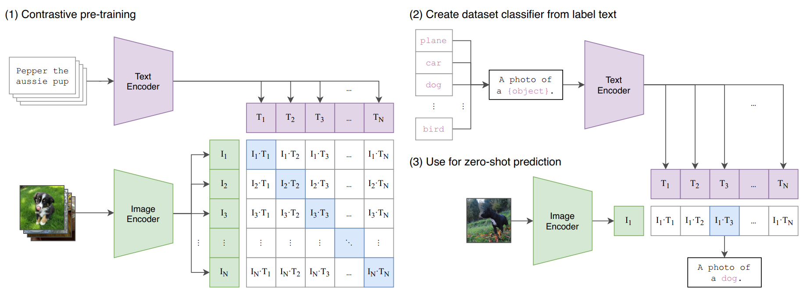
Exercise II: CLIP for Zero-shot learning
Image Source: https://openai.com/research/clip

Slide 35
Improving Performance: Advanced Computer
Vision Techniques.
3. Generalization

Slide 36
Foundation Models
Foundation models, a term increasingly used in the context of deep learning, refer to large-scale models that are pre-trained on vast amounts of data across a wide range of tasks and can be adapted or fine-tuned to specific tasks with relatively minimal additional training.
These models serve as a foundational layer, providing a rich, versatile representation of knowledge that can be leveraged for various applications.
Examples of foundation models include GPT (Generative Pre-trained Transformer) for natural language processing tasks and various large-scale models in computer vision such as DINOv2 (Vision Transformer).

Slide 37
Foundation Models
Large Scale: They are typically very large in terms of the number of parameters, often ranging from millions to billions, allowing them to capture a wide breadth of patterns, relationships, and nuances in the data they are trained on.
Pre-trained on Broad Data: Unlike models trained on specific tasks from the start, foundation models are pre-trained on large, diverse multimodal datasets.
General Purpose: They are designed to be general-purpose, meaning they can be adapted or fine-tuned to perform well on a wide range of tasks, even those not seen during the initial training phase.

Slide 38
DINOv2
A suite of base models has been developed to generate universal characteristics that are applicable to a wide array of visual tasks at both the image level (such as image classification, instance retrieval, and video comprehension) and the pixel level (including depth estimation and semantic segmentation).
This method leverages and enhances upon the foundations of DINO and iBOT, introducing several modifications to augment the feature quality and the pretraining efficiency.
To ensure comprehensive coverage of crucial visual domains, a massive pretraining dataset comprising 142 million images was compiled and refined from data obtained through web crawling.

Slide 39
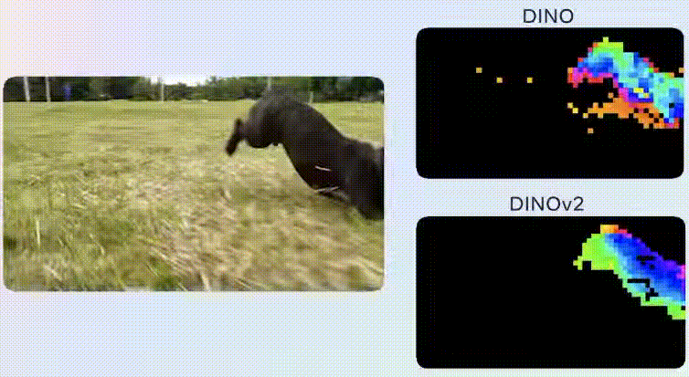
DINOv2: Results
Image Source: https://www.kdnuggets.com/2023/05/dinov2-selfsupervised-computer-vision-models-meta-ai.html

Slide 40
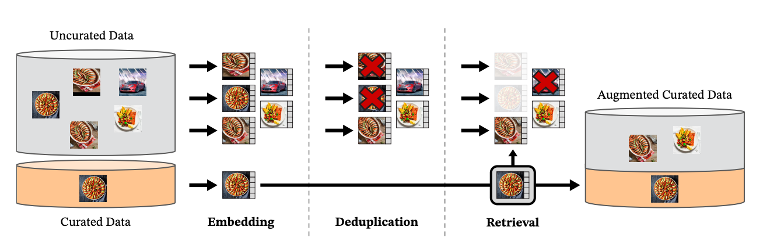
DINOv2: Training dataset
Image Source: https://arxiv.org/abs/2304.07193

Slide 41
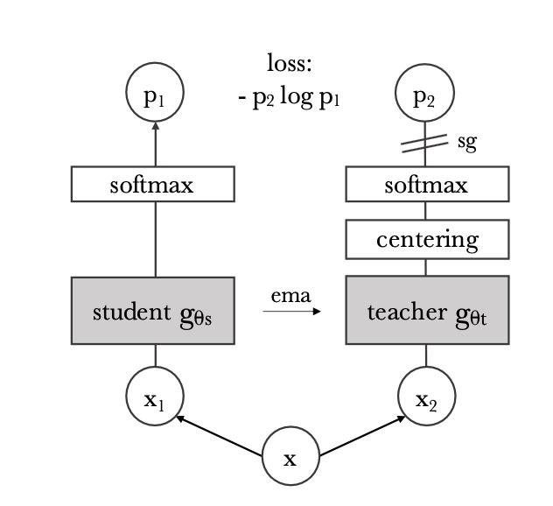
DINOv1 Architecture
Image Source: https://arxiv.org/abs/2104.14294

Slide 42
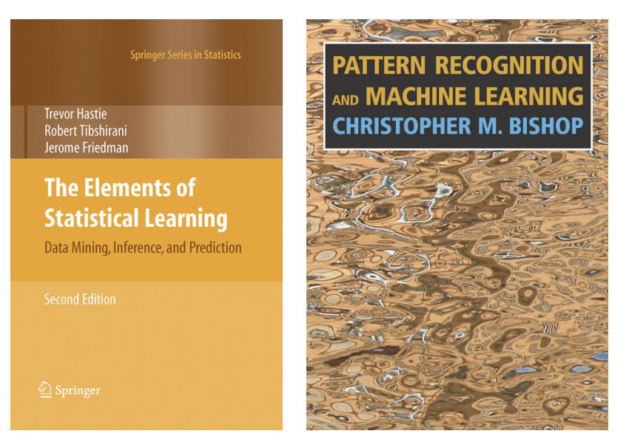
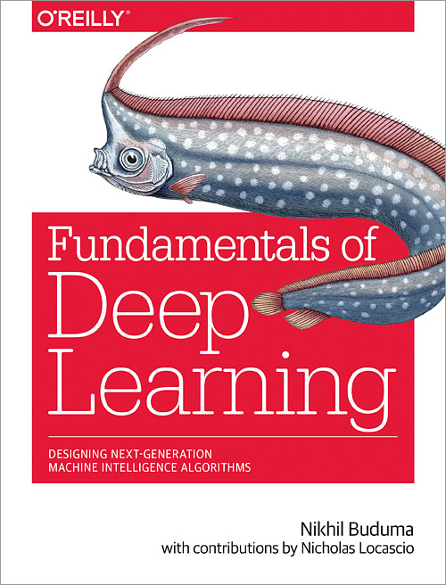
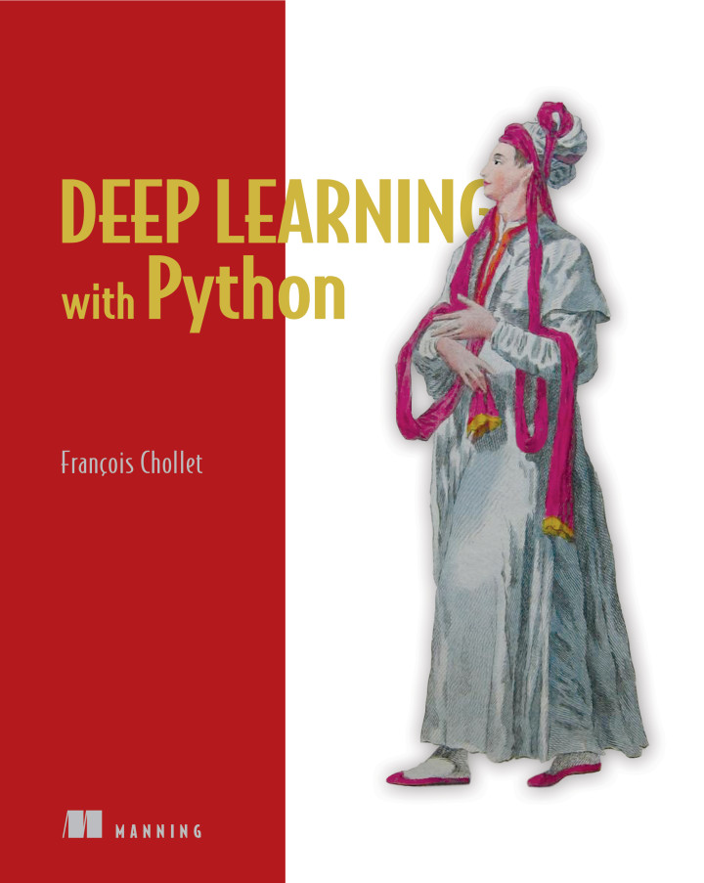
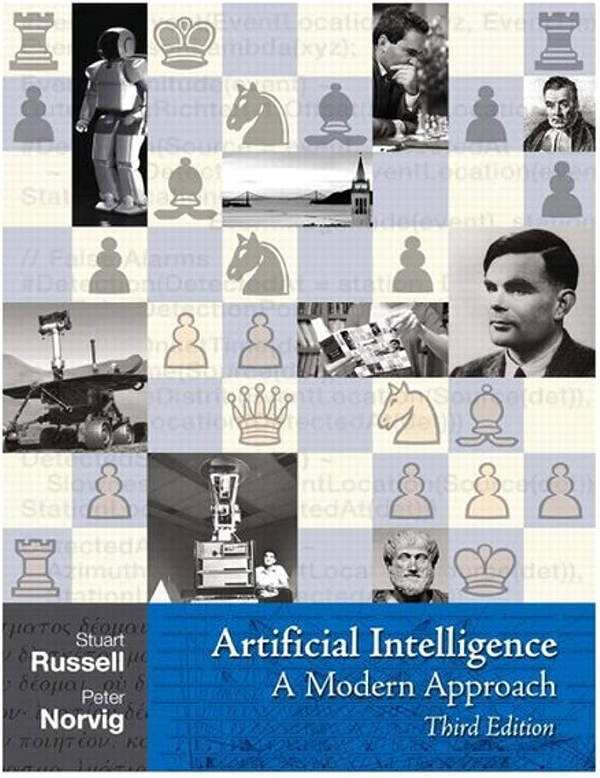
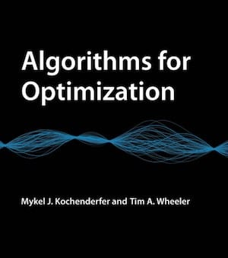
Bibliography

